Slide 1

(Name of school)
Opening Year Prayer Service
2024/2025
Notes:
Introduction for the Principal:
The resource is divided into two parts. The first part invites the children to consider the natural world and biodiversity and why difference is essential in our natural world. The second part invites the children to consider the ways in which we are all different and to celebrate that difference.
Finally, please note that there are suggested instructions for each slide in the notes under each slide. Obviously adapt as you see fit for your own context. We hope this resource proves a helpful addition in your work as faith leader of your school.

Slide 2
Opening Year Reflection
SCHOOL CREST HERE
Notes:
Note for principal:
You can begin by welcoming the children and staff to the prayer service.
Different people and different faith traditions have different beliefs, and all of these are welcome in our school.
You could explain your school crest.

Slide 3
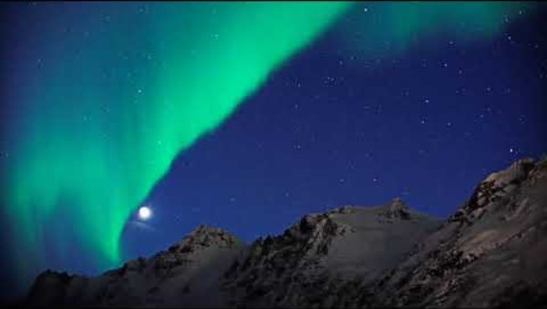
Opening Hymn
Notes:
Note for Principal:
John Rutter’s, Look at the World, with this video:
https://www.youtube.com/watch?v=kxr8QBPq1z0 (This is particularly suited as it includes a children’s choir).
Principal: our opening hymn captures the theme of our prayer today. That we would be able to see all the wonderful things around us in our world. And that we would start by looking at the people around us and thanking God for the things that make us different and all the gifts that God has given us. Because as the hymn tells us “all things come from God”.
If you wish to use your choir, any appropriate opening hymn e.g. This is the Day (https://www.youtube.com/watch?v=I77gXp8g2HQ) works here.
Gathering Song (Grow in Love, 2nd class – leaving the third verse out)

Slide 4
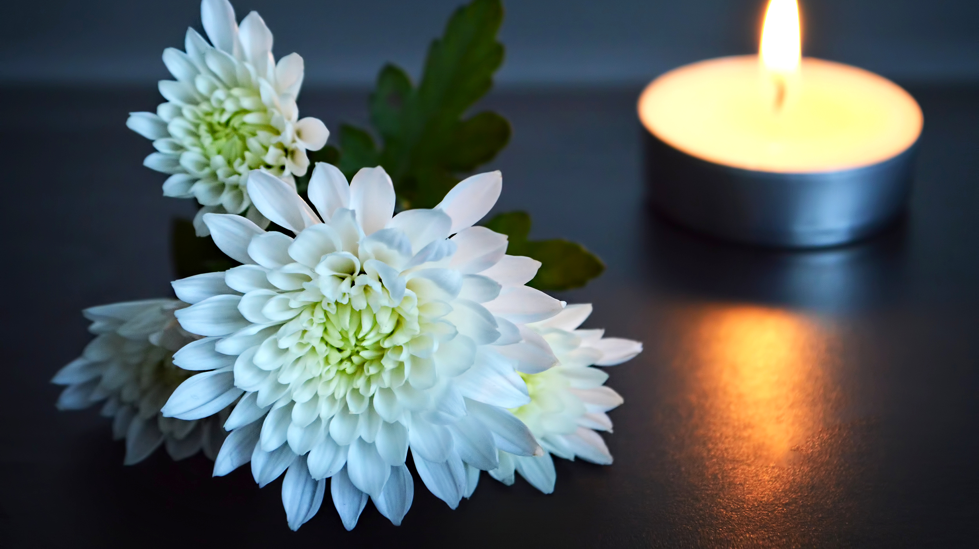
Notes:
Note for principal:
Introduce anyone who will be co-leading the service e.g. teachers, pupils etc.
This slide is a chance to flag your sacred space and in doing so to help pupils begin to become quiet in themselves as they prepare to pray together.
Our sacred space:
A bible
A candle
A lantern representing Nano Nagle. (You might say something here about Nano and her spirituality focused on helping all children).
What will be brought up during the service:
- Symbols of our differences : a hurl/football, a book, a paint brush, a musical instrument, a warm blanket (symbolising kindness) and so on… (See Slide 7 for more ideas here)
A picture of the Season of Creation logo. See slide 18.

Slide 5
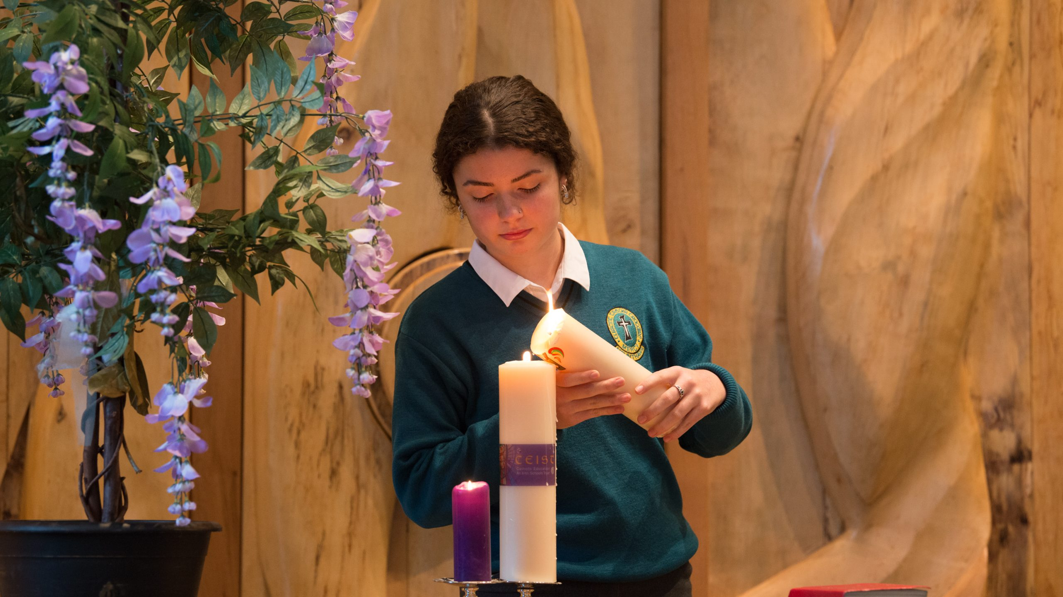
Notes:
Principal:
And so, we light a candle. We light a candle at the beginning of every prayer we make in our school.
Our candle reminds us that God is with us as we pray together. God is our light and lights the way for us here in (name of school).
We invite now _________________ (child’s name) to light our candle as our prayer begins.
And we begin our prayer now, “In the Name of the Father….”
(If you wish to use music as part of the service, a hymn relating to light can be used here).
Principal: Let’s listen now as we hear the word of God which will be read to us now by (teacher/pupil’s name)

Slide 6
A reading from the first letter of St Paul to the Corinthians
There are different kinds of gifts; but they are all from the same Spirit. There are different ways to serve; but all these ways are from the same Lord. And there are different ways that God works in people; but all these ways are from the same God. God works in us all in everything we do. Something from the Spirit can be seen in each person, to help everyone. The Spirit gives one person the ability to speak with wisdom. And the same Spirit gives another the ability to speak with knowledge. The same Spirit gives faith to one person. And that one Spirit gives another gifts of healing. The Spirit gives to another person the power to do miracles, to another the ability to prophesy. And he gives to another the ability to know the difference between good and evil spirits. The Spirit gives one person the ability to speak in different kinds of languages and to another the ability to interpret those languages. One Spirit, the same Spirit, does all these things. The Spirit decides what to give each person.
The Word of the Lord.
Thanks be to God.
Notes:
Reader 1
Principal:
We take a moment to say thank you to God for our own gifts and talents and for the gifts and talents of our friends and our classmates. This is what this reading is about; recognising that every one is different but special to God. That’s what we’re about here in (school name) because….. (you can say something here about your own school’s ethos, mission statement, history, vision etc.)

Slide 7
We present some symbols now:
Notes:
Principal:
We invite (children’s names) now to come forward to present some symbols representing the ways in which we are different and yet we are all part of our community here in (School’s name).
(Note: use symbols like school books, a school bag, sports equipment, musical instruments, trophies, medals a blanket, art work etc. You can also consider using other symbols e.g. a globe representing all the countries from which you’re students come and/or the neurodiversity symbol, etc. One reader to introduce all the symbols, maybe from sixth class, is fine.
Reader 2:
We present now some symbols to our sacred space……

Slide 8
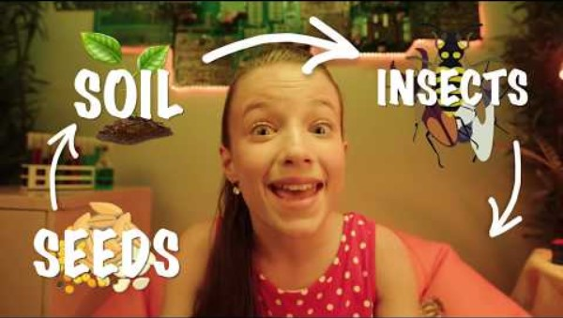
What nature teaches us about diversity (aka everyone being different)
Notes:
Principal:
We’ve read from the Bible – one of the symbols on our sacred space and presented some symbols representing the gifts and talents and differences in our school.
We’re going to look now at what nature teaches us about how being different matters. In nature biodiversity is the word we use to describe the amazing variety of life there is on our planet. And let’s listen to this short vlog now from a youtuber to explain why ‘variety is the spice of life’.
Then (child’s name) will show us a picture of one of the world’s smallest creatures and (child’s name) will take us through a video that looks at one of the biggest creatures on our planet – the whale!
(Note: There are other videos about biodiversity online that are arguably better but we want to avoid any of the videos that go into too much detail in terms of the decline of biodiversity; that’s important of course but it’s for another day. That kind of topic with children is best covered in a classroom context that allows for discussion and for action plans which are essential ways of avoiding any kind of climate anxiety in children)

Slide 9
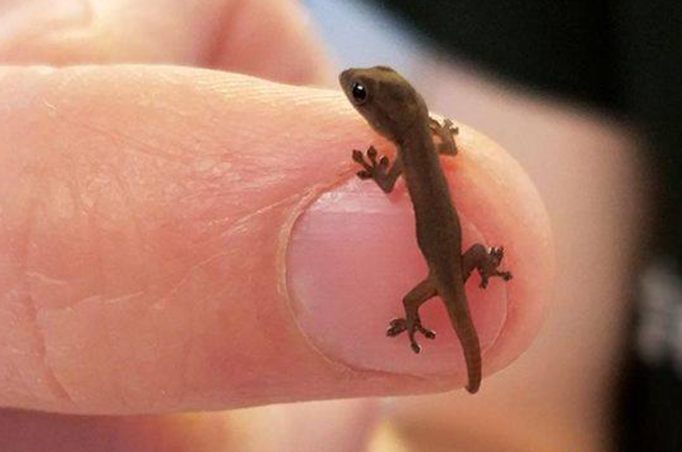
One of the smallest creatures
Notes:
Reader 3:
Here is a picture of a tiny one day old Cameroon Dwarf Gekko!
But it isn’t enough the smallest creature in the world. There are creatures many, many times smaller.
But take a minute to look at how perfectly formed this little creature is. It’s tiny feet, tiny eyes, tiny body. And it’s tiny tail…. Which it can detach from its body to distract predators and make its escape! Clever little fellow!
And yet it has a purpose! It helps to maintain the unique ecosystem in which it lives. It’s a really important part of the biodiversity of our planet.

Slide 10

And compare our gecko to a whale!!
Notes:
Reader 4:
And now we’re going to look at a video about a HUGE WHALE. It’s an essential part of our biodiversity as well. From the smallest to the biggest, every creature is essential in our planet.

Slide 11
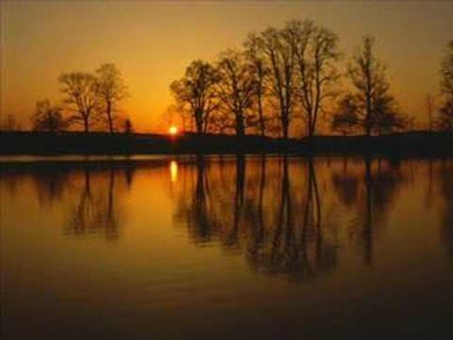
Notes:
https://youtu.be/MHIfRLNYUGw
Principal: We pause now to reflect on the beauty of creation.
Note: An alternative hymn can be chosen but preferably one that speaks of the beauty and/or diversity of nature, e.g. All God’s Creatures have a place in the Choir).

Slide 12
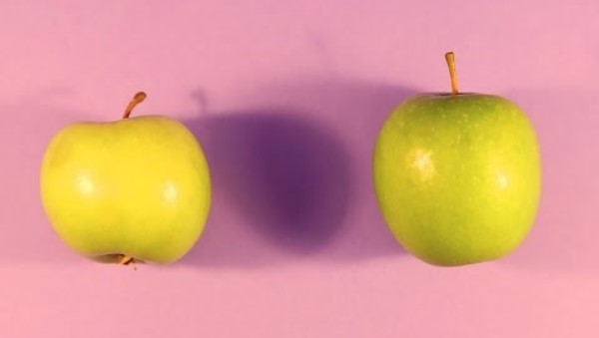
So is it okay for us as humans to be different?
Notes:
Principal: And we also see huge variety in human beings. Like in nature, difference is really important. We listen now to a poem by Mark Grist.
(Note you can have a teacher/child read this if you’d prefer a life reading rather than the video.)
See https://www.youtube.com/watch?v=Z_GUQQadwrM

Slide 13
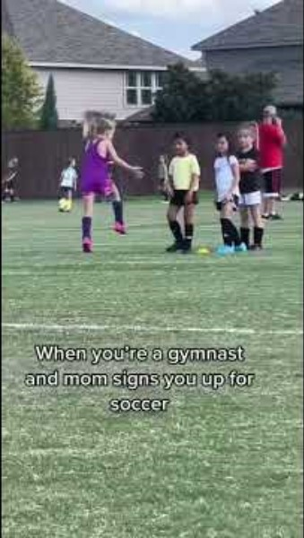
We are all unique
Notes:
Note for principal: You can show this video and if you wish interact with the group; what do they think this video means?
You might say a few words here about what it means to you and what it means to your school. Everyone has different talents and some times it depends on the environment you’re in whether or not those talents can shine. You can say something about the school being a place where everyone’s talents have a place to shine.

Slide 14
10 ways we celebrate difference in (school name)
10.
9.
8
7.
6.
5.
4.
3.
2.
Notes:
Principal: So what does that look like in our school in practical terms?
Here are our top ten tips for how we want you to celebrate difference in our school this year?
(you can add these yourself depending on your school’s ethos and vision/mission statement)

Slide 15
And number 1: Love one another
Notes:
Note for principal: use images from your school and local community that show love in action in your own school community.

Slide 16
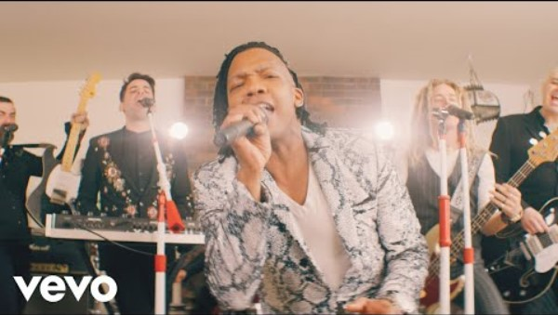
Notes:
Principal: This hymn is called ‘Love one Another.’
(You can of course, conclude with a different hymn from Grow in Love with which the children might be more familiar).
Principal: We present now our final symbol to our sacred space. This will be read by (child’s name) and presented by (child’s name).

Slide 17
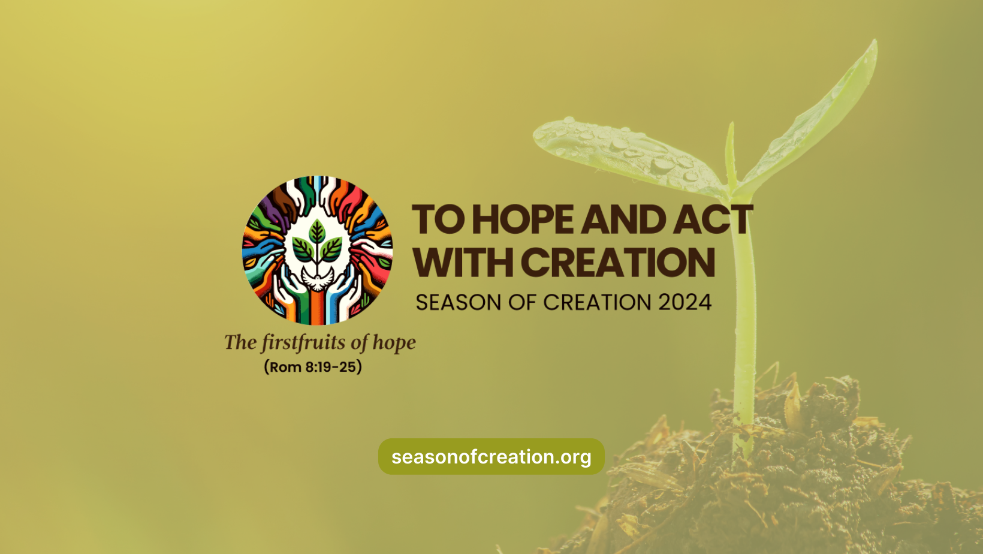
Notes:
Reader 5: All across the world, Christians will celebrate Season of Creation from the 1st September to the 4th October. This happens every year. This year the theme of Season of Creation is to Hope and Act with Creation. This is the Logo of the celebration and we have it presented here in our sacred space.
It’s a challenge to us all to use our talents and gift to protect our natural world, We pray in a special way . In our school, we’re called to look after ourselves, one another and the world we live in. Part of helping you to grow is us believing you can make a huge difference to the world.

Slide 18
And so together, we pray:
For our world. Thank you God for all the different animals and living creatures in our world. They show us that difference is a really good thing. Lord hear us. Lord graciously hear us.
For our world. May we always have the courage to do what is right to protect our world and all living creatures in our world. Lord hear us. Lord graciously hear us.
For our school. May our school be a kind and gentle space that allows us to be ourselves. May it be a place that celebrates all the wonderful ways we are different. Lord hear us. Lord graciously hear us.
For our school. May we always have the courage to reach out and be friends with people who might be feeling lonely. We all need to feel loved and accepted. Lord hear us. Lord graciously hear us.
For our teachers. May God be with them this year in all that they do for us. Lord hear us. Lord graciously hear us.
For the prayers in our own hearts……… Lord hear us. Lord graciously hear us.
All: Nano Nagle. Pray for Us.
Notes:
Principal: We invite now (children’s names) to come forward to read our prayers of the faithful.
Readers 6 to 11

Slide 19
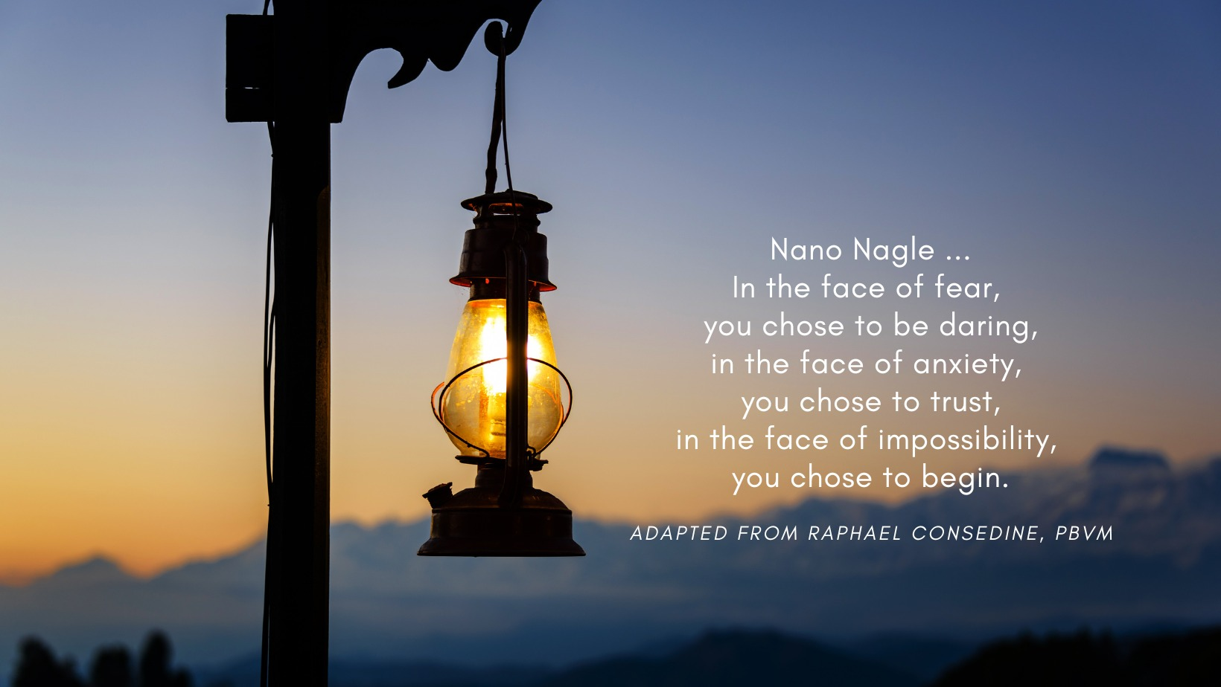
Notes:
Principal: you might say this prayer and offer it as a blessing to your school for the year ahead along with your own words of good wishes.

Slide 20
Concluding hymn:
Notes:
Note for principal: You can pick a concluding hymn focused on Love. It is preferable if the concluding hymn is one that all/most of the children know.

