Slide 1

Sixth Year
Opening Year Prayer Service
2024/2025
Notes:
Introduction for the Principal:
This short reflection will take about 30 minutes. It might sit well within a larger assembly or meeting with the Year Group.
This year’s Season of Creation resources combine two core Christian ideas and encourage students and colleagues ‘to hope and to act.’ This is what leadership in a faith looks like whether you’re in a senior leadership role in the school or whether you’re in first year, TY, or sixth year. Obviously, sixth years have a particular role in terms of leadership in schools.
Our hopes and our prayers as Catholic schools always have a practical end; prayer can’t just be to console or to comfort ourselves. Prayer always challenges us to action and perhaps the area we most need to be challenged at the moment in our world is in terms of our responsibility to care for our common home.
Specifically, the resource for 6th years provides a space for students to reflect, in a mature way, on the key Christian virtue of hope. Sixth year is often very challenging for students as they deal not only with questions about their future but also the reality of the Leaving Certificate. When any challenge is being faced, feeling overwhelmed is understandable and this resource provides a space to name that in the context of the Christian virtue of hope. Resilience is a term often used in modern educational circles. In Catholic schools, resilience is built on a deep sense of knowing God is Love and knowing that you are part of a community that loves and supports you. It is from there, a place of faith, that hope arises in the human heart.
‘To Hope and to Act with Creation’ is the theme of the Season of Creation and this resource, along with all of the other resources for the other year groups, draws on some of the material and key ideas from Season of Creation. Season of Creation begins on September 1, World Day of Prayer for the Care of Creation, and ends on October 4, the feast of St. Francis of Assisi, the patron saint of ecology beloved by many Christian denominations. Season of Creation is an ecumenical and global prayer moment supported by Irish religious sisters, priests and brothers along with a growing number of lay movements and organisations.
It is also worth considering, if you wish, ways of linking to your founding Congregation’s ongoing story as many religious congregations are prioritising the challenge of climate change in their work particularly, in terms of their work in the developing world. This can be done by adding short videos from Congregation websites or a story about a sister/priest and the work they do in this area.
The link between hope, resilience and Season of Creation is made in terms of examples from nature that demonstrate nature’s power to survive and thrive. We have much we can learn from the natural world around us.
Using the hashtag #SeasonofCreation linking to all the Christian denominations represented in your school and local community would be a great way to further build links within your local community among Christians of different denominations.
For sixth year students, the service is broken up into three parts. The first part gives students a space to reflect on hope and where there hope comes from. It comes from a sense of self belief, a sense that others belief in them and, for believers, a deep trust that God is with them. The second part invites them to consider ways they might further grow in this sense of hope during the challenges of the year ahead. Unlike the resources of the other years, there is arguably less emphasis on action for others and for creation, simply because for many 6th years they themselves feel like they’re in survival mode. However, at the same time, helping others is deeply empowering and reminds students that their needs are not necessarily always at the centre of everything.
If your schools opening year prayer services fall outside these Season of Creation dates, the resource can still be used. You and your RE team will know best how to further adapt these resources for your own context.
Given challenges around attention space for increasing numbers of young – and not so young – people, all videos used in these resources are quite short. You can if you wish say this to your gathered group when you’re about to play a video. It can help with keeping their attention.
Finally, please note that there are suggested instructions for each slide in the notes under each slide. Obviously adapt as you see fit for your own context. We hope these resources prove a helpful addition in your work as faith leader of your school.

Slide 2
Opening Year Reflection
SCHOOL CREST HERE
Sixth year
Notes:
Note for Principal:
You can begin by welcoming the 6th year students to the prayer service and perhaps say something around the importance of prayer in your school as a way of centring everyone on what we see as important and how we understand God at the centre of everything we do. Ultimately when we pray together, we hope it softens us up a little bit to help us look after one another and our planet and to help us feel as if we belong.
Different people and different faith traditions have different beliefs, and all of these are welcome in our school.
You could, if you wish, explain your school crest.

Slide 3
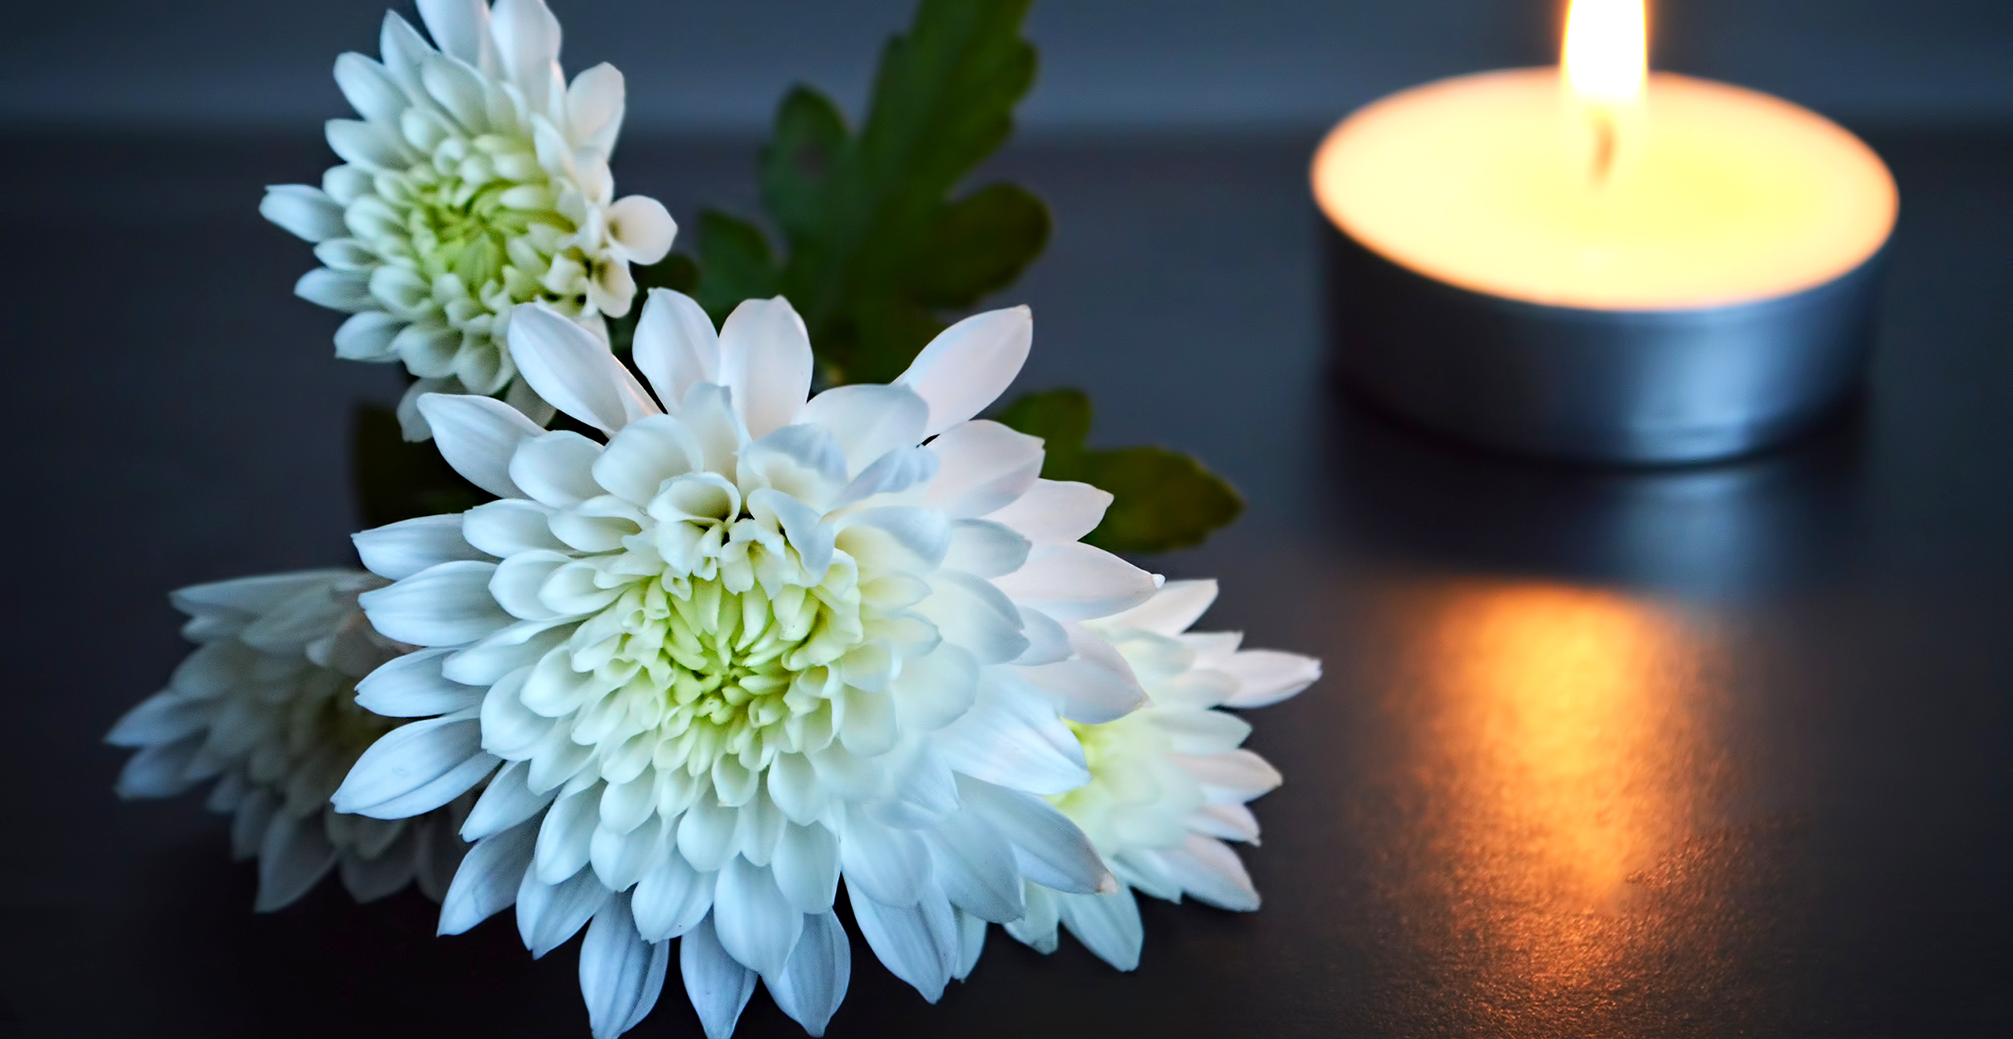
Notes:
Note for principal: Introduce anyone who will be co-leading the service.
This slide is a chance to introduce your sacred space and in doing so to help students begin to become quiet in themselves as they prepare to pray together.
A candle; representing God’s presence with us.
The picture of the symbol of the Season of Creation 2024 (see slide 14 or go to seasonofcreation.org)
A Bible

Slide 4
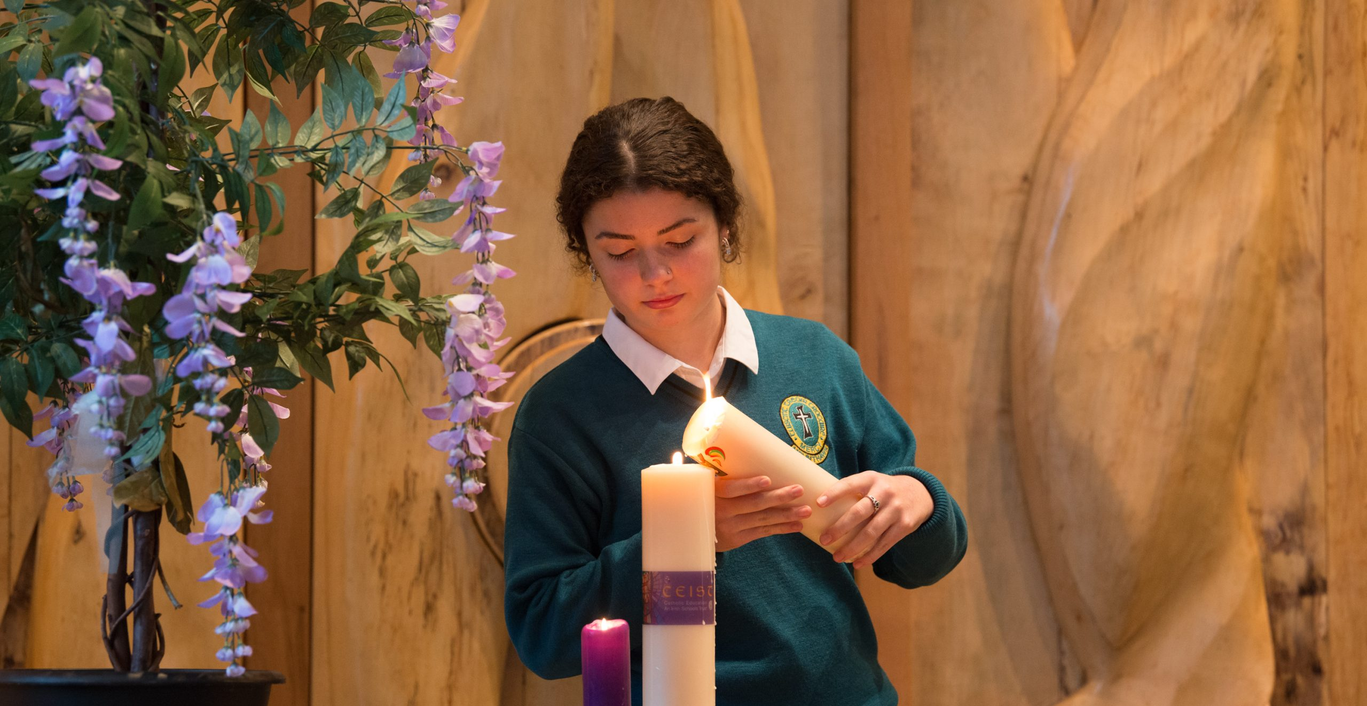
Notes:
Principal: The first symbol is our candle. And so, we light a candle. We light a candle at the beginning of every prayer we make in our school.
What does the lighting of our candle do? It reminds us that we are not alone. God is with us as we pray together. Light is a symbol of hope, which is the theme of our service today. God is our light and lights the way for us as a school community. God is with us as we journey together as a Year group from the start of first year to the end of sixth year. We pray God’s blessing on you in a special way as you begin Sixth Year.
(You can say more here if you wish about the group itself in terms of what they’ve come through and the journey they’ve made to get to this point.)
We invite now _________________ (student name) to light our candle as our prayer begins.
And we begin our prayer now, “In the Name of the Father….”
(If you wish to use music as part of the service, a hymn relating to light can be used here).

Slide 5
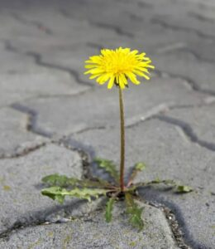
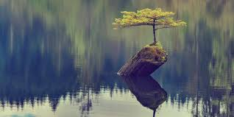
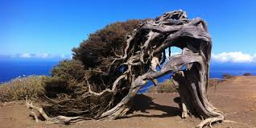
What is resilience?
Resilience in nature is defined as the ability of a system to absorb shock.
Notes:
Principal: Pause for a moment to reflect on these images of hope and resilience. Nature teaches us a lot about resilience and about hope.

Slide 6
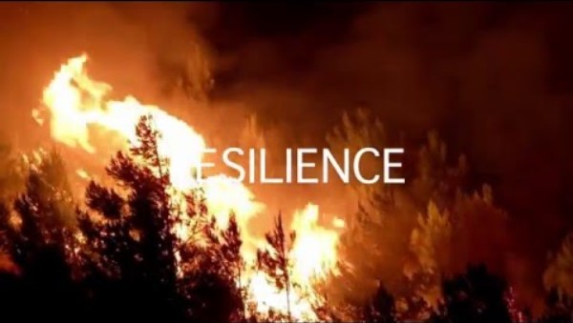
Notes:
Note for Principal: you might suggest ways the group has already demonstrated remarkable resilience, e.g. getting through Covid lockdowns, doing online learning. Individual students and groups of students have survived other disappointments and set backs and you’re here with us stronger and more together, hopefully because of it. Nature teaches us a lot about resilience. Let’s have a look at this video to see how.
https://youtu.be/CQOIQ1yaGcg

Slide 7
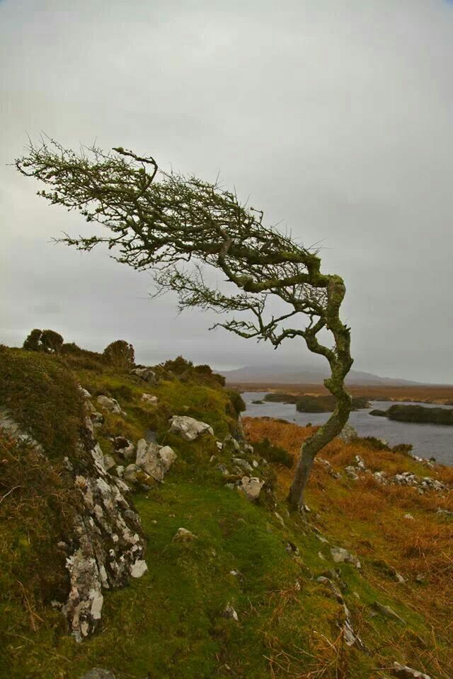
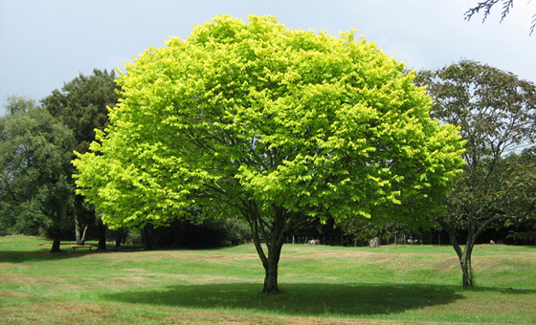
The theme of our service: Hope
Notes:
Principal: the theme of our service today as you begin Sixth Year is Hope. For people of faith, resilience is not something we have to do by ourselves. It’s first and foremost built on hope; a deep sense that we’re not alone, that God is with us, that we’re in a community of people that care for us and that we have the inner gifts and capacity to get through whatever is ahead of us.
Consider these two pictures of trees.
The tree on the left looks like your ‘ideal’ tree. It’s perfectly symmetrical, it looks beautiful. It’s just lovely in every way.
The picture on the right is of a hawthorn tree in Connemara, that has grown entirely in the direction the wind has blown. It’s a very hardy, long lived deciduous, tree which can be found throughout Connemara. Well grown and sheltered ones grow straight, while more exposed ones are twisted bent by the wind.
One tree is not better than the other, they both do what they’re supposed to do; they just look different. In fact, some people might consider the tree on the right – the Connemara hawthorn tree – to be the more interesting tree because it has a story to tell. It is a survivor. It is a symbol of hope.

Slide 8
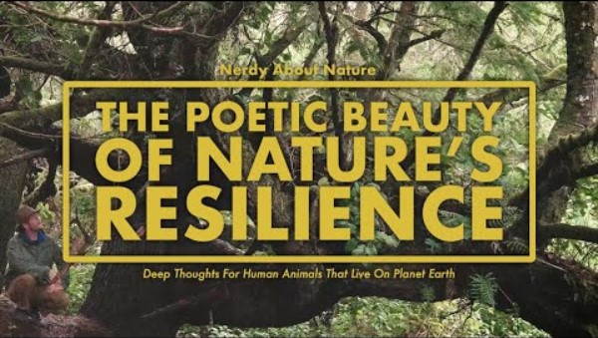
Notes:
Principal: what do trees have to teach us about hope, about resilience. Let’s look at this question further by looking at this video. It’s called the Poetic Beauty of Nature’s resilience: deep thoughts for human animals that live on planet earth. This powerful video echoes what I was just saying about trees. Note the resilience of the trees.

Slide 9
Where does our hope come from?
A reading from the St Paul’s Letter to the Romans.
Our hope comes from God. May He fill you with joy and peace because of your trust in Him. May your hope grow stronger by the power of the Holy Spirit.
I am sure you are wise in all things and full of much good. You are able to help and teach each other. I have written to you with strong words about some things. I have written so you would remember.
The Word of the Lord
Thanks be to God.
Notes:
Principal: So where does our hope come from? First it comes from our faith; a deep sense that God is with us.
Let’s listen now to the Word of God. We invite (reader’s name) to read for us now.

Slide 10
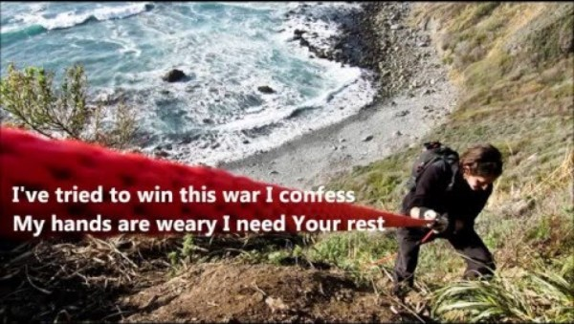
We listen now in song to this hope:
Notes:
https://www.youtube.com/watch?v=xjckW5PGNuw

Slide 11
How is this hope made real in our lives now?
Notes:
Principal:. We take some time now to look at what faith in one another looks like for this year group.
Note for principal: you might add here images of the sixth years from over the years in terms of how they’ve helped one another and the wider school community, ways they’ve supported one another, ways they’ve gotten involved in school life.

Slide 12
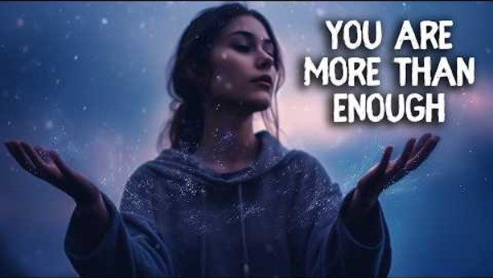
Also from the belief others have in you…
Notes:
Principal; This song summarises our belief in you, our belief that no matter what you may struggle with or may face, you are more than enough.

Slide 13
Our deepest Fear by Marianne Williamson
Our deepest fear is not that we are inadequate. Our deepest fear is that we are powerful beyond measure. It is our light, not our darkness that most frightens us. We ask ourselves, 'Who am I to be brilliant, gorgeous, talented, fabulous?' Actually, who are you not to be? You are a child of God. Your playing small does not serve the world. There is nothing enlightened about shrinking so that other people won't feel insecure around you. We are all meant to shine, as children do. We were born to make manifest the glory of God that is within us. It's not just in some of us; it's in everyone. And as we let our own light shine, we unconsciously give other people permission to do the same. As we are liberated from our own fear, our presence automatically liberates others.”
Notes:
Principal: we invite (reader’s name) to read this beautiful reflection called Our Deepest Fear. This reflection speaks very powerfully to this message of hope; to our belief in you.
Note for principal: if you want to give a parting prayer card to 6th students, you could share this with them on their way out.

Slide 14
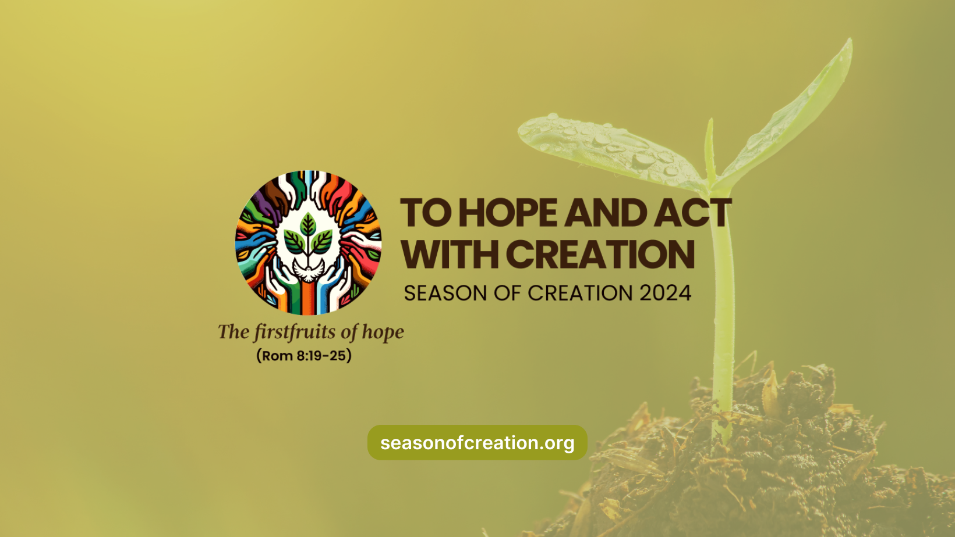
Where does our faith and hope come from?
Notes:
Principal: In addition to the candle, and to the Bible in our sacred space, we have this image, which (reader’s name) will know explain to us. This pictures represents our belief that hope grows stronger when we act together for the good of others.
Reader 3: All across the world, Christians will celebrate Season of Creation from the 1st September to the 4th October. This happens every year. This year the theme of Season of Creation is to Hope and Act with Creation. This is the Logo of the celebration.
It’s a challenge to us to really connect with our feelings of hope deep within ourselves and to act accordingly. Millions of people all over the world will be praying and acting for creation over the next four to five weeks. We join them today in their prayers.
Principal: We’ll now look at a video about a group of women from the Developing World who demonstrate this theme of hope and action in the most remarkable way. As you watch this video, think of what their hopes and actions are teaching you about the year ahead.

Slide 15
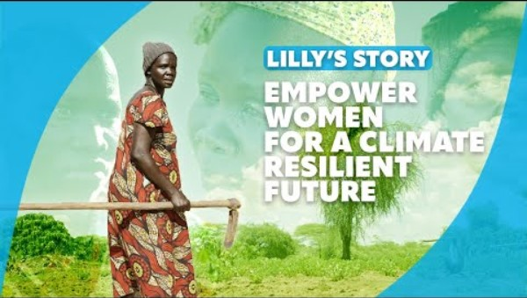
Notes:
https://youtu.be/y5uxYLIGw5k

Slide 16
What does hoping and acting look like?
Notes:
Note for principal: This is a space for you to offer advice for the year ahead in terms of spiritual and emotional self-care. It might be good to remind students here, using pictures/images, of the people they have in the school that they can turn to for support. It would also be important to speak to the value of good friendship and the importance of students looking out for one another. It is important here to also stress that helping others and doing good in our world and for our world has actually been proven to make us feel better about ourselves and to feel more hopeful.
The next slide speaks to the renewal that can come from spending time in nature and how that helps students. So off the phones and go for a walk!

Slide 17
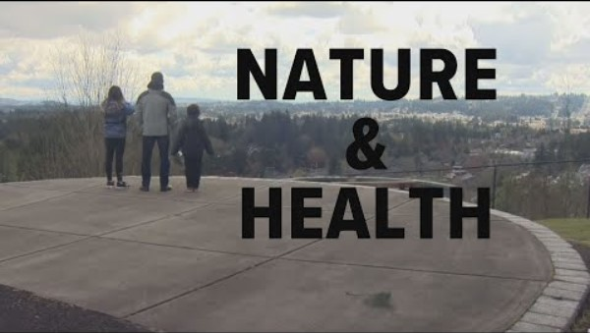
And also to get out and immerse yourself in nature…
Notes:
https://youtu.be/pier0ISddEc

Slide 18
And so together, we pray:
Lord, bless all 6th Year students as we begin our final year together in (name of school). Help us to have faith and hope and to love one another and our planet. Lord hear us. Lord graciously hear us.
Lord, bless our teachers. Be with them as they support us on this last stage of our journey in (school name). Thank you Lord for their belief in us. Help them to challenge us with their confidence in our ability to make a difference. Lord hear us. Lord graciously hear us.
Lord, bless all of the other students in our school. We think especially of the new first years. We remember what it felt like to be starting out. May their time in our school be marked by learning, peace, friendship and fun. Lord hear us. Lord graciously hear us.
For our world. In the silence of our own hearts we pray for the courage to do what we can to help protect our world. Lord hear us. Lord graciously hear us.
Notes:
Principal:
(These prayers of the faithful can be read by 6th years students)

Slide 19
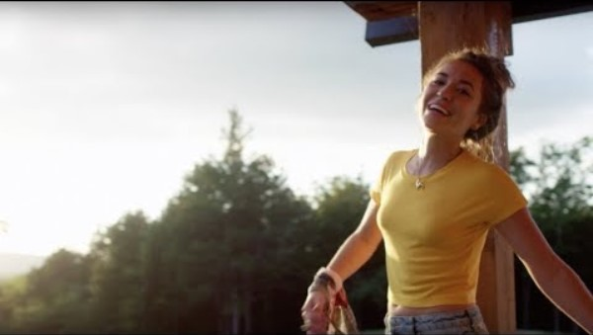
Notes:
Principal: We conclude now with a hymn to hope and to knowing who we are in God’s eyes.
https://www.youtube.com/watch?v=sIaT8Jl2zpI
Note for principal: feel free to pick a different hymn. Also, you may want to conclude with your own words of encouragement.

