Slide 1

Fifth Year
Opening Year Prayer Service
2024/2025
Notes:
Introduction for the Principal:
This short reflection will take about 30 minutes. It might sit well within a larger assembly or meeting with the Year Group.
Last year’s opening year reflections focused on the theme of vocation and the year before that on the theme of hope. This year’s resources combine these two core Christian ideas and encourage students and colleagues ‘to hope and to act.’
Our hopes and our prayers as Catholic schools always have a practical end; prayer can’t just be to console or to comfort ourselves. Prayer always challenges us to action and perhaps the area we most need to be challenged is in terms of our responsibility to care for our common home.
Specifically, the resource for fifth year students, as they enter the final part of their post primary education, encourages students to reflect on their own values, how those values give them life and how those values can be made manifest in our world today. Values are what motivate our action and it is, for Christians, in part our actions that bring us hope. (For Christians, we also know our hope can’t ever just be about our own actions, which often fall short, our hope ultimately lies in the God).
‘To Hope and to Act with Creation’ is the theme of the Season of Creation and this resource, along with all of the other resources for the other year groups, draws on some of the material and key ideas from Season of Creation. Season of Creation begins on September 1, World Day of Prayer for the Care of Creation, and ends on October 4, the feast of St. Francis of Assisi, the patron saint of ecology beloved by many Christian denominations. Season of Creation is an ecumenical and global prayer moment supported by Irish religious sisters, priests and brothers along with a growing number of lay movements and organisations.
Using the hashtag #SeasonofCreation linking to all the Christian denominations represented in your school and local community would be a great way to further build links within your local community among Christians of different denominations.
It is also worth considering, if you wish, ways of linking to your founding Congregation’s ongoing story as many religious congregations are prioritising the challenge of climate change in their work particularly, in terms of their work in the developing world. This can be done by adding short videos from Congregation websites or a story about a sister/priest and the work they do in this area.
For fifth year students, the service is broken up into two parts. The first part invites students, as they begin fifth year to reflect on their own still-emerging values. The second half invites students to reflect how they’re going to live those values out over the year to come, particularly in terms of care of our common home.
If your school’s opening year prayer services fall outside these Season of Creation dates, the resource can still be used. You and your RE team will know best how to further adapt these resources for your own context.
Given challenges around attention space for increasing numbers of young – and not so young – people, all videos used in these resources are quite short. You can if you wish say this to your gathered group when you’re about to play a video. It can help with keeping their attention.
Finally, please note that there are suggested instructions for each slide in the notes under each slide. Obviously adapt as you see fit for your own context. We hope these resources prove a helpful addition in your work as faith leader of your school.

Slide 2
Opening Year Reflection
SCHOOL CREST HERE
Fifth year
Notes:
Note for principal:
You can begin by welcoming fifth year students to the prayer service and perhaps saying something around the importance of prayer in your school as a way of centring everyone on what we see as important and how we understand God at the centre of everything we do. Ultimately when we pray together, we hope it softens us up a little bit to help us look after one another and our planet and to help us feel as if we belong.
Different people and different faith traditions have different beliefs, and all of these are welcome in our school.
You could also, if you wish, explain your school crest.

Slide 3
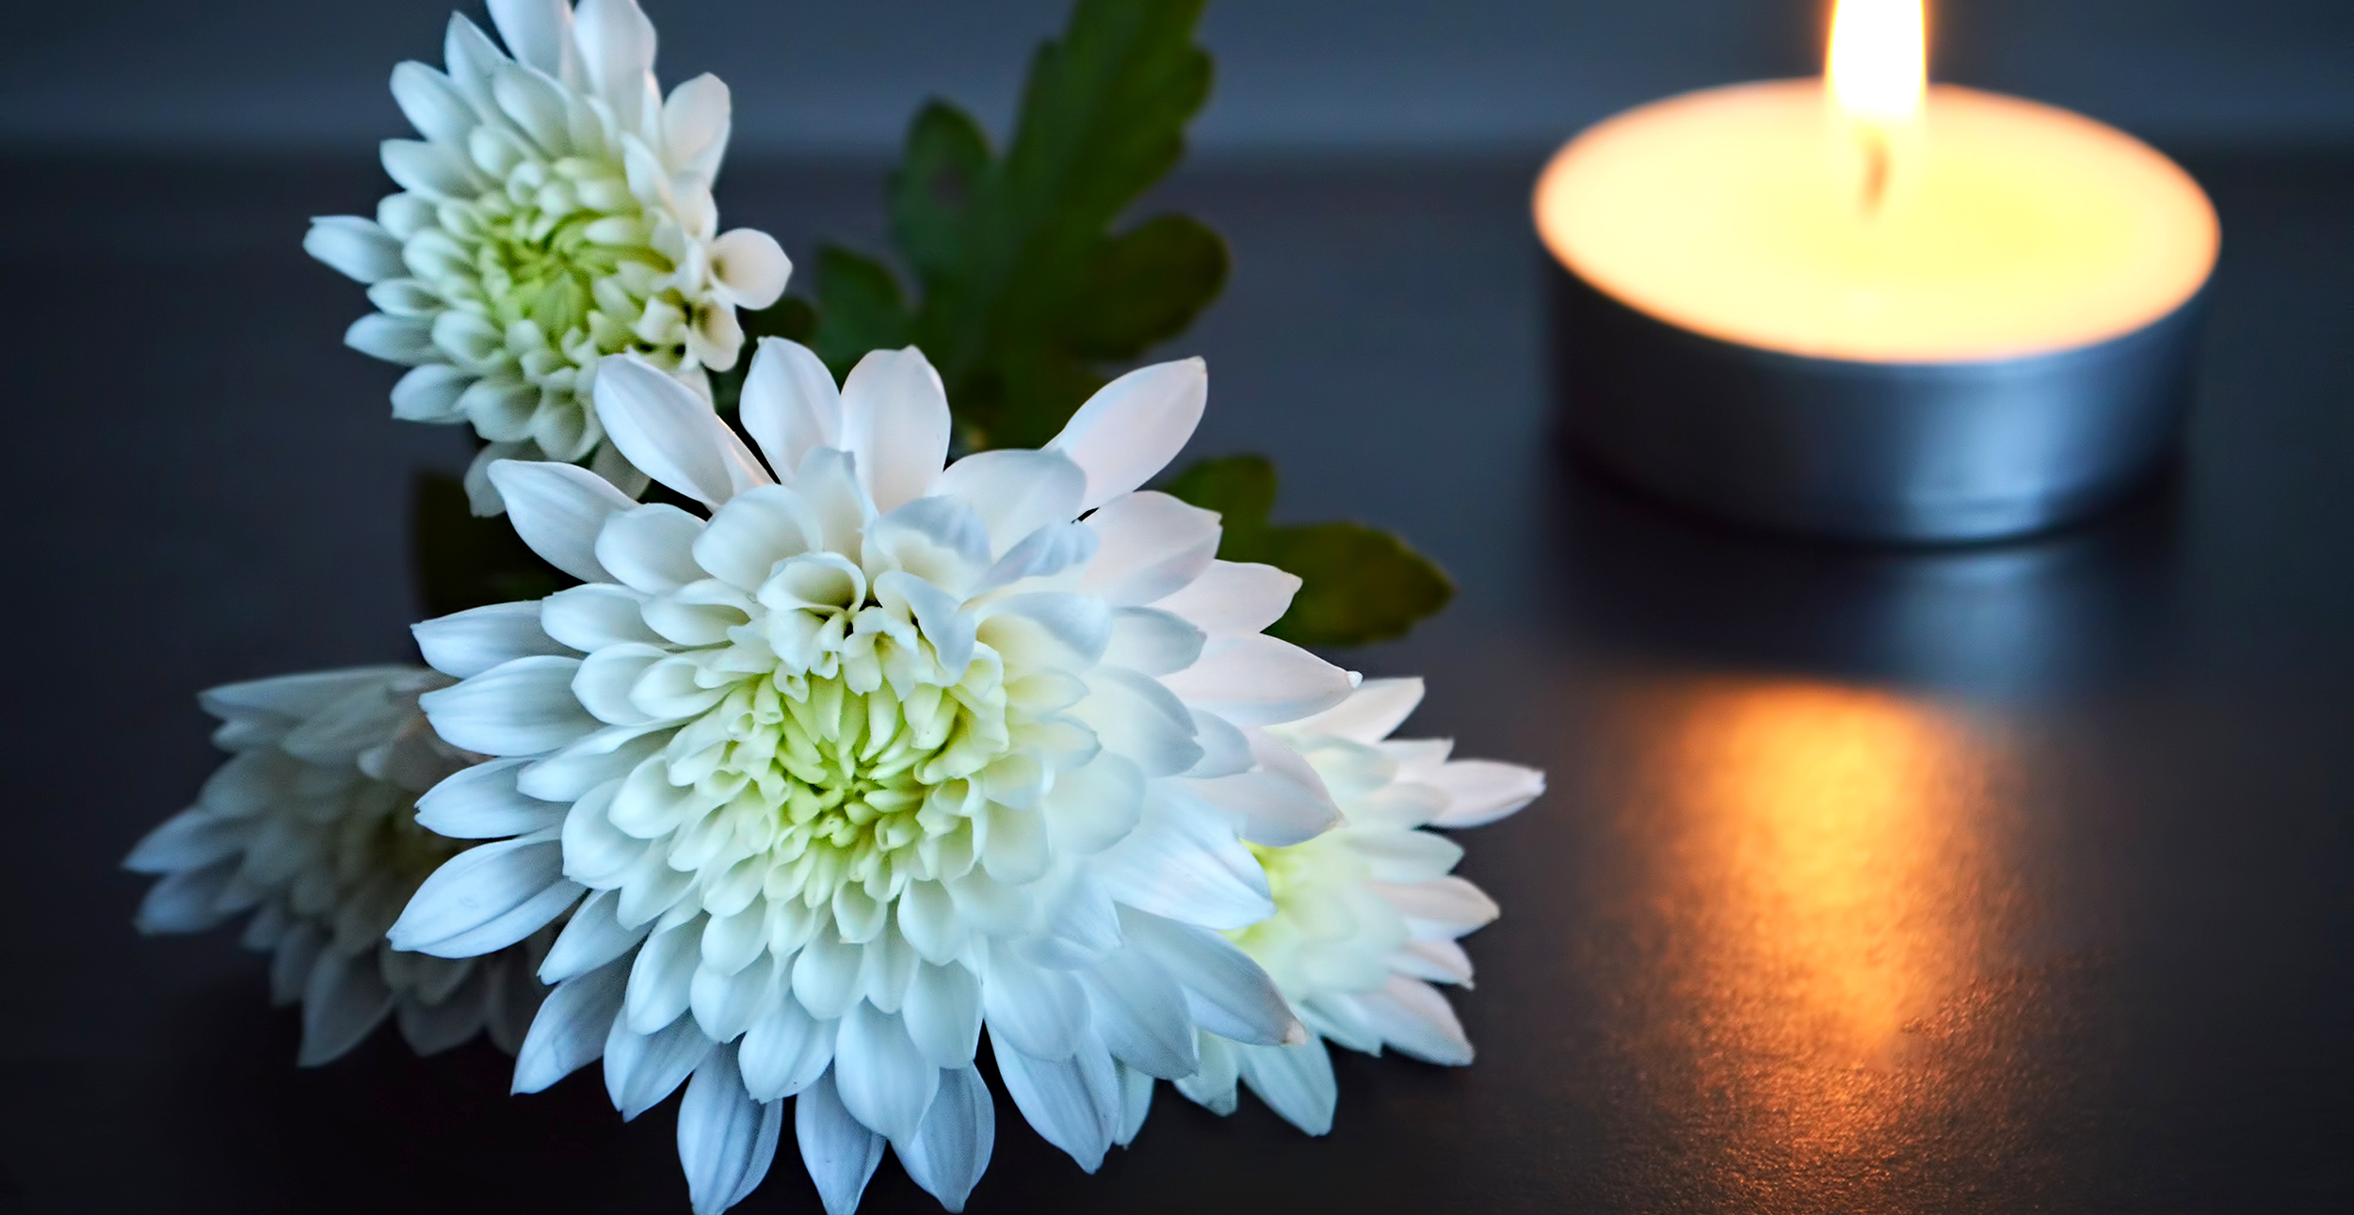
Notes:
Note for principal: Introduce anyone who will be co-leading the service.
This slide is a chance to introduce your sacred space and in doing so to help students begin to become quiet in themselves as they prepare to pray together.
A candle; representing God’s presence with us.
The picture of the symbol of the Season of Creation 2024 (see slide 10 or go to seasonofcreation.org)
A compass
A Bible

Slide 4
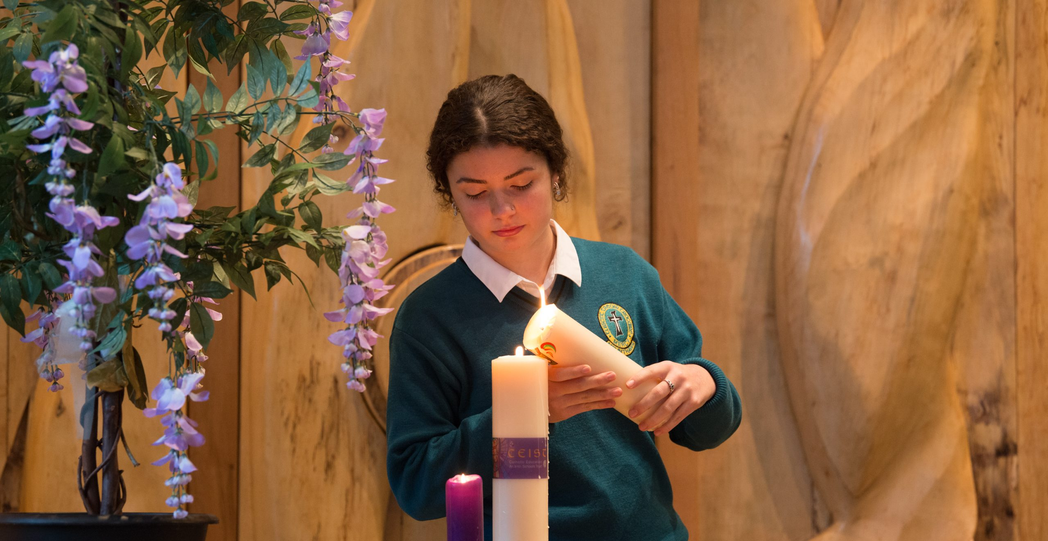
Notes:
Principal: The first symbol is our candle. And so, we light a candle. We light a candle at the beginning of every prayer we make in our school.
What does the lighting of our candle do? It reminds us that we are not alone. God is with us as we pray together. God is our light and lights the way for us as a school community. God is with us as we journey together as a Year group from the start of first year to the end of sixth year. We pray God’s blessing on you in a special way as you begin Fifth Year.
We invite now _________________ (student name) to light our candle as our prayer begins.
And we begin our prayer now, “In the Name of the Father….”
(If you wish to use music as part of the service, a hymn relating to light can be used here).

Slide 5

Notes:
Note for principal: you might say a few words to students about their starting fifth year and that transition into the last two years of their schooling in (school name). A word acknowledging their hopes and fears, ambitions and concerns might be helpful.

Slide 6
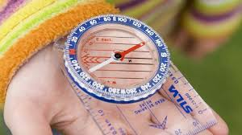
What matters to YOU?
Notes:
Principal: (Student name) now presents our second symbol – a compass. A compass shows the direction we want to go. As you begin fifth year what direction are you moving towards? Where do you want to go? What’s important to you? How do you show what’s important to you by how you act? These are just some of the questions we’ll be reflecting on through our prayer today together.

Slide 7
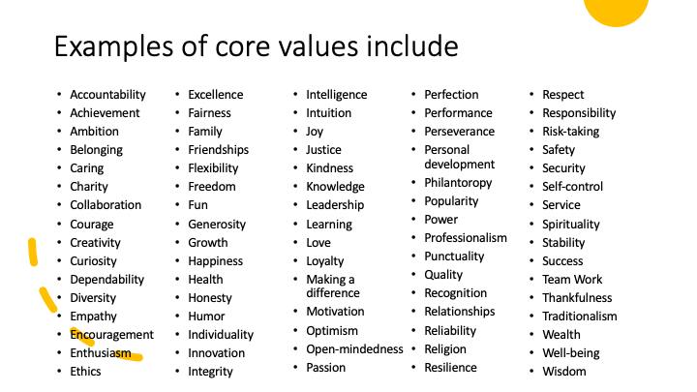
Notes:
Principal:
Here is a long list of values. These values, like points on our compass, can give our lives direction….. Can you see any of your own values here? How can we work out our own values?
So pause for a moment in silence to reflect on your own values…. What is really important to me?’
To help you answer that question, we’re going to reflect now using a short five minute video that takes us through a process of finding out what’s important to each of us.

Slide 8
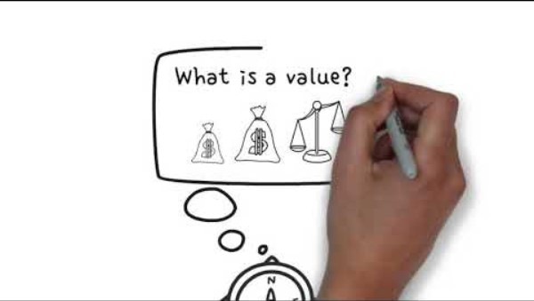
Notes:
https://youtu.be/fPYHNPf5XpA

Slide 9
A reading from St Paul’s First Letter to the Corinthians.
If I speak in the tongues[a] of men or of angels, but do not have love, I am only a resounding gong or a clanging cymbal. If I have the gift of prophecy and can fathom all mysteries and all knowledge, and if I have a faith that can move mountains, but do not have love, I am nothing. If I give all I possess to the poor and give over my body to hardship that I may boast, but do not have love, I gain nothing.
When I was a child, I talked like a child, I thought like a child, I reasoned like a child. When I became a grown up, I put the ways of childhood behind me. For now we see only a reflection as in a mirror; then we shall see face to face. Now I know in part; then I shall know fully, even as I am fully known.
And now these three remain: faith, hope and love. But the greatest of these is love.
The Word of the Lord.
Thanks be to God.
Notes:
Principal: (student name) will now lead us in a reading. The other symbol in our sacred space is the Bible. The Bible is like the compass; it gives direction and shows us what’s important. The reading we’re going to hear now says that three things are the most important – faith, hope and love – and of these things, for Christians, the greatest of these things is love. The reading also speaks about the difference between seeing things the way children see them and seeing things in maybe a more mature way. Is their an invitation there for you as you move now into the two most senior years in our school?

Slide 10
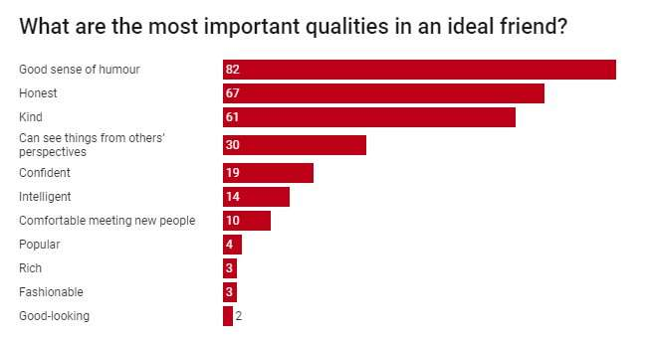
What do YOU value in your friends? (And therefore probably value for yourself too!)
Notes:
Principal:
So what in reality do YOU value? Another way of answering that question is to ask what values or qualities you value in your friends.
This is from a survey carried out in 2018 (see https://phys.org/news/2018-11-young-people-diversity-humour-honesty.html) carried out by sociologists in Wales. It’s interesting to see what the young people surveyed valued in their friends. See how high values like honest and kindness are? This are values we can all get behind and obviously encourage here in (school’s name).
(You could give some examples of the values of honesty and kindness that your school witnesses to).

Slide 11
The values of (school name)
Notes:
(Note for principal: you might add here images from the life of the school and/or the school’s mission/vision statement outlining what’s important to your school.)

Slide 12
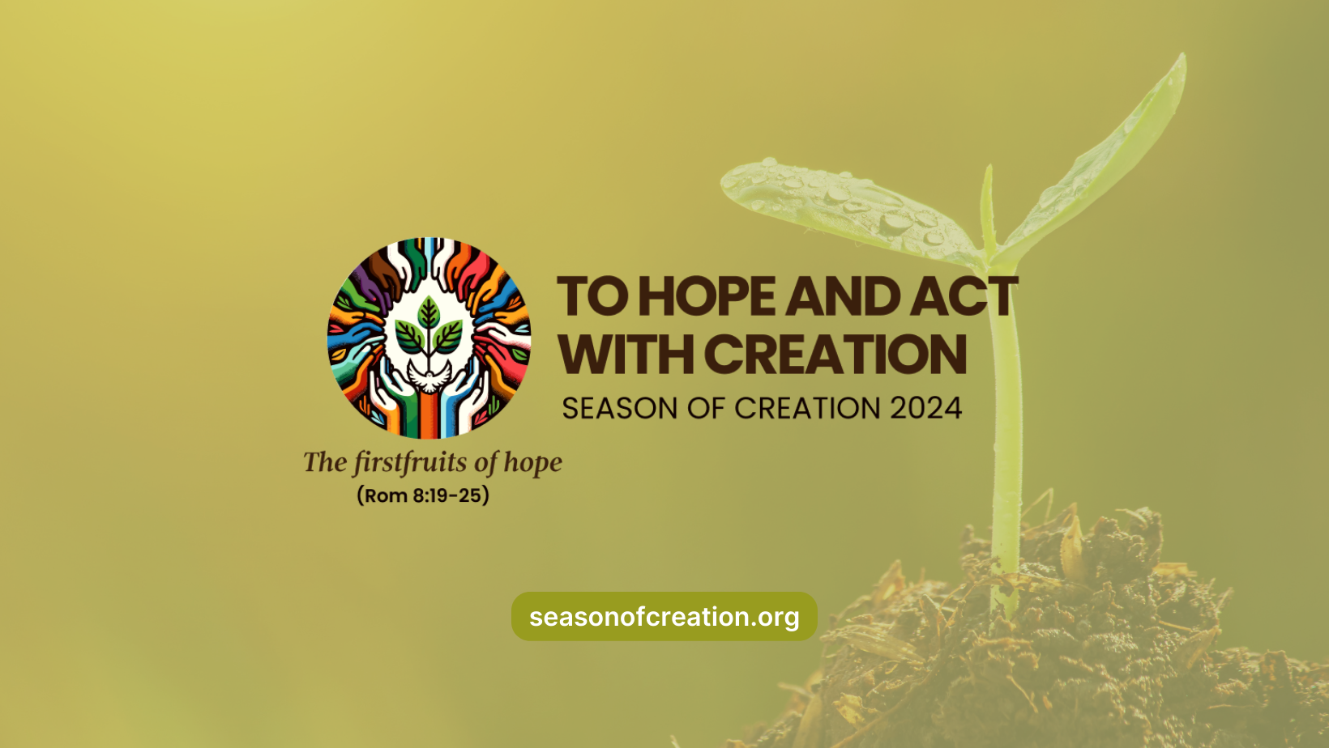
Notes:
Principal: Our final symbol in our sacred space that I’d like to draw your attention to is this. (student name) is now going to introduce us to the final symbol on our sacred space.
Reader 8: All across the world, Christians will celebrate Season of Creation from the 1st September to the 4th October. This happens every year. This year the theme of Season of Creation is to Hope and Act with Creation. This is the Logo of the celebration.
It’s a challenge for us to reflect on our own values and how we can put those at the service of the care of creation.

Slide 13
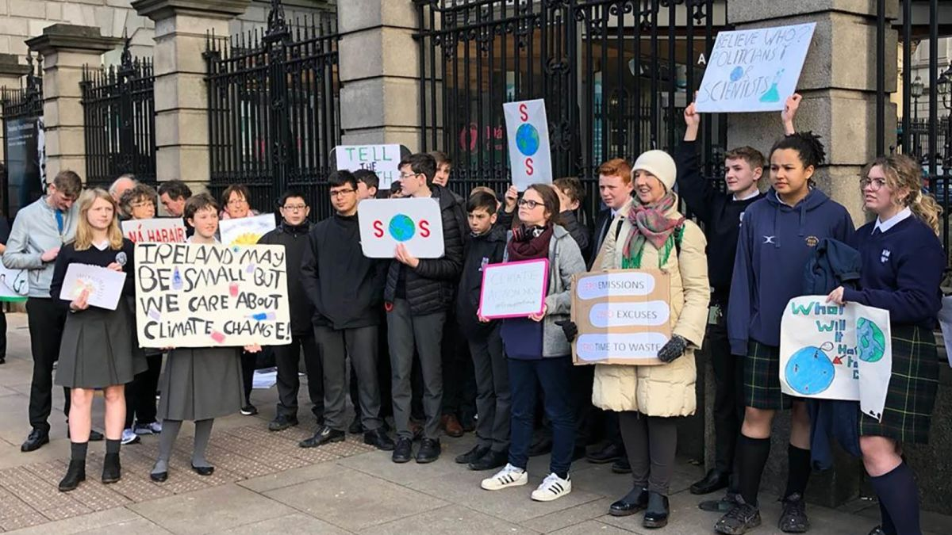
Irish young people
Notes:
Principal: In a survey undertaken by the ESRI in November 2022, the researchers found that over 90 per cent of youth in Ireland judge protecting the environment to be very important value for them.. Most believe there are things they can do in their everyday lives to help combat climate change and feel responsible to do so.
(See https://www.esri.ie/news/young-people-support-more-radical-climate-action#:~:text=The%20findings%20are%20contained%20in,on%20activities%20that%20cause%20emissions.)

Slide 14
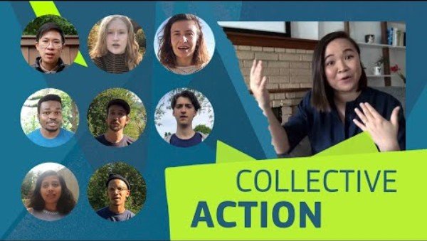
Faith, hope and love ….. in action….
Notes:
https://youtu.be/o7a8wCu8Wr8

Slide 15
Getting involved in our school
Notes:
Note for principal: You might share actions fifth year students in your school can do and opportunities they have in your school to put their values in action in terms of the climate crisis. Images and/or examples would work best.

Slide 16
And so together, we pray:
Lord, bless all fifth year students as we begin this next part of our educational journey here in (school’s name). Help us to live out the best of our values in how we care for one another and care for our world this year. Lord hear us. Lord graciously hear us.
Lord, bless our teachers. Be with them as they support us on our journey and inspire them to help us grow. Help them to challenge us to be our best selves. Lord hear us. Lord graciously hear us.
Lord, bless all of the other students in our school. May their time in our school be marked by learning, peace, friendship and fun. Lord hear us. Lord graciously hear us.
For our world. In the silence of our own hearts we pray for the courage to do what we can to help protect our world. Lord hear us. Lord graciously hear us.
Notes:
(These prayers of the faithful can be lead by fifth year students).

Slide 17
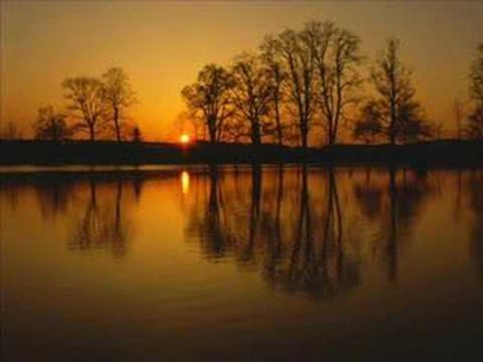
Notes:
https://youtu.be/MHIfRLNYUGw
Note for principal: feel free to pick a different hymn. You may also wish to end the service before the hymn with your own words of conclusion.

