Slide 1

Transition Year
Opening Year Prayer Service
2024/2025
Notes:
Introduction for the Principal:
This short reflection will take about 30 minutes. It might sit well within a larger assembly or meeting with the Year Group.
Last year’s opening year reflections focused on the theme of vocation and the year before that on the theme of hope.
Our hopes and our prayers as Catholic schools always have a practical end; prayer can’t just be to console or to comfort ourselves. Prayer always challenges us to action and perhaps the area we most need to be challenged is in terms of our responsibility to care for our common home.
Specifically, the resource for TY students encourages students to reflect on the idea of the preciousness of time; and why TY is a particularly precious time in terms of an opportunity to engage in different types of learning and to experience school and their communities in a new way.
‘To Hope and to Act with Creation’ is the theme of the Season of Creation and this resource, along with all of the other resources for the other year groups, draws on some of the material and key ideas from Season of Creation. Season of Creation begins on September 1, World Day of Prayer for the Care of Creation, and ends on October 4, the feast of St. Francis of Assisi, the patron saint of ecology beloved by many Christian denominations. Season of Creation is an ecumenical and global prayer moment supported by Irish religious sisters, priests and brothers along with a growing number of lay movements and organisations.
Using the hashtag #SeasonofCreation linking to all the Christian denominations represented in your school and local community would be a great way to further build links within your local community among Christians of different denominations.
It is also worth considering, if you wish, ways of linking to your founding Congregation’s ongoing story as many religious congregations are prioritising the challenge of climate change in their work particularly, in terms of their work in the developing world. This can be done by adding short videos from Congregation websites or a story about a sister/priest and the work they do in this area.
For TY students, the service is broken up into three parts. The first part explores the idea of time and the preciousness of time, the second part challenges students to reflect on the concept of ‘wasting time’ and the final part invites them to consider how they’re going to use their time in TY for the good of others and our common home.
If your schools opening year prayer services fall outside these Season of Creation dates, the resource can still be used. You and your RE team will know best how to further adapt these resources for your own context.
Given challenges around attention space for increasing numbers of young – and not so young – people, all videos used in these resources are quite short. You can if you wish say this to your gathered group when you’re about to play a video. It can help with keeping their attention.
Finally, please note that there are suggested instructions for each slide in the notes under each slide. Obviously adapt as you see fit for your own context. We hope these resources prove a helpful addition in your work as faith leader of your school.

Slide 2

Opening Year Reflection
SCHOOL CREST HERE
Transition year
Notes:
You can begin by welcoming the TY students to the prayer service and perhaps saying something around the importance of prayer in your school as a way of centring everyone on what we see as important and how we understand God at the centre of everything we do. Ultimately when we pray together, we hope it softens us up a little bit to help us look after one another and our planet and to help us feel as if we belong.
Different people and different faith traditions have different beliefs, and all of these are welcome in our school.
You could explain your school crest.

Slide 3

Notes:
Note for principal: Introduce anyone who will be co-leading the service.
This slide is a chance to introduce your sacred space and in doing so to help students begin to become quiet in themselves as they prepare to pray together.
A digital watch
An alarm clock
A traditional watch
An egg timer
A candle; representing God’s presence with us.
The picture of the symbol of the Season of Creation 2024 (see slide 10 or go to seasonofcreation.org)
Small slips of paper for resolutions and a small basket
A Bible

Slide 4
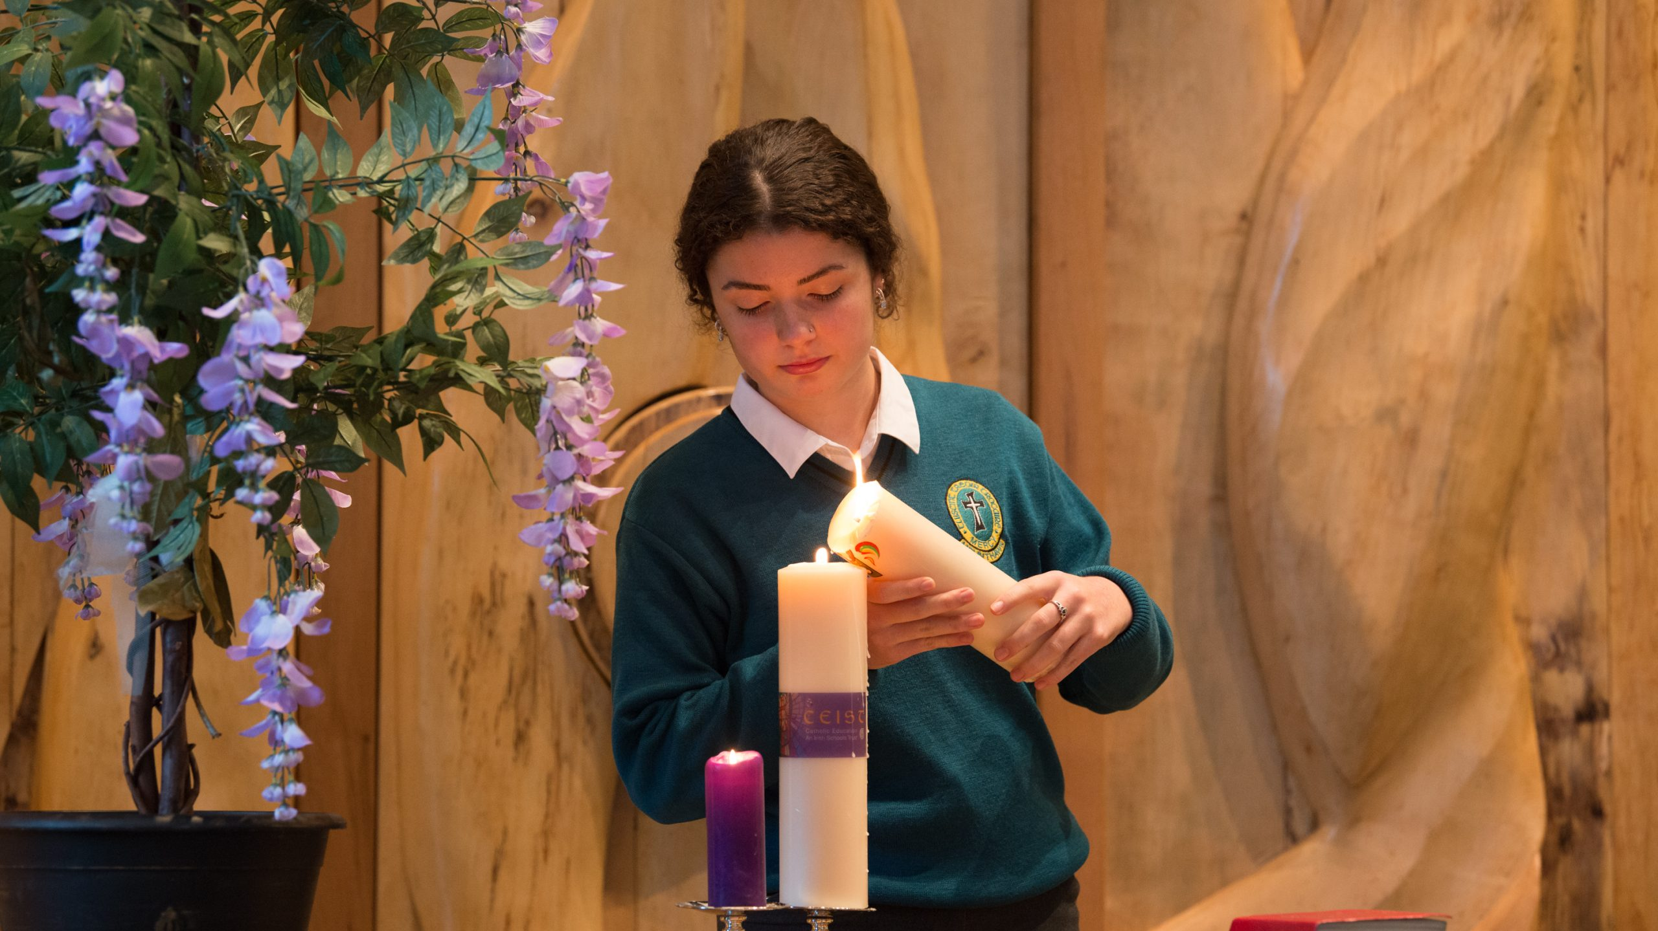
Notes:
Principal: The first symbol is our candle. And so, we light a candle. We light a candle at the beginning of every prayer we make in our school.
What does the lighting of our candle do? It reminds us that we are not alone. God is with us as we pray together. God is our light and lights the way for us as a school community. God is with us as we journey together as a Year group from the start of first year to the end of sixth year. We pray God’s blessing on you in a special way as you begin Transition Year.
We invite now _________________ (student name) to light our candle as our prayer begins.
And we begin our prayer now, “In the Name of the Father….”
(If you wish to use music as part of the service, a hymn relating to light can be used here).

Slide 5

The theme of our service
Notes:
Principal: the theme of our service today as you begin Transition Year is Time, specifically how you spend your time over the next year as part of our Transition Year group. It’s an exciting programme, a programme that will stretch you and challenge you in new ways. But the important thing to do as you begin Transition Year is to recognise only you can really decide how you’re going to spend your time this year. Are you going to really jump into the experience and give it everything or are you going to sit back passively and just coast? That’s a question that’s very important, and it’s not just important for this Year, it’s important for the rest of your life. Are you going to live your life, embrace God’s greatest gift to you – your own life – or are you going to just go with the flow and let life happen around you?
Whatever way you use to tell the time; your watch, your smart watch, your phone – it’s still the same reality. And all those different ways of telling the time are represented here on our sacred space. And maybe the most visual way of showing the passing of time, is also the simplest, the sands of an egg timer. Which we also have on our sacred space. The egg timer represents time so well because we can see the sands of time falling, and once those seconds, minutes and hours are gone, they’re gone, never to be repeated. Time is precious.
To help us understand this theme further we’re going to listen to some music now. This song is written and performed by Phineas O’Connell, Billie Eilish’s brother. It’s called Only a Life Time. Let’s listen to it and see what it might mean to you in terms of the preciousness of your life and the time you have now.

Slide 6
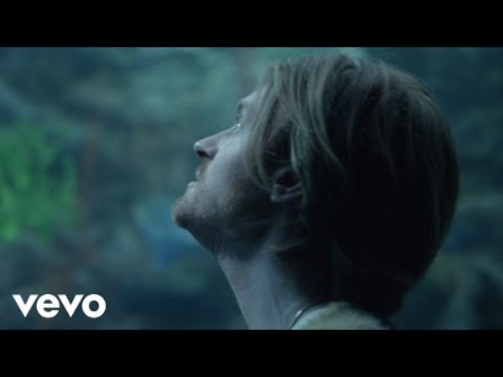
Notes:
https://www.youtube.com/watch?v=b2KRc5ilYRc

Slide 7

Notes:
Principal: So our prayer service has these words from the Book of Psalms at its centre, “So teach us to number our days”, in other words to see how precious time is, “so that we would get a heart that is full of wisdom”.
We listen now to the word of God read to us by (student name).

Slide 8
A reading from the Book of Ecclesiastes
There is a time for everything, and a season for every activity under the heavens:
a time to be born and a time to die, a time to plant and a time to uproot,
a time to kill and a time to heal, a time to tear down and a time to build,
a time to weep and a time to laugh, a time to mourn and a time to dance,
a time to scatter stones and a time to gather them, a time to embrace and a time to refrain from embracing,
a time to search and a time to give up, a time to keep and a time to throw away,
a time to tear and a time to mend, a time to be silent and a time to speak,
a time to love and a time to hate, a time for war and a time for peace.
God has made everything beautiful in its time. He has also set eternity in the human heart; yet no one can fathom what God has done from beginning to end.
The Word of the Lord
Thanks be to God.
Notes:
Reader 1

Slide 9
10 things to do to make the most of Transition Year in our school
10.
9.
8.
7.
6.
5.
4.
3.
2.
Notes:
Note for principal: you and your TY Coordinator and Year Head can personalise this list to your own school context. A mix of the social, spiritual, academic, experiential would be good to include here to give students as broad a sense of what’s ahead of them.

Slide 10

And most importantly….
At number 1:
Use for talents for the good of others and of our world

Slide 11

A short meditation on time….86,400 seconds
Notes:
Note for principal: this is a powerful meditation on the value of time, particularly the first half of the video. The gift of 86,400 seconds we’re each given at the start of every day.
(If you want to shorten it, it can be concluded at 3.05 minutes if you wish)
Video https://www.youtube.com/watch?v=Cho8ESO4PJE

Slide 12

Notes:
Principal: One thing we’d be encouraging all TY to give consideration to during the year when you have time to do so now in a way you maybe didn’t up until now is the question of climate change. (student name) is now going to introduce us to the final symbol on our sacred space.
Reader 8: All across the world, Christians will celebrate Season of Creation from the 1st September to the 4th October. This happens every year. This year the theme of Season of Creation is to Hope and Act with Creation. This is the Logo of the celebration.
It’s a challenge to us to use our time wisely and to consider ways we can raise our voices to care for our common home. In our school, we’re called to use our time to ook after ourselves, one another and the world we live in.

Slide 13
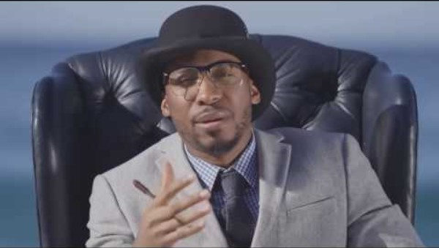
This is the urgent issue of our time….
https://youtu.be/sacc_x-XB1Y
Notes:
https://youtu.be/sacc_x-XB1Y

Slide 14
What does a good use of our time look like in our school?
Notes:
Note for principal: include here:
Images from your school of different social outreach/social justice activities especially as they relate to dealing with the climate crisis facing our world.

Slide 15
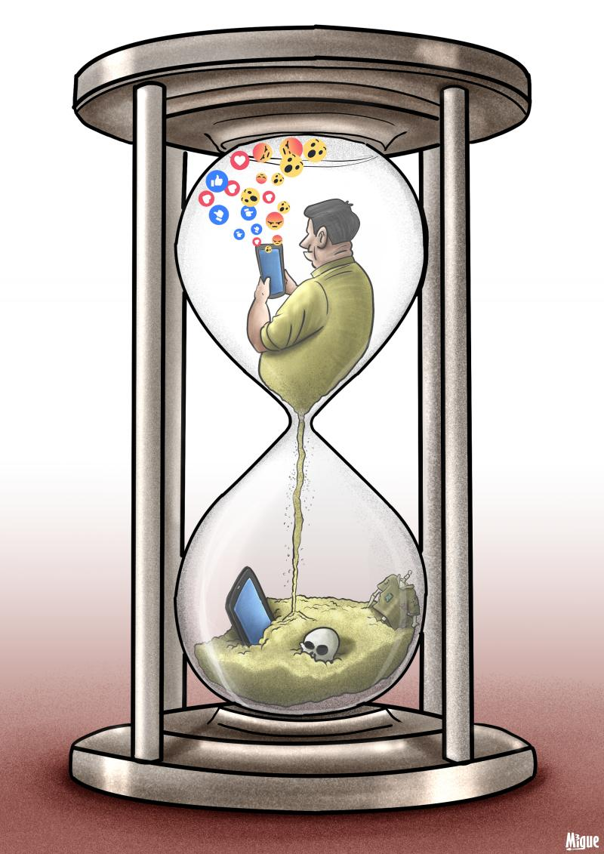
So, “don’t waste the time you have….”
Notes:
Note for principal: You might speak briefly here to social media/technology use and the ‘rabbit hole’ syndrome. But it is obviously only one part of a bigger problem in terms of the energy (especially emotional) that is taken by excessive engagement in social media.
You or the TY Year Head or Coordinator might also speak here to other ways you’ve seen TY pass students by and how that can be avoided.

Slide 16

A ‘new year’s resolution
Notes:
Note for principal: this moment in the service invites students to pause with some time to write down ONE way they’re intending on spending their time wisely this year as part of TY.
You can ask students to bring pencils/pens with them and give them a few moments quiet (with quiet music) for this exercise. (Your RE teachers can help guide students in a short meditation). Then all the resolutions are collected. You may decide to display these and have an opportunity during the year for students to review them if you wish.

Slide 17
And so together, we pray:
Lord, bless all Transition Year students as we begin this exciting year together. Help us to use our time wisely, for the good of others and for the good of our world. Lord hear us. Lord graciously hear us.
Lord, bless our teachers. Be with them as they support us on our journey and inspire them to help us grow. Help them to challenge us with their confidence in our ability to make a difference. Lord hear us. Lord graciously hear us.
Lord, bless all of the other students in our school. May their time in our school be marked by learning, peace, friendship and fun. Lord hear us. Lord graciously hear us.
For our world. In the silence of our own hearts we pray for the courage to do what we can to help protect our world. Lord hear us. Lord graciously hear us.
Notes:
(These prayers of the faithful can be lead by TY students)

Slide 18
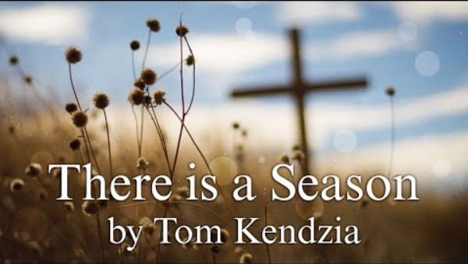
And to conclude:
Notes:
https://www.youtube.com/watch?v=7ScjUxzrY7o
Note for principal: feel free of course to pick an alternative (shorter hymn) and/or to conclude with your own words for your students.

