Slide 1

Third Year
Opening Year Prayer Service
2024/2025
Notes:
Introduction for the Principal:
This short but challenging reflection will take about 30- 40 minutes. It might sit well within a larger assembly or meeting with the Year Group.
Last year’s opening year reflections focused on the theme of vocation and the year before that on the theme of hope. This year’s resources combine these two core Christian ideas and encourage students and colleagues ‘to hope and to act.’ This is what leadership in a faith school looks like whether you’re in a leadership role in the school or whether you’re in first year or sixth year.
Many, if not most third years have a fairly good sense at this stage of their strengths and what they find more challenging. In a Catholic school, any gifts we are given in terms of our abilities are not given just for the person himself or herself; they’re given to serve the wider community. And when we give our gifts in the service of others we give glory to God. This prayer service speaks to acknowledging one’s own gifts and the gifts of others and being grateful for these gifts. But the prayers also challenge your third years to reflect on the ways they can be of service to their school, their local community and the world. This is what being a leader means.
As with the other Opening Year Reflections, our hopes and our prayers as Catholic schools always has a practical end; it can’t just be to console or to comfort ourselves. Prayer always challenges us to action and perhaps the area we most need to be challenged is in terms of our responsibility to care for our common home.
‘To Hope and to Act with Creation’ is the theme of the Season of Creation and this resource for second years, along with all of the other resources for the other year groups, draws on some of the material and key ideas from Season of Creation. Season of Creation begins on September 1, World Day of Prayer for the Care of Creation, and ends on October 4, the feast of St. Francis of Assisi, the patron saint of ecology beloved by many Christian denominations. Season of Creation is an ecumenical and global prayer moment supported by Irish religious sisters, priests and brothers along with a growing number of lay movements and organisations.
Using the hashtag #SeasonofCreation linking to all the Christian denominations represented in your school would be a great way to further build links within your local community among Christians of different denominations.
It is also worth considering, if you wish, ways of linking to your founding Congregation’s ongoing story as many religious congregations are prioritising the challenge of climate change in their work particularly, in terms of their work in the developing world. This can be done by adding short videos from Congregation websites or a story about a sister/priest and the work they do in this area.
For third years the service is divided into two parts:
The call to be ambitious for the higher gifts
The call to put our own gifts at the service of others and of our world.
If your schools opening year prayer services fall outside these Season of Creation dates, the resource can still be used. You and your RE team will know best how to further adapt these resources for your own context.
Videos used are short. It can sometimes be helpful, given the attention span issues many young – and not so young – people are experiencing to say that at the start of a video when you’re about to play it!
Finally, please note that there are suggested instructions for each slide in the notes under each slide. Obviously adapt as you see fit for your own context. We hope these resources prove a helpful addition in your work as faith leader of your school.

Slide 2
Opening Year Reflection
SCHOOL CREST HERE
Third years
Notes:
Note for principal: You can begin by welcoming the third years to the prayer service and perhaps saying something around the importance of prayer in your school as a way of centring everyone on what we see as important and how we understand God at the centre of everything we do. Different people and different faith traditions have different beliefs and all of these are also welcome in our school.
You could, if you wish, explain your school crest.

Slide 3
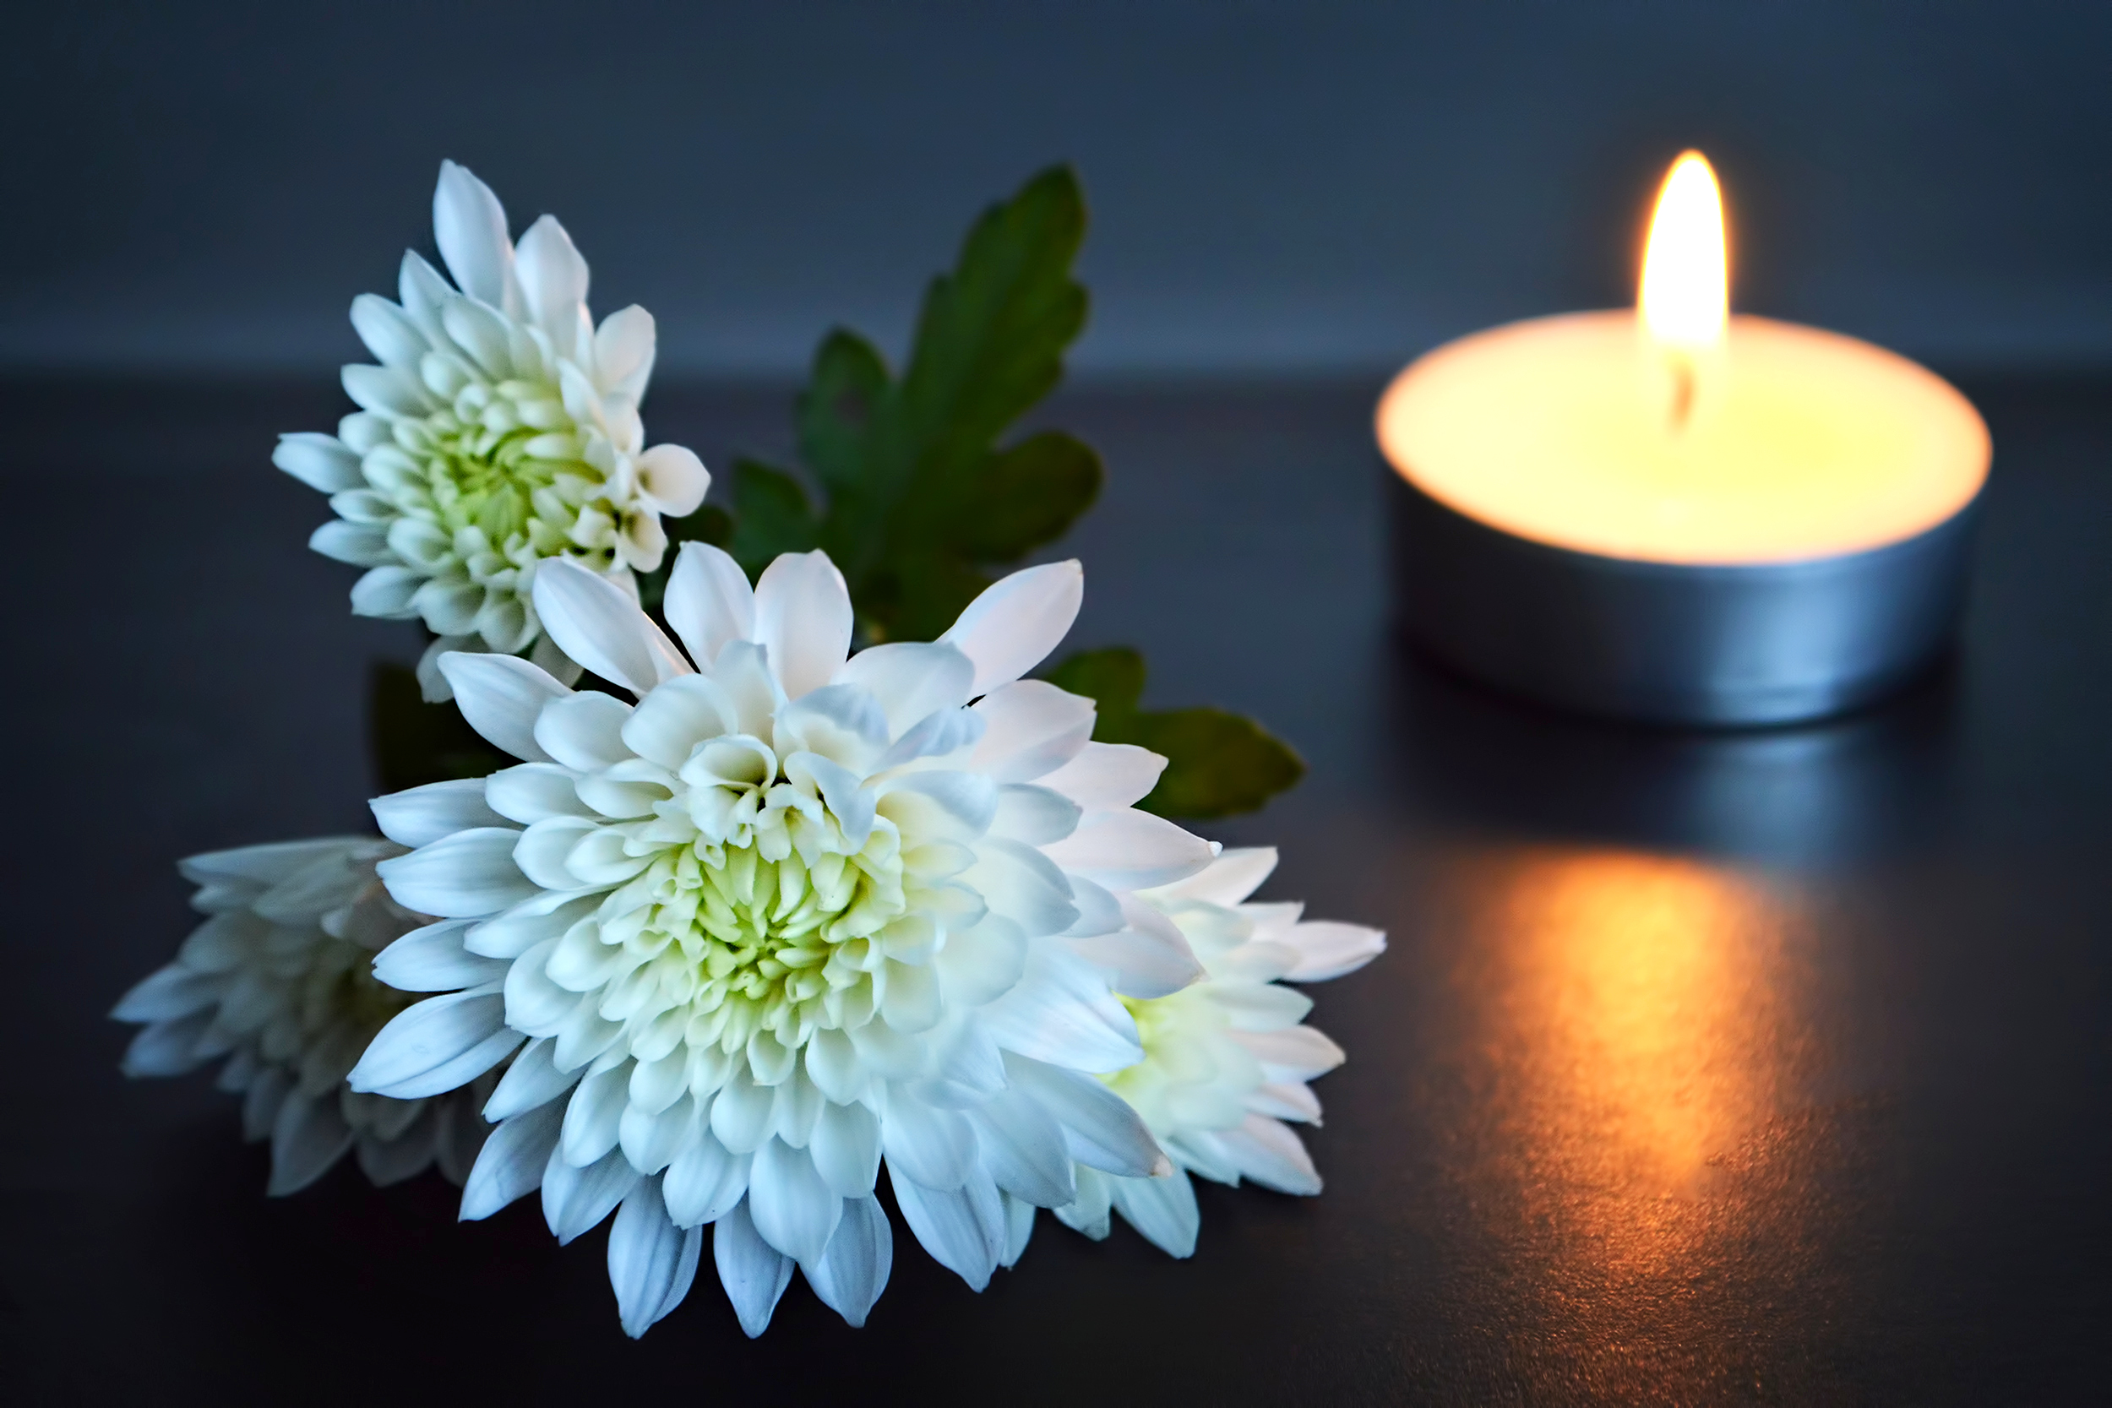
Notes:
Note for principal: Introduce anyone who will be co-leading the service.
This slide is a chance to introduce your sacred space and in doing so to help students begin to become quiet in themselves as they prepare to pray together.
A candle; representing God’s presence with us.
The picture of the symbol of the Season of Creation 2024
A bible
A copy of a sample Junior Cycle Profile of Achievement Certificate
A globe

Slide 4
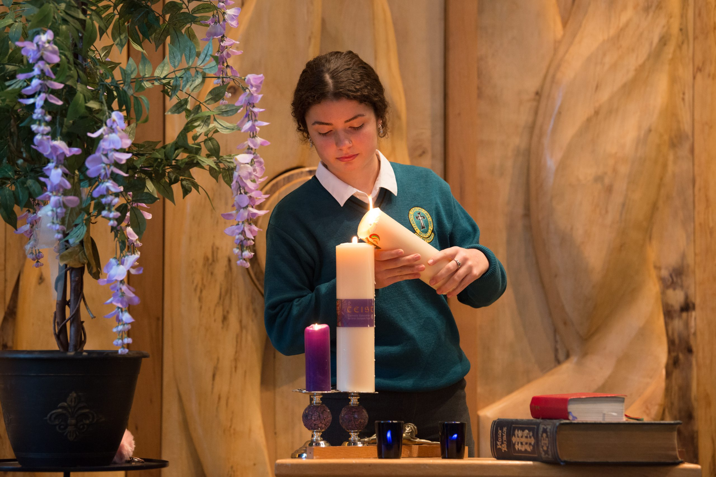
Notes:
Principal: The first symbol I introduced you to was the candle. And so, we light a candle. We light a candle at the beginning of every prayer we have.
What does the lighting of our candle do? It reminds us that we are not alone. God is with us as we pray together. God is our light and lights the way for us as a school community. God is with us as we journey together as a Year group from the start of first year to the end of sixth year. We pray God’s blessing on you in a special way as you begin third year and we pray a prayer of gratitude for what you achieved in first and second year. (Of course, you can say more in terms of particular achievements you wish you acknowledge about the year group in front of you).
We invite now _________________ (student name) to light our candle as our prayer begins.
And we begin our prayer now, “In the Name of the Father….”
(If you wish to use music as part of the service, a hymn relating to light can be used here).

Slide 5
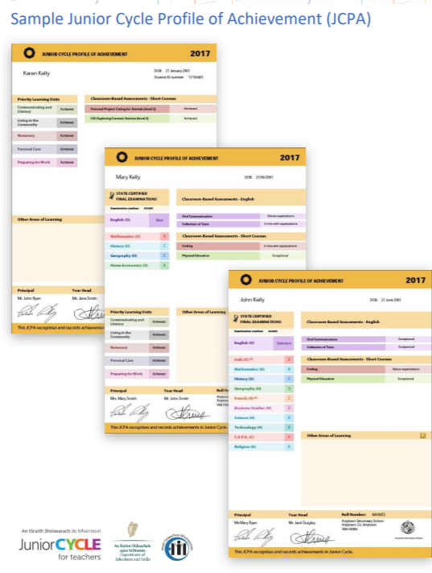
Imagine yourselves in a year’s time
Notes:
Note for Principal: A few words about the second symbol. The JCPA. You can say a few words here of congratulations to students for their achievements in 2nd year, emphasising of course the character of the group and positive examples of ways they’ve interacted with one another and helped one another.
You can let them know what they’ve to look forward to this year and what they’ll be looking forward to this time next year in terms of receiving the JCPA.
Point out the fact that the JCPA records not only their JC results but also ‘Other Areas of Learning’ and give some examples of this from previous years.
Remind the students of your ambitions for them not just academically, or in terms of sports or other extra-curricular engagement but especially in terms of what really, really matters ; how they care for one another.
Offer as a suggestion that this prayer service as they begin third year is about helping them focus on what their ambitions for third year might be.
It might also be worth acknowledging that you understand that no one is ever defined by exam results; we are each much more than just our achievements.
Principal: We listen now to (students’ names) as they present our other symbols.

Slide 6
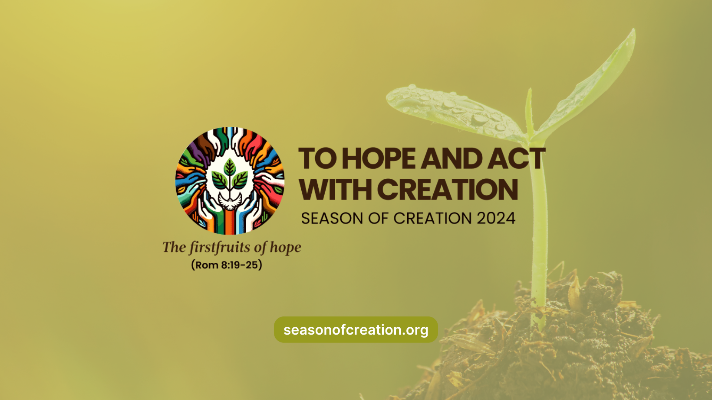
Notes:
Reader 1: Our third symbol is a picture of the logo of the Season of Creation 2024. All across the world, Christians will celebrate Season of Creation from the 1st September to the 4th October. This happens every year. This year the theme of Season of Creation is to Hope and Act with Creation.
It’s a challenge to us all to use our talents and gift to protect our natural world. In our school, we’re called to be real about what we do, and ambitious about what we can do. We are more powerful than we realise and we’re called to use this wisely in our care of others and of our natural world.

Slide 7
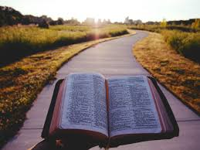
Notes:
Reader 2: As part of our sacred space, we present a bible. All religious traditions have a holy text that guides people of that faith on the right path. For Christians, the bible shows us the way to go and tells us that God always travels with us in all that we do. We pray that we will have the courage to follow the right path for our own lives and for the good of others and for our planet. The word of God helps guide us in terms of how we can be ambitious and what we can do with our gifts and talents. We listen now to the Word of God.

Slide 8
A reading from the first letter of St Paul to the Corinthians
Be ambitious for the higher gifts. And I am going to show you a way that is better than any of them.
If I have all the eloquence of people or of angels, but speak without love, I am simply a gong booming or a cymbal clashing. If I have the gift of prophecy, understanding all the mysteries there are, and knowing everything, and if I have faith in all its fullness, to move mountains, but without love, then I am nothing at all. If I give away all that I possess, piece by piece, and if I even let them take my body to burn it, but am without love, it will do me no good whatever.
Love is always patient and kind; it is never jealous; love is never boastful or conceited; it is never rude or selfish; it does not take offence, and is not resentful.
Love takes no pleasure in other people’s sins but delights in the truth; it is always ready to excuse, to trust, to hope, and to endure whatever comes. Love does not come to an end.
The Word of the Lord.
Thanks be to God
Notes:
Reader 3

Slide 9
What does being ambitious for the higher gifts mean to us in (school name)?
Notes:
Note for principal: you can use images here from your school that reflect what being ambitious for the higher gifts looks like for your school community, pictures of students helping in their community, green flags, voluntary work, pictures of students talking to one another, pictures of students doing extracurricular activities and as on. You can then speak to the importance of all that is done in the school being done in a spirit of care and love. You could add music to the images and make it a short slide show within this larger slide show.

Slide 10
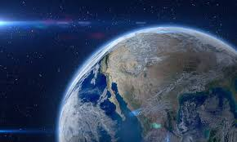
Notes:
Reader 4: Our last symbol is a globe. This is a symbol of the beauty of our world and how fragile our world is. Let’s take a moment to reflect on this from the perspective of being an astronaut, going out into space.

Slide 11

Notes:
https://youtu.be/AipdIH5TzH8

Slide 12
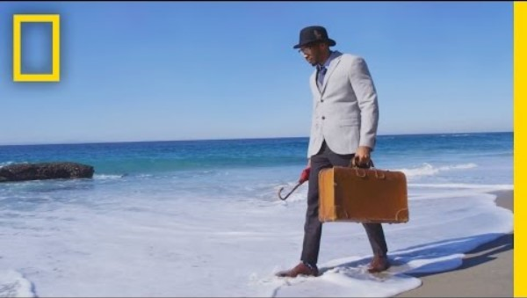
But then we reflect on another reality..
Notes:
https://youtu.be/B-nEYsyRlYo
Principal: we take a moment to watch this short award winning film that outlines the ways in which our earth is in crisis. And the challenge to all of us to use our talents to do something about that crisis.

Slide 13
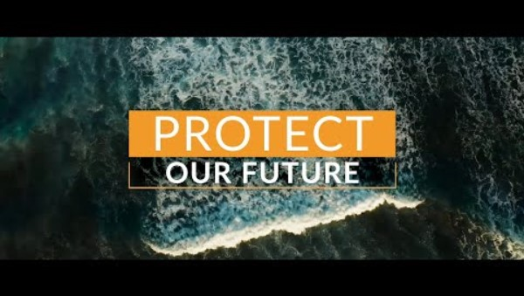
What can we do….start by caring… then act…
Notes:
Note for principal: Climate anxiety among young people is real and it’s important to name that. It’s also important to give examples of the things that young people are already doing in your school and in their families to fight climate change. That gives a great example to other people. Young people are in fact often leading the way. This short video talks though about the first thing that’s necessary; a change of heart and a chance of mind. Then actions that bring hope are possible. A conversation is first required though. We have to start to really care…… and then the Holy Spirit will inspire us to act together.

Slide 14
Being a leader in my school:
Notes:
Note for principal: you might just give one or two examples of ways third year students can be ambitious this year in terms of helping take care of the environment.

Slide 15
And so together, we pray:
Lord, bless all Third year students as we begin a new school year. Bless all that we do this year with one another in our learning, in our sports, in our clubs and in our friendships. Lord hear us. Lord graciously hear us.
As Season of Creation begins, Lord bless us all in our school with a deep sense of wonder at the world around us. Help us to appreciate the gift of creation by taking moments every day to notice the beauty of nature around us. Lord year us. Lord graciously hear us.
As Season of Creation begins, help us to be ambitious not just academically or with our sports but in terms of how we care for one another and our planet. Bless us with hope in our actions. Bless us with a rich imagination to find new ways of using our voices to protect our world. Lord hear us. Lord graciously hear us.
Lord, bless all of the other students in our school. May their time in our school be marked by learning, peace, friendship and fun. Lord hear us.
Notes:
(These prayers of the faithful can be lead by some of the third years or by tutors/year head.)

Slide 16
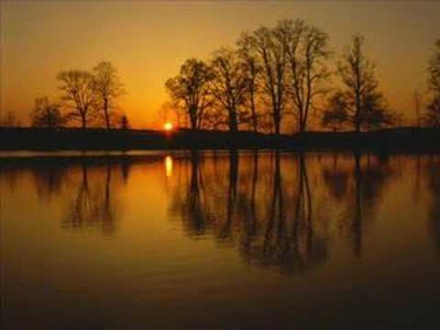
We conclude now with a hymn to nature
Notes:
https://youtu.be/MHIfRLNYUGw
Note for principal: feel free to pick a different hymn and to say a few words by way of concluding the prayer service.

