Slide 1

Second Year
Opening Year Prayer Service
2024/2025
Notes:
Introduction for the Principal:
This short but challenging reflection will take about 30 minutes. It might sit well within a larger assembly or meeting with the Year Group.
Last year’s opening year reflections focused on the theme of vocation and the year before that on the theme of hope. This year’s resources combine these two core Christian ideas and encourage students and colleagues ‘to hope and to act.’ This is what leadership in a faith school looks like whether you’re in a leadership role in the school or whether you’re in first year, second year or sixth year.
Having completed their first year in your school, there is a challenge presented to your second years in this Prayer Service. The heart of this challenge is for them to see the world around them with ‘telescope’ and ‘microscope’ eyes; to see the world around them more clearly and with fresh eyes. To act for creation, to seek to protect our natural world, we must all first have a deep sense of connection to it. That connection can happen through prayer and reflection such as this. It is from this deep sense of connection that leadership qualities can then emerge in our young people around issues relating to the care of our common home.
Our hopes and our prayers as Catholic schools always has a practical end; it can’t just be to console or to comfort ourselves. Prayer always challenges us to action and perhaps the area we most need to be challenged is in terms of our responsibility to care for our common home.
‘To Hope and to Act with Creation’ is the theme of the Season of Creation and this resource for second years, along with all of the other resources for the other year groups, draws on some of the material and key ideas from Season of Creation. Season of Creation begins on September 1, World Day of Prayer for the Care of Creation, and ends on October 4, the feast of St. Francis of Assisi, the patron saint of ecology beloved by many Christian denominations. Season of Creation is an ecumenical and global prayer moment supported by Irish religious sisters, priests and brothers along with a growing number of lay movements and organisations.
Because of course spirituality is at the heart of how we see and how we interact with one another and with our world. Using the hashtag #SeasonofCreation linking to all the Christian denominations represented in your school would be a great way to further build links within your local community among Christians of different denominations.
It is also worth considering, if you wish, ways of linking to your founding Congregation’s ongoing story as many religious congregations are prioritising the challenge of climate change in their work particularly, in terms of their work in the developing world. This can be done by adding short videos from Congregation websites or a story about a sister/priest and the work they do in this area.
For second years, the service is broken up into three parts:
Gratitude for what has been achieved so far
Awe and wonder at the world around us
A word of challenge.
If your schools opening year prayer services fall outside these Season of Creation dates, the resource can still be used. You and your RE team will know best how to further adapt these resources for your own context.
Videos used are short. It can sometimes be helpful, given the attention span issues many young – and not so young – people are experiencing to say that at the start of a video when you’re about to play it!
Finally, please note that there are suggested instructions for each slide in the notes under each slide. Obviously adapt as you see fit for your own context. We hope these resources prove a helpful addition in your work as faith leader of your school.

Slide 2
Opening Year Reflection
SCHOOL CREST HERE
Second Years
Notes:
Note for principal: You can begin by welcoming the second years to the prayer service and perhaps saying something around the importance of prayer in your school as a way of centring everyone on what we see as important and how we understand God at the centre of everything we do.
Different people and different faith traditions have different beliefs, and all of these are also welcome in our school.
You could, if you wish, explain your school crest

Slide 3
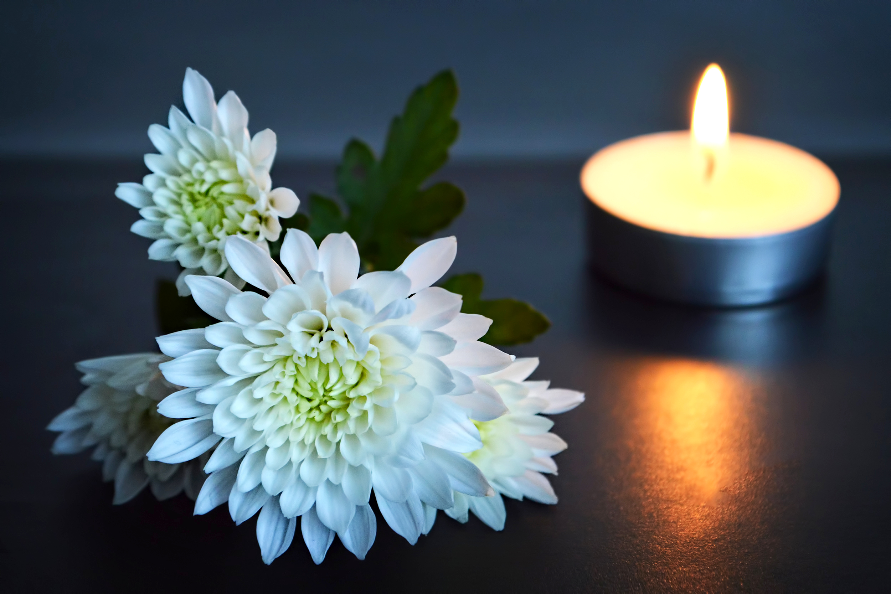
Notes:
Note for principal: Introduce anyone who will be co-leading the service.
This slide is a chance to introduce your sacred space and in doing so to help students begin to become quiet in themselves as they prepare to pray together.
A microscope and a telescope
A candle; representing God’s presence with us.
The picture of the symbol of the Season of Creation 2024
A bible
A copy of any CS Lewis book e.g. The Lion, the Witch and the Wardrobe

Slide 4
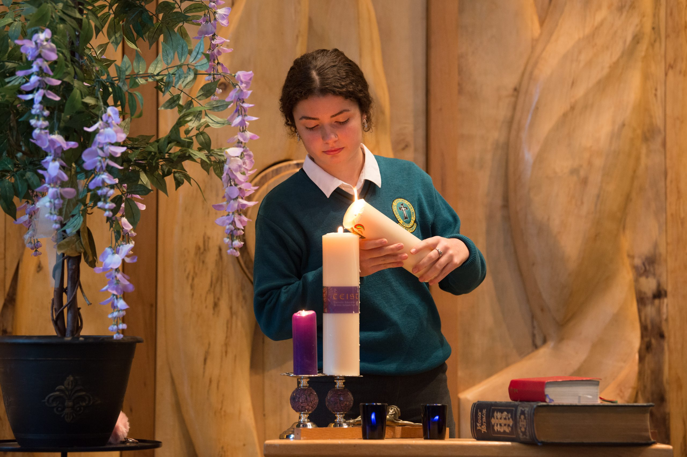
Notes:
Principal: The first symbol I introduced you to was the candle. And so, we light a candle. We light a candle at the beginning of every prayer we have.
We will then spend some time reflecting on the rest of our sacred space and praying together for the gift of wonder at your life and the gift of life from the stars furthest from us to the smallest cells of our own bodies we cannot see.
What does the lighting of our candle do? It reminds us that we are not alone. God is with us as we pray together. God is our light and lights the way for us as a school community. God is with us as we journey together as a Year group from the start of first year to the end of sixth year. We pray God’s blessing on you in a special way as you begin second year and we pray a prayer of gratitude for what you achieved in first year. (Of course, you can say more in terms of achievements you wish you to acknowledge about the year group in front of you).
We invite now _________________ (student name) to light our candle as our prayer begins.
And we begin our prayer now, “In the Name of the Father….”
(If you wish to use music as part of the service, a hymn relating to light can be used here).
We begin our prayer now by listening to the word of God. It will be read for us by (student name)

Slide 5
A reading from St Paul’s Letter to the Corinthians
I always thank my God for you because of his grace given you in Christ Jesus. For in him you have been enriched in every way—with all kinds of speech and with all knowledge— God thus confirming our testimony about Christ among you. Therefore you do not lack any spiritual gift as you eagerly wait for our Lord Jesus Christ to be revealed.
The Word of the Lord.
Thanks be to Go
Notes:
Note for Principal: you might say a few further words, if you wish, here of gratitude for the year group and what they achieved last year. You can link your words to the rest of the service by saying your gratitude for what they have achieved is linked to a profound sense of wonder around who they are as people made by God. The God who made the universe, who fashioned the mountains and the seas made each of them. And that is the theme of our service today. Encourage them to pause with a sense of wonder at that reality of themselves as part of the universe God has made.

Slide 6
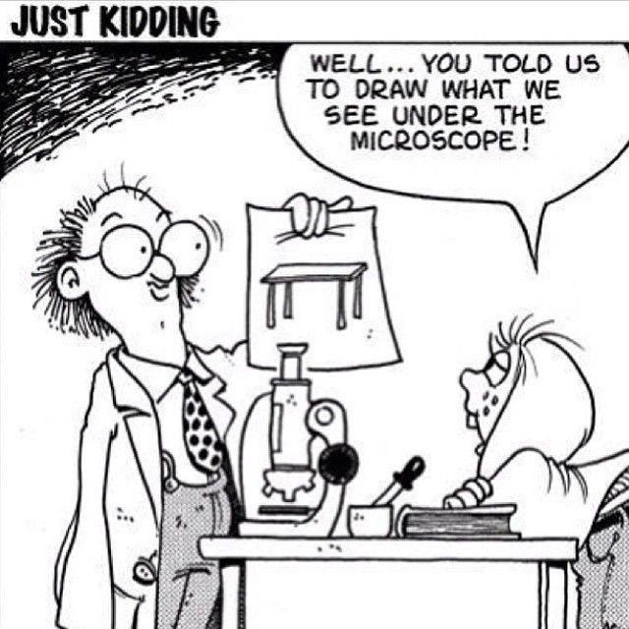
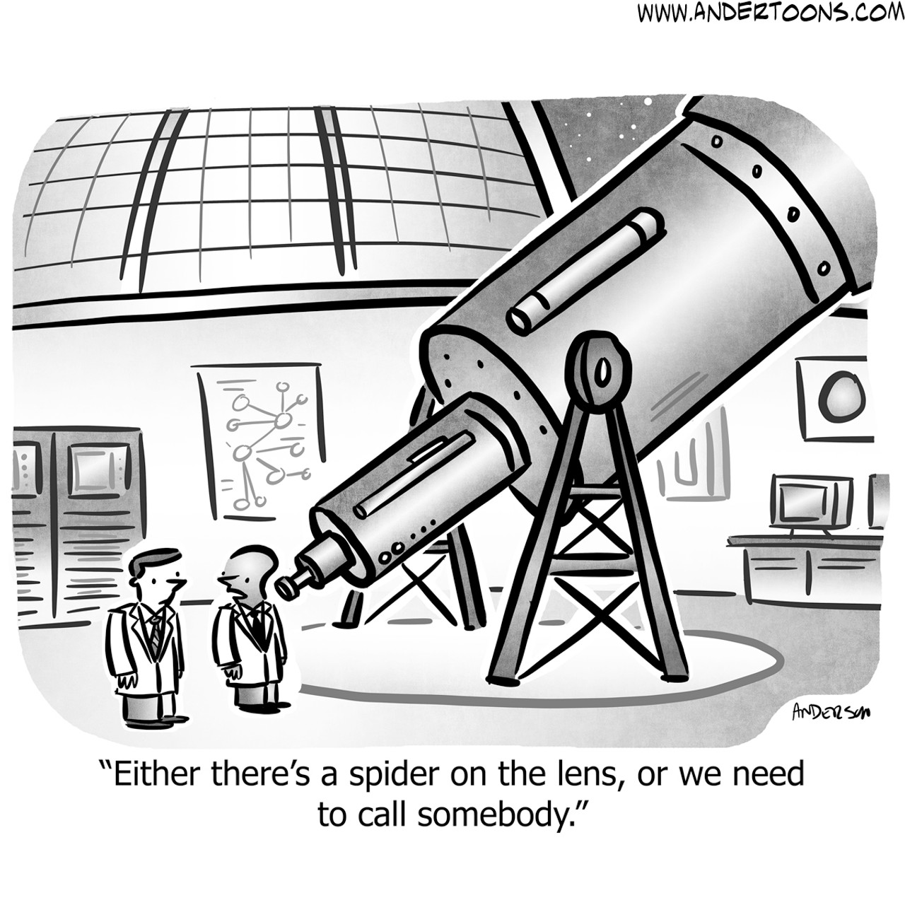
Notes:
Principal: To help us understand this theme more we turn now to the remainder of our symbols in our sacred space. They will be presented to us now by (students’ names).
Reader 1: Our second symbol which we present as part of our prayer service today is a microscope. We are familiar with what a microscope does from science classes. A microscope allows us to study objects too small to be seen by the naked eye. The most powerful electron microscopes allow us to see objects as small as an atom. For our prayer today we take the opportunity to wonder at the incredible beauty and order of the smallest particles of creation, things smaller than even the cells in our bodies.
Reader 2: Our third symbol is a telescope. Again, from science, mainly physics this time, we learn that it is device used to form magnified images of distant objects. The most powerful telescopes in the world can see objects in the far reaches of the universe. The Hubble Space Telescope, for example, has observed galaxies that are more than 13 billion light-years away. For our prayer today we take the opportunity to wonder at the incredible beauty of the immense universe that surrounds us.
Reader 3: We take a moment of silence to wonder at the beauty of the universe from the smallest objects to the huge universe around us.

Slide 7
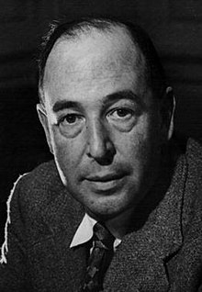

CS Lewis
Notes:
Reader 4: Our next symbol is a book written by the English writer CS Lewis. CS Lewis was a writer of Children’s books, an English professor in Oxford and a person of deep faith. His books were metaphors about the battle of good versus evil. He spent a long time thinking about why his faith was important to him and wrote a lot about his faith for others to read his opinions. He had a very particular understanding of the importance of the relationship between religion and science.

Slide 8
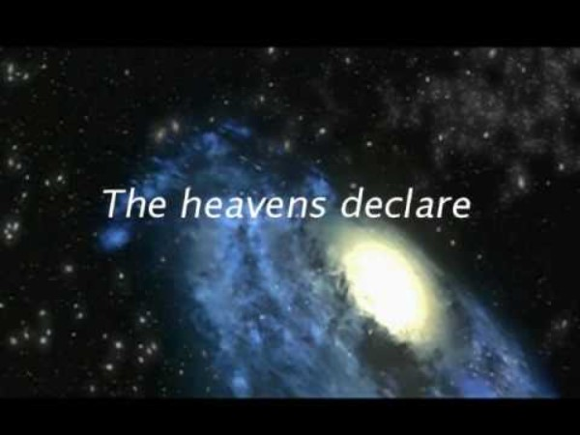
Notes:
Principal: We’re now going to watch a short video and it’s a challenging one about the beauty of creation. The speaker talks about Psalm 19. The Psalms are poems in the Old Testament. The words of that psalm are “the heavens are telling the glory of God”. In other words, the writer of the Psalm, 1000s of years ago had telescope eyes. He could see that the whole universe was amazing and that we were an amazing part of it.
Let’s take a few minutes now to reflect on his ideas.
(Note for principal: this is a challenging video and the language will stretch students, especially at the start of the video but it is worth showing because it captures so well this idea of having ‘telescope’ eyes to see the beauty of all creation).

Slide 9
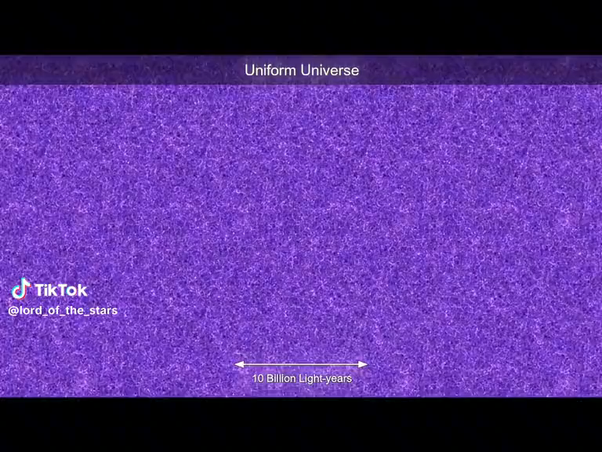
Notes:
Principal: This short tiktok video is another way of saying the same thing. It takes us from the outer expanse of the universe (10 billion light years away) to the smallest cellular reality of the human body, cells in the human eye. Spend a moment marvelling at the God who created all of this reality and your place within that.
Isn’t the world around us amazing? Aren’t we all amazing too?
In the Christian tradition, this sense of wonder invites us always to take care of ourselves, one another and our planet.

Slide 10
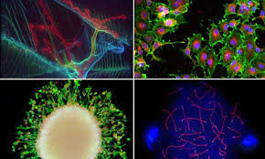
Microscopic images of cells
Notes:
Principal: And what do microscopes tell us of the beauty of creation? Here are some images that were part of a display put up in Times Square in New York, April 2014, of various cells of various living organisms, including human cells. Highlights included an image of a ‘spine ganglion’. This is a nodule on a dorsal root of the spine that contains nerve cells that carry signals from the body's organs to the brain.
Another image shows a microscopic close up of fruit fly larvae.
All the images show the beauty of nature close up and can inspire us to feelings of wonder and awe.

Slide 11
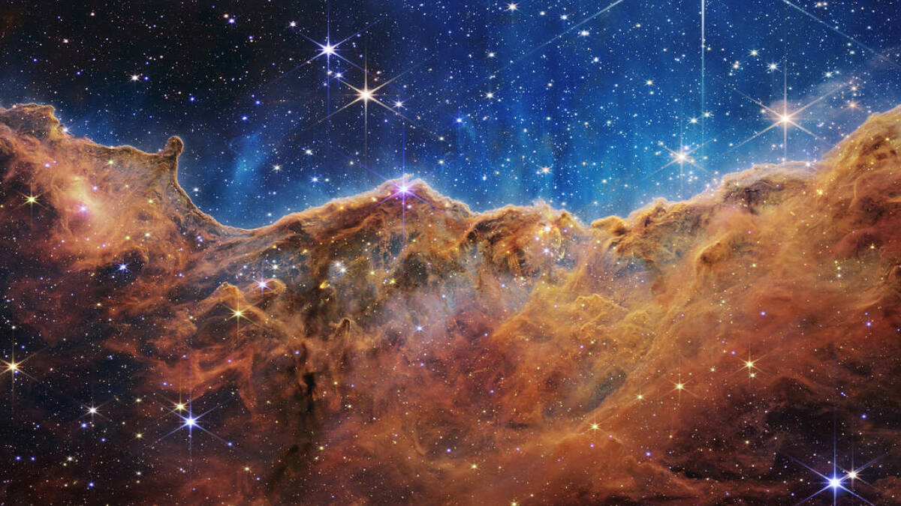
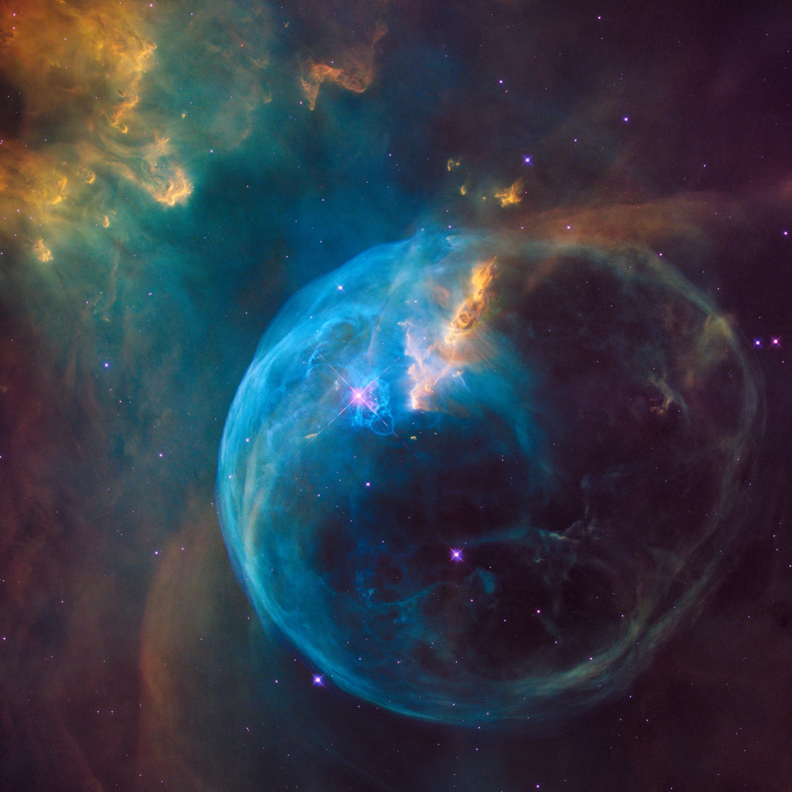
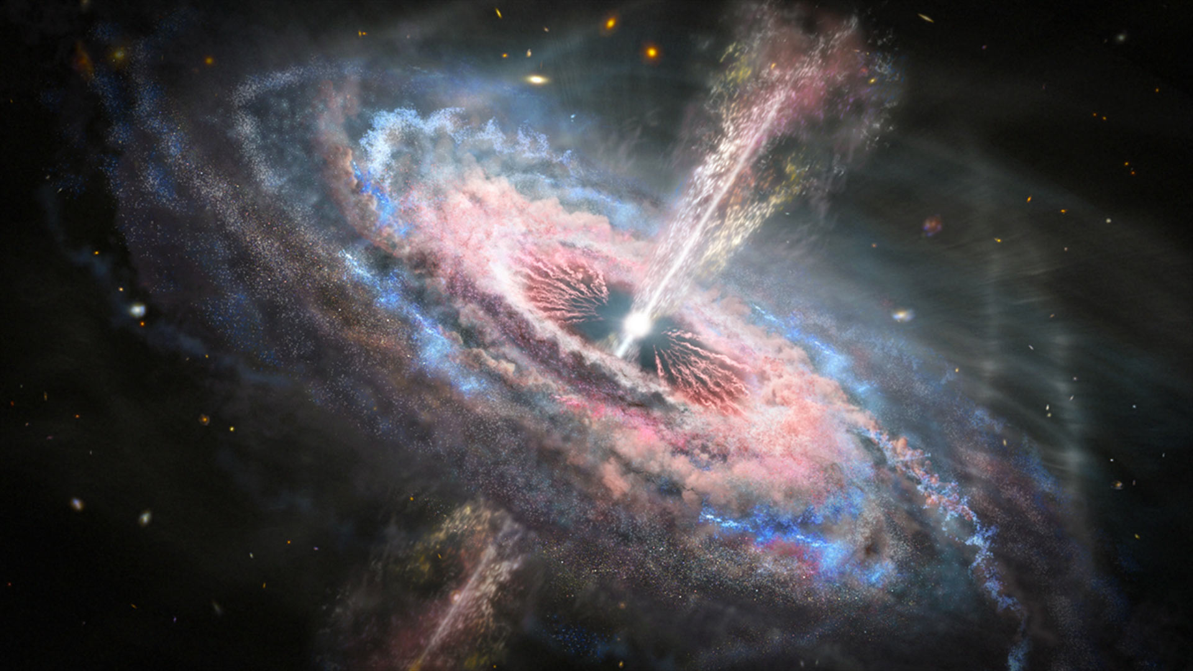
And the telescope
Notes:
Principal: And here are some images from the James Webb and Hubble telescopes; images from the far reaches of the universe that show the beauty of creation. And the immensity of it. The James Webb telescope can see back in space 13.5 billion years. That gives us a picture of space we’ve never had before. Take a moment to marvel at these beautiful images and our place in the immensity of the universe.

Slide 12
We pause to reflect on the wonder of creation in the world around us
Notes:
Note for principal: Here it would be good to add in pictures from your school grounds or from your local area. You can add additional slides to the slide show and add music if you wish. It would also be good to intersperse pictures of the students (particularly of the second years) and the staff as well.
Principal: But we don’t have to use telescopes or microscopes to actually have telescope or microscope eyes; all we have to do is look around us, to pause, to take in the beauty of the world all around us.

Slide 13
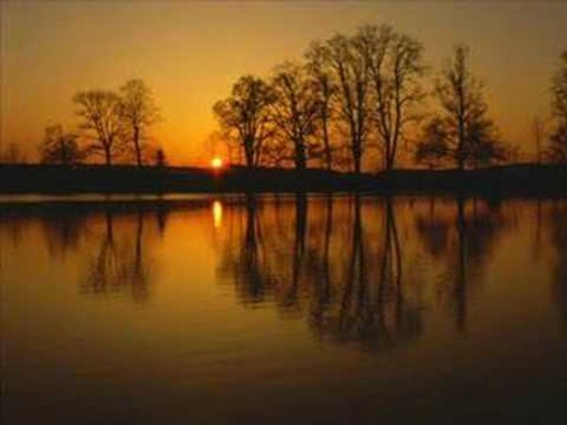
Notes:
https://www.youtube.com/watch?v=MHIfRLNYUGw
Principal: We take a moment in song to reflect on the beauty of the world around us. And for people of faith, a moment to reflect on the God who made everything.

Slide 14
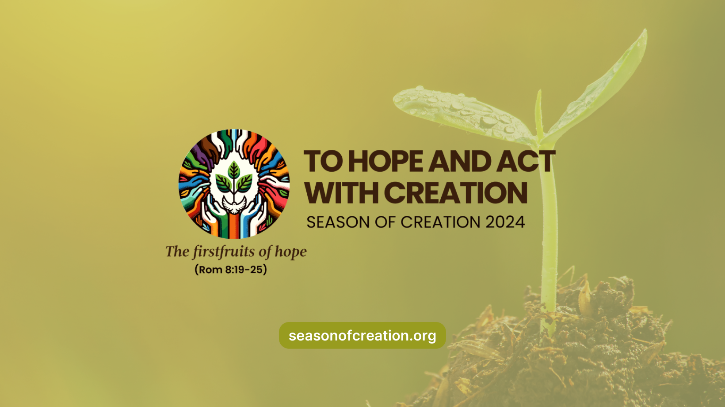
Notes:
Principal: We invite (student name) to present our next symbol.
Reader 5: Our next symbol is a picture of the logo of the Season of Creation 2024. All across the world, Christians will celebrate Season of Creation from the 1st September to the 4th October. This happens every year. This year the theme of Season of Creation is to Hope and Act with Creation.
It’s a challenge to us all to use our talents and gift to protect our natural world. In our school, we’re called to be real about what we do, and ambitious about what we can do. We take a moment to become conscious of all the ways we are already working to make the world a better place……. We become conscious during our prayer service of the ways we are more powerful than we realise and how we’re called to use this wisely in our care of others and of our natural world.

Slide 15
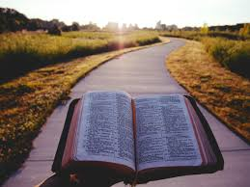
Notes:
Reader 6: As part of our sacred space, we present a bible. All religious traditions have a holy text that guides people of that faith on the right path. For Christians, the bible shows us the way to go and tells us that God always travels with us in all that we do. We pray that we will have the courage to follow the right path for our own lives and for the good of others and for our planet.

Slide 16
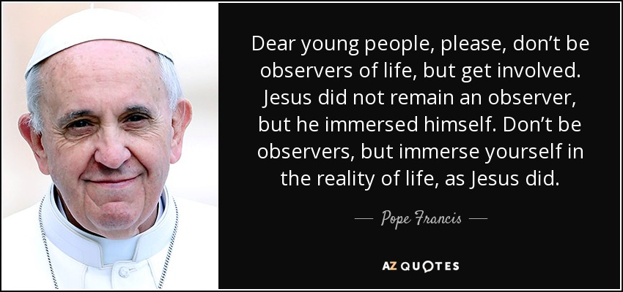
So, what is our faith calling us to do?
Notes:
Note for principal: depending on the group you could say something more here about Pope Francis and his letter to all people on the planet in which he called us all to take care of our common home. That letter called Laudato Si which means ‘Praise Be’ is a letter that empowers all people to take seriously their relationship with our planet. And that relationship starts with a deep feeling of wonder at the gift our planet is to us and to all creatures on it.

Slide 17
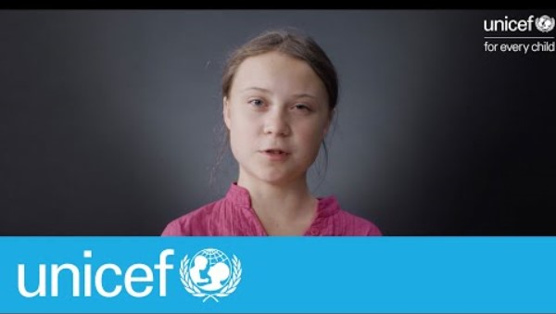
Notes:
Principal: you’re probably wondering what you can do. You’re already doing a lot. Let’s look at some young people and what they’re doing. Maybe it will inspire you. It’s also good to remember all that we’re doing in our school to care for our common home….. (you can give examples here). As second years, it would be important to see how you can step up and become leaders in the school in this area of the school’s life.

Slide 18
Ways to get involved in (school name)
Notes:
Note for principal: This might also be an opportunity to remind students of any projects in the school that speak to climate justice. Or any projects that are going to begin this year. You can add your own information relating to these in the slides here. (Obviously with any material relating to climate justice, you want to ensure students understand that while they have a role to play, it is not only their responsibility. You might also remind them that if they have any anxiety around this or any other issue there are people with whom they can speak in the school).

Slide 19
And so together, we pray:
Lord, bless all second years as we begin a new school year. Bless all that we do this year with one another in our learning, in our sports, in our clubs and in our friendships. Lord hear us. Lord graciously hear us.
As Season of Creation begins, Lord bless us all in our school with a deep sense of wonder at the world around us. Help us to have ‘microscope’ and ‘telescope’ eyes. Help us appreciate the gift of creation by taking moments every day to notice the beauty of nature around us. Lord year us. Lord graciously hear us.
Lord, we pray in gratitude for all the little and big ways we are working together in our families, schools and communities to care for our common home. Lord hear hear. Lord graciously hear us.
As Season of Creation begins, bless us with the courage to take action for climate justice. Bless us with hope in our actions. Bless us with a rich imagination to find new ways of using our voices to protect our world. Lord hear us. Lord graciously hear us.
Lord, bless all of the other students in our school, especially our first years. We know better than any other group what it feels like to be in their shoes. May their time in our school be marked by learning, peace, friendship and fun. Lord hear us. Lord graciously us.
Notes:
Principal: (Students’ names and/or colleagues’ names) will now lead us in our concluding Prayers of the Faithful.
(These prayers of the Faithful can be lead by some of the second years, by class tutors or by the Year Head.)

Slide 20
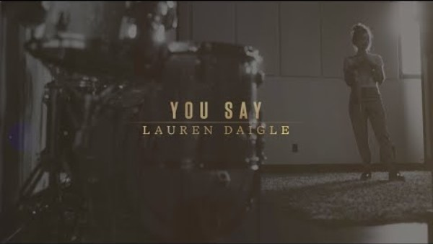
Final hymn:
Notes:
Note for principal: you can use this hymn or any alternative. You might also, of course, wish to say concluding words of encouragement to the 2nd years.
https://www.youtube.com/watch?v=N8WK9HmF53w

