Slide 1

First Year
Opening Year Prayer Service
2024/2025
Notes:
Introduction for the Principal:
This short reflection will take about 30 minutes. It might sit well within a larger assembly or meeting with the Year Group.
Our hopes and our prayers as Catholic schools always have a practical end; it can’t just be to console or to comfort ourselves. Prayer always challenges us to action and arguably the area we most need to be challenged is in terms of our responsibility to care for our common home.
Specifically, the resource for first year encourages students, in the context of their first year in your school, to reflect on their own gifts and responsibilities and on how these gifts can be nurtured and can also brought to bear in creative ways in the care of others and of our common home.
‘To Hope and to Act with Creation’ is the theme of the Season of Creation and this resource for first years, along with all of the other resources for the other year groups, draws on some of the material and key ideas from Season of Creation. Season of Creation begins on September 1, World Day of Prayer for the Care of Creation, and ends on October 4, the feast of St. Francis of Assisi, the patron saint of ecology beloved by many Christian denominations. Season of Creation is an ecumenical and global prayer moment supported by Irish religious sisters, priests and brothers along with a growing number of lay movements and organisations.
Because of course spirituality is at the heart of how we see and how we interact with one another and with our world. The Charter also speaks to the importance of ecumenism. Using the hashtag #SeasonofCreation linking to all the Christian denominations represented in your school and local community would be a great way to further build links within your local community among Christians of different denominations.
It is also worth considering ways of linking to your founding Congregation’s ongoing story as many religious congregations are prioritising the challenge of climate change in their work particularly, in terms of their work in the developing world.
For first years, the service is broken up into two parts.
- The first part explores what a young tree needs to grow. The young tree here is a metaphor for the young people beginning their first year in your school.
- The second half looks at the responsibilities that come with this growth in terms of the call to ‘bear fruit’ in their own lives, in the school’s life and in the wider community’s life.
If your schools opening year prayer services fall outside these Season of Creation dates, the resource can still be used. You and your RE team will know best how to further adapt these resources for your own context.
Given challenges around attention space for increasing numbers of young – and not so young – people, all videos used in these resources are quite short. You can if you wish say this to your gathered group when you’re about to play a video. It can help with keeping their attention.
Finally, please note that there are suggested instructions for each slide in the notes under each slide. Obviously adapt as you see fit for your own context. We hope these resources prove a helpful addition in your work as faith leader of your school.

Slide 2
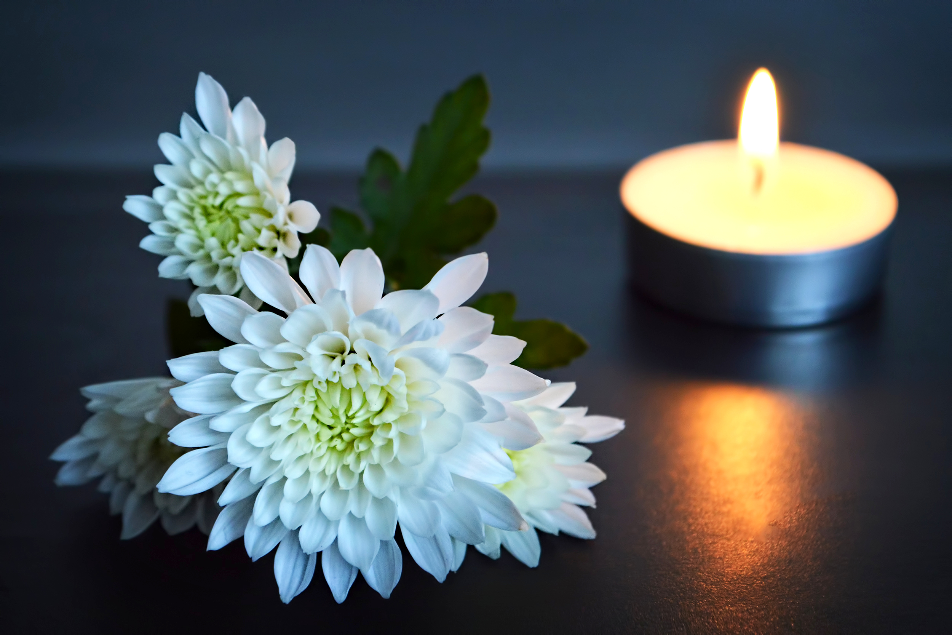
Notes:
Introduce anyone who will be co-leading the service e.g. teachers, sixth years etc.
There will be an opportunity later in the service to introduce year head, class tutors, guidance counsellors etc.
Finally, this slide is a chance to flag your sacred space and in doing so to help students begin to become quiet in themselves as they prepare to pray together.
A young tree/sapling in a pot
A candle; representing God’s presence with us.
The picture of the symbol of the Season of Creation 2024 (see slide 16 or go to seasonofcreation.org)
A Bible

Slide 3
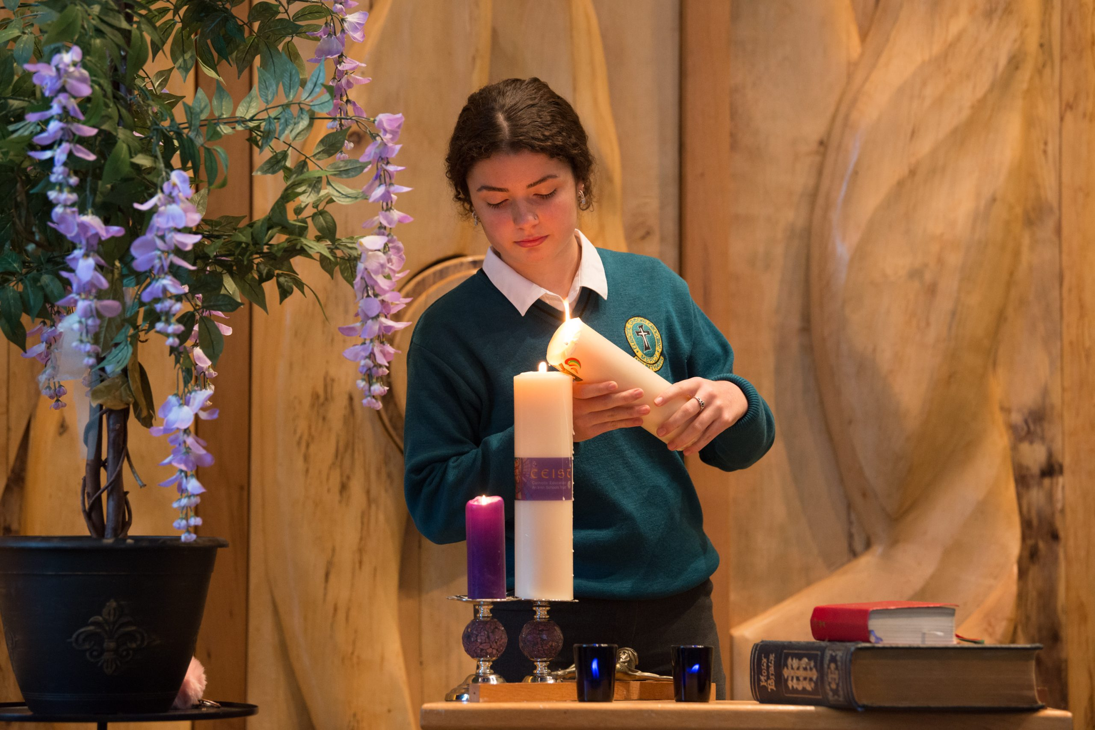
Notes:
Principal: To help us understand the theme of our service, we’re going to pay some attention to these symbols in our sacred space. The first symbol is our candle. And so, we light a candle. We light a candle at the beginning of every prayer we make in our school.
What does the lighting of our candle do? It reminds us that we are not alone. God is with us as we pray together. God is our light and lights the way for us as a school community. God is with us as we journey together as a Year group from the start of first year to the end of sixth year. We pray God’s blessing on you in a special way as you begin first year.
We invite now _________________ (student name) to light our candle as our prayer begins.
And we begin our prayer now, “In the Name of the Father….”
(If you wish to use music as part of the service, a hymn relating to light can be used here).

Slide 4
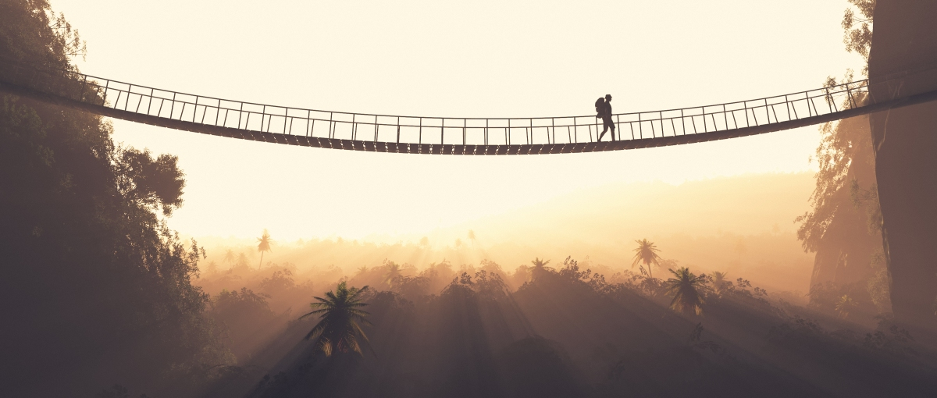
Notes:
Note for principal: You might invite students to take a moment to reflect on this image. What does it say to them about moving into first year having left sixth class? What might walking across this bridge look like? What does it feel like to start something new? Are you happy? Do you feel excited? Are you nervous? Are you a little bit sad? A
After you’ve given a few moments to allow them to quietly reflect on your questions, it’s good at the start of the service for you as the school leader to do what you would naturally do; to acknowledge the feelings of the first years; to acknowledge the nerves and to remind them that their nervousness and the mix of emotions they might be feel are all natural.
It’s also important to acknowledge that this is a fresh start with words like…..There’s no going back to the other side of the bridge! It’s a new beginning. Everyone is crossing the bridge and we’re all here to welcome you and to support you. We are delighted you are here because we know what talents and gifts you bring with us and we’re very excited to see the difference you’re going to make to our school.
Invite a further moment of silence to allow student to reflect on this image and what it means to them.

Slide 5
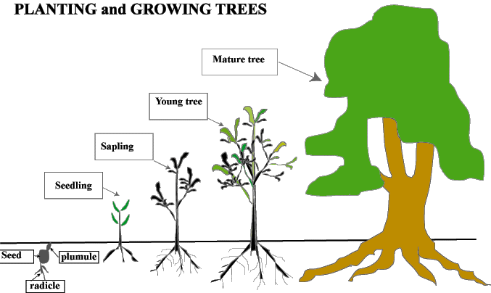
.’
Notes:
Principal: The second symbol is the little tree which is here as part of our sacred space.
One of the subjects you’ll all be studying this year is Science. In Science you’ll learn that one of the characteristics of all living things is growth. Sometimes we think of growth as something that happens when you’re a child and until you stop growing taller physically. But growth is a characteristic of all life from birth to death. Given the right conditions, living things can grow!
So, what are the right conditions for your growth here in (name of school)? And when we talk about your growth, what are we talking about? We’re talking about your school work – your academics of course, but also your social skills in terms of friendships. We’re also talking about your growing sense of who you are, your growth as a person with a good heart for others, your growth in terms of your interests and so on.
As we pray together and reflect together now, let’s reflect on that question; what do you need to grow as first years?

Slide 6
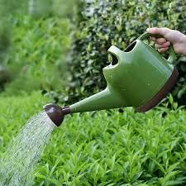
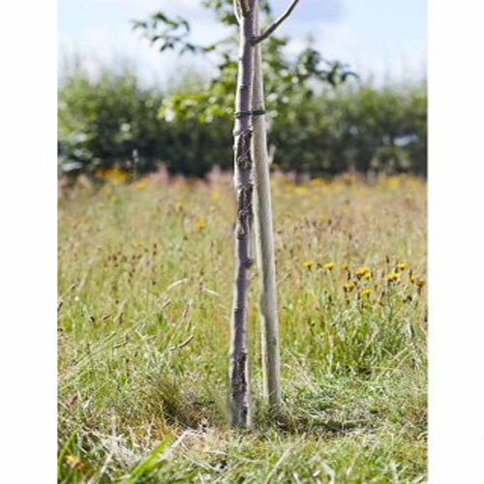
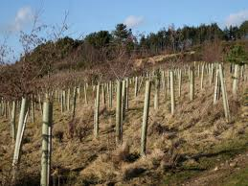
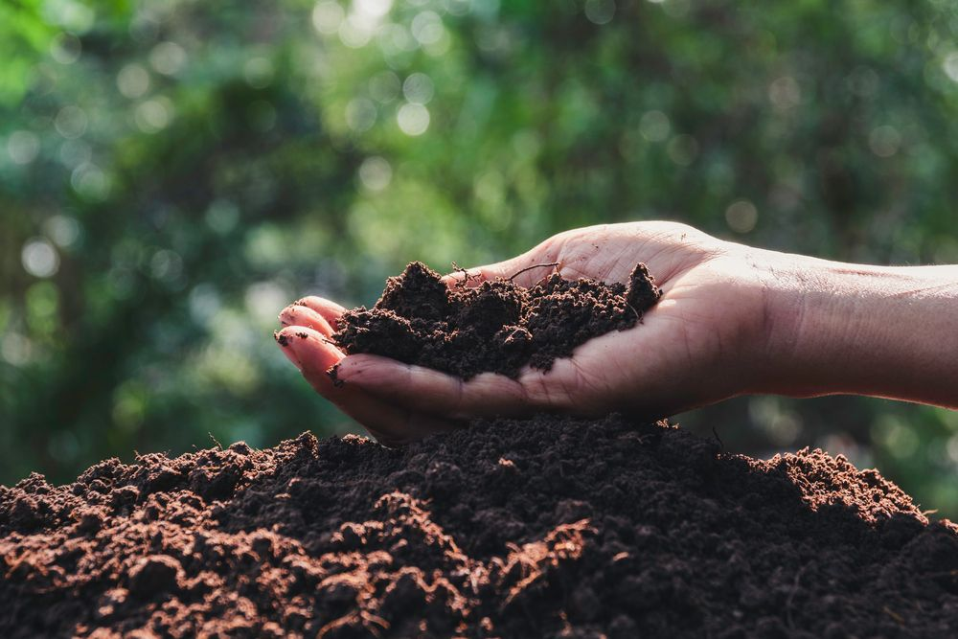
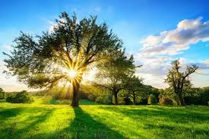
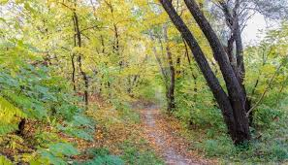
Notes:
Principal: We use symbols to try to explain and reflect on something important. These images and symbols help us to see things a little bit differently. Let’s look at what this young tree needs and see if we can learn something about what you need as you begin first year. (Note: feel free to have actual physical symbols added here where you can, it makes it more real e.g. a watering can, stakes, fertiliser, etc). We invite now (sixth year students’ names) to lead us in this part of our service.
Reader 1: A tree needs water. Without water a tree will die. In the Christian tradition, water is a symbol of life and of faith. Here in (school’s name) we believe we all need to be nourished by the water of our faith. We do this through our Religion classes, through our Masses and other sacraments that we celebrate together, through the celebration of other religious festivals and through the retreat programme. We also do it by treating one another as God’s beloved sons and daughter. Our faith helps us to grow in confidence and in wisdom.
Reader 2: A young tree sometimes needs to be protected in stormy weather. A stake is placed beside the tree to help it grow up and be strong. In our schools, that’s the function of our school rules, to help you understand the boundaries of good and bad behaviour so that you and everyone else in the school can weather any storm in peace together. The guidelines in our school are not there to stop you from growing but are there to help you grow and to help others grow too.
Reader 3: A young tree needs fertiliser. Natural fertilisers are best because they don’t harm the environment around the tree. For us in (name of school) the fertiliser represents your learning. All the good stuff you’ll learn in our school that will interest you, excite your mind, spark your interests. It’s likely that over these five or six years, you’ll develop a passion for a particular subject. You will probably, hopefully discover what you want to do with your life. We pray together today that your learning will feed your mind and your soul and help you grow strong. You’ll be engaging with subjects you’ve never studied before. We pray you’ll be open to learning in a way that nourishes you and allows others to be nourished too.
Reader 4: A tree needs shelter. In the natural world most trees don’t grow on their own. They grow in clumps, groves, and forests. Likewise, here in (school name) we believe that you do better when you’ve good friends around you. But we go further than that. We believe it is your job actually in our school to make sure no one is feeling ignored or isolated. That’s how important we understand friendship to be. So, when you see a fellow first year struggling to settle, we tell you to be a leader and to reach out and make sure they feel part of the group. It’s also for that reason we take bullying so seriously. We know to grow you’ll need to feel cared for and accepted for who you are.
Reader 5: A tree needs light and needs time. In science you’ll learn about the chemistry of what happens when light nourishes a tree. Light as we’ve already seen is a symbol of God’s presence. God guides us in all that we do here in (name of school). No one here is expecting you to get everything right immediately and all the time. We believe you will grow but that doesn’t mean you won’t make mistakes. And in our school when that happens we just gently shine some light on your actions and help you grow through challenging times.
Reader 6: As well as shelter, a young tree also needs space and time. Give yourself time and space to settle into your new school. Don’t be afraid of the quiet moments, of time on your own to reflect on how things are going for you. Pray and be hopeful because God is especially with you in those quieter moments too.

Slide 7
The people who will help you grow:
Notes:
Note for principal: This might be a good opportunity for you as principal to introduce Year Head(s), Tutors, Guidance Counsellors, Prefects. Head Girls/Boys, and so on. They can be introduced in the context of people who will help them to grow.
You call also include pictures of these key people on this slide.

Slide 8
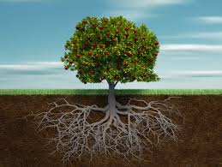
Notes:
Reader 7: For a young tree to grow, it needs to begin to develop strong roots. Having a sense of yourself – who you really are, what you’re good at, what you need help with, your values, what’s important to you, will help you get stronger here in (school’s name). Your family and your friendships are part of those roots. The town/village/suburb you come from are important too. The sports clubs and other clubs you belong too. They’re all part of your story. Keep nourishing all those roots and giving them time to grow as you grow. We pray a prayer of gratitude for the primary schools you’ve come from and for your families.

Slide 9
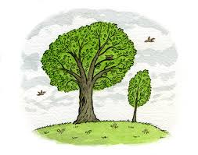
Over to our sixth years…
Notes:
Principal:
This is a picture of a small tree and a tall tree! So now we turn once again to our older students!
So we’re going to talk to a couple of six years about what helped them grow over the last few years. Obviously, our sixth years are still growing themselves in lots of ways. No one here is a finished product!
(You can ask the 6th years to have something formal pre-prepared or you can informally ‘interview’ them. Either way it would be great if they could connect what they say to the image of a tree and the seven things highlighted here that helps trees to grow. In particular, it would be important to stress the ways in which the 6th year students have been of service to their school and community. And obviously if the sixth years can speak to their own faith and the way their faith has developed that would be great too. Obviously, it doesn’t need to be too confessional in tone. Finally, the two sixth years might present something to the sacred space that represents their time in the school.)
When the sixth years are finished, you might give a quiet moment for some music if you wish. Any hymn with a sense of the beauty of nature would be good. For example: https://www.youtube.com/watch?v=MHIfRLNYUGw. This is a particularly good video as there are lots of trees in it!.
Alternatively, here’s a nice Amy Grant song, https://youtu.be/kYzGMsBwU8c

Slide 10
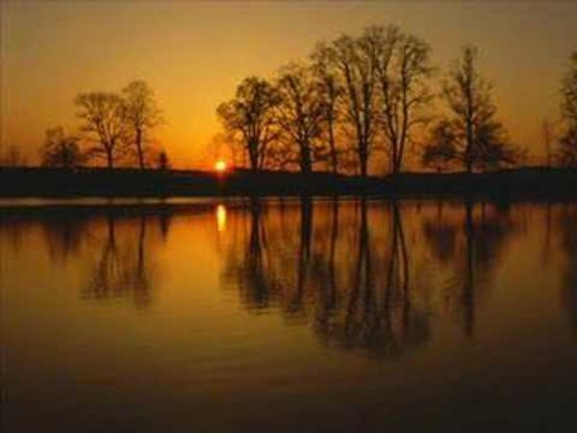
Notes:
https://youtu.be/MHIfRLNYUGw

Slide 11
Notes:
Principal: We come now to the final part of our service.
Trees make a huge difference to our world, and we believe, with the right help and support, you can too!
It is our hope that as you grow in our school, like a good strong tree that has been well taken care of, you’ll bear fruit. What will that fruit look like it our school? It’ll look like kindness, you doing your best in your exams., you representing your school with pride on the camogie/hurling/soccer field. It’ll look like you getting involved in projects for justice in your local community. It will look like your year group being happy together.
All of the good stuff we’ve just reflected on – the sunlight, the shelter, the food, the water, the space, the stake, the roots – only make sense when a tree starts making a difference to its environment. And that’s what we’re going to reflect on now as we listen first to the word of God. (Student name) will now read for us the Word of God.

Slide 12
A Reading from the First Letter of John
Beloved, let us love one another, for love is from God, and whoever loves has been born of God and knows God. Anyone who does not love does not know God, because God is love. In this the love of God was made manifest among us, that God sent his only Son into the world, so that we might live through him. In this is love, not that we have loved God but that he loved us and sent his Son to be the sacrifice for our sins.
Beloved, if God so loved us, we also ought to love one another. No one has ever seen God; if we love one another, God abides in us and his love is perfected in us.
The Word of the Lord.
Thanks be to God.
Notes:
Reader 8
(After the reading you could say a few words if you wish about the importance of love and care at the heart of the school. It is ultimately feeling cared for and loved that help us all to grow and that is why it is so important in the school. )

Slide 13
10 ways to ‘bear fruit’ in (school name)
10. Try new things in our school e.g. new clubs, new sports. Take a few chances; you’ll surprise yourself.
9. Be kind to everyone; be especially kind to anyone who is struggling.
8. Do your work to the best of your own ability. No one can ever argue with that.
7. If you’re worried about anything, don’t hold it in. Talk to someone you trust.
6. Be brave. It takes courage to make friends beyond your normal circle of friends.
5. Be grateful. Education is a privilege denied to many in our world.
4. Stand up for what you believe in. Be brave in your convictions.
3. Let other people be themselves. Don’t judge other people for being different.
2. Be yourself. You have unique gifts and talents. Let them shine.
Notes:
Principal: So what does that look like in our school in practical terms?
Here are our top ten tips for you to grow and bear fruit in our school!
(Note: obviously amend as you wish depending on your own school’s particular characteristic spirit).

Slide 14
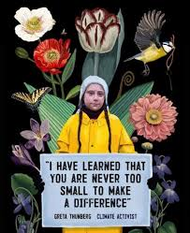
And number 1:
Never, ever underestimate the difference you can make in your community and in our wider world through your actions.
Notes:
Principal: One way you can make a huge difference in our world is by taking seriously the challenge of climate change. Greta Thunberg the young climate activist once famously said, “I have learned that you are never too small to make a difference”. We pray that we will all have the courage to use our talents to bear fruit in the lives of others and for the good of our planet. (Student name) will now say a little bit more about this.

Slide 15
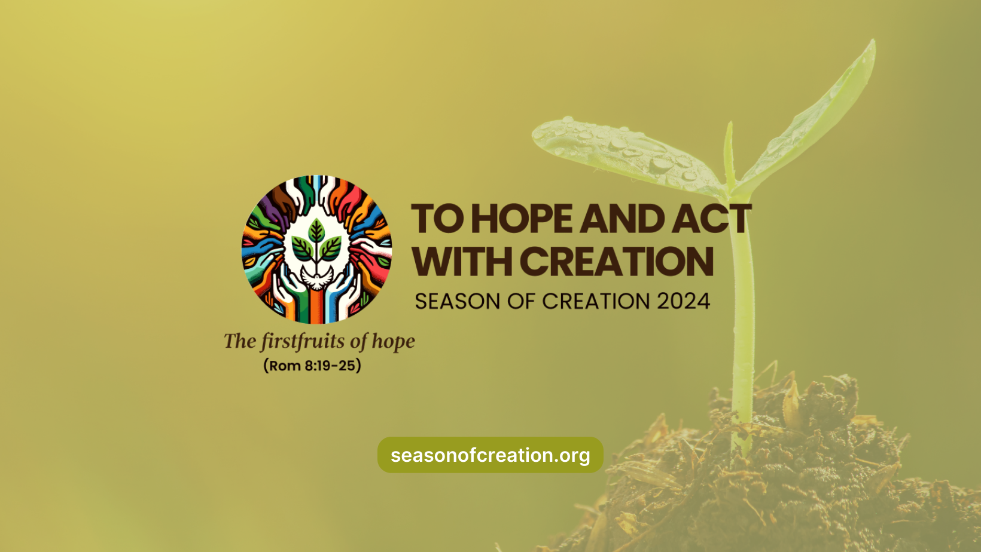
Notes:
Reader 8: All across the world, Christians will celebrate Season of Creation from the 1st September to the 4th October. This happens every year. This year the theme of Season of Creation is to Hope and Act with Creation. This is the Logo of the celebration and we have it presented here in our sacred space.
It’s a challenge to us all to use our talents and gift to protect our natural world. In our school, we’re called to look after ourselves, one another and the world we live in. Part of helping you to grow is us believing you can make a huge difference to the world.

Slide 16
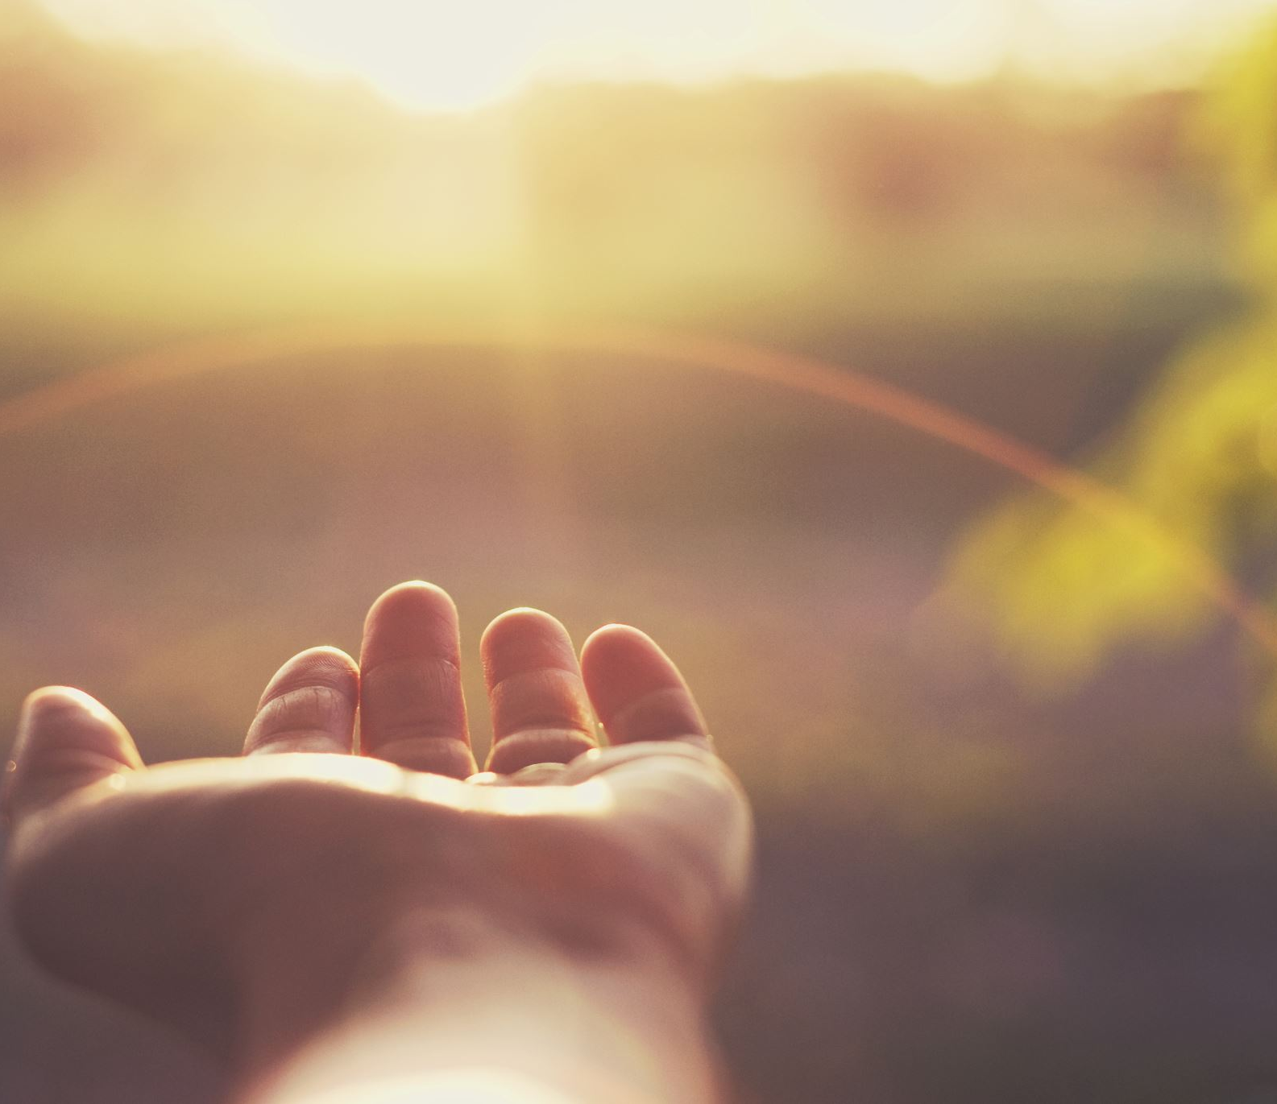
And so together, we pray:
Lord, bless all first years. Be with us as we begin our adventures here in (school name). Help us over our years together to grow strong in the people we are, for the good of others and for the good of our world. Lord hear us. Lord graciously hear us.
Lord, bless our teachers. Be with them as they support us on our journey and inspire them to help us grow. Help them to challenge us with their confidence in our ability to make a difference. Lord hear us. Lord graciously hear us.
Lord, bless all of the other students in our school. May their time in our school be marked by learning, peace, friendship and fun. Lord hear us. Lord graciously hear us.
Lord, bless our families. Today is a big day for them as well. Lord hear us. Lord graciously hear us.
For our world. In the silence of our own hearts we pray for the courage to do what we can to help protect our world. Lord hear us. Lord graciously hear us.
Notes:
Note for principal: These prayers of the faithful can be lead by some of the first years, by fifth/sixth years or by some of the teachers.

Slide 17
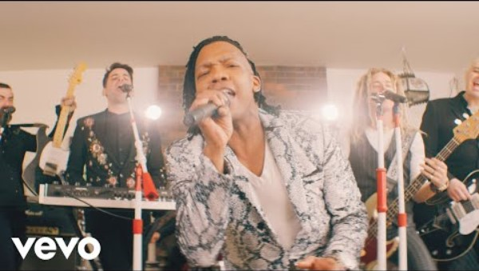
Notes:
Principal: Our concluding hymn is simply called ‘Love one Another.’
That’s the best way you can grow and the best way you can bear fruit!
(You can of course, conclude with a different hymn and/or your own final words).

