Slide 1
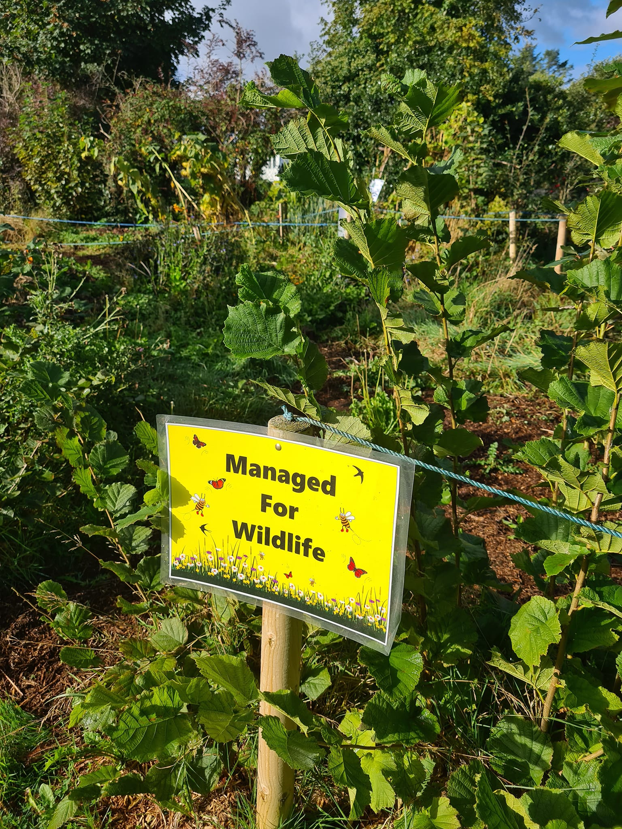




Welcome
“Returning to nature”
Return 30% of church grounds to nature by 2030
Notes:
Welcome

Slide 2
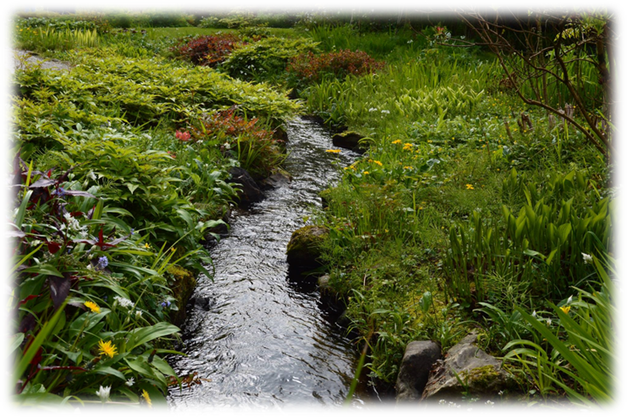

“Nature is a magnificent book in which God speaks to us & grants us a glimpse of his infinite beauty and goodness. Rather than a problem to be solved, the world is a joyful mystery to be contemplated with gladness & praise” (Laudato Si’, 9, 12).
Notes:
Optional quotes from Laudato Si’ for opening reflection

Slide 3
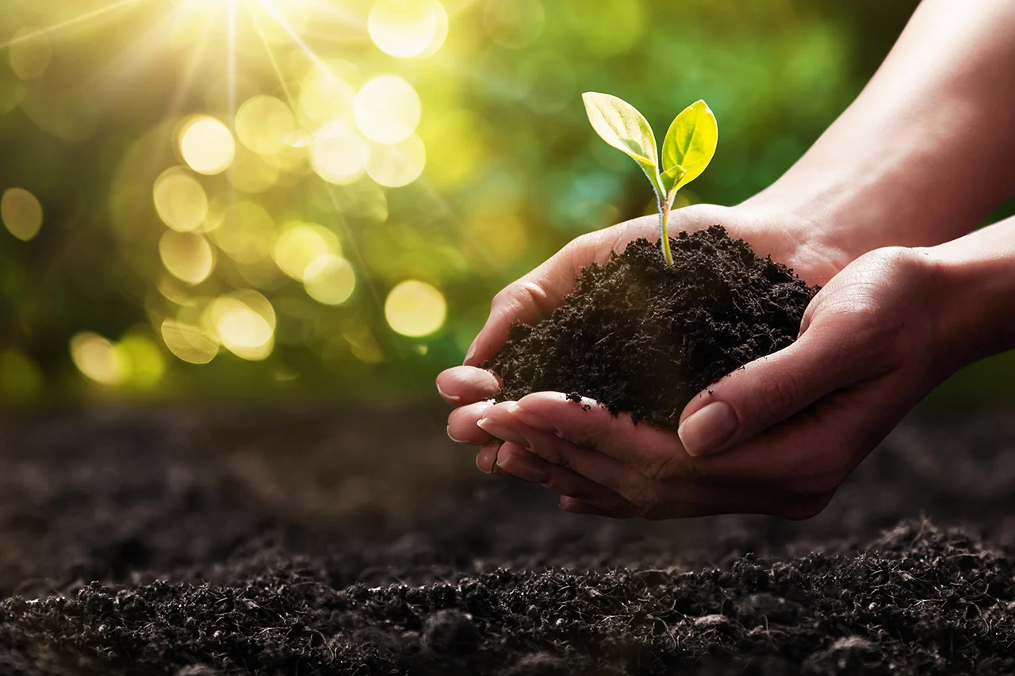
“The entire material universe speaks of God’s love, God’s boundless affection for us. Soil, water, mountains: everything is a caress of God… God has written a precious book, whose letters are the multitude of created things.
(Laudato Si’, 84)
Notes:
Optional quotes from Laudato Si’ for opening reflection

Slide 4
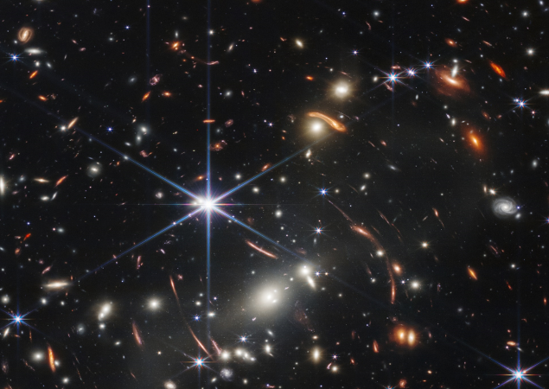
From panoramic vistas to the tiniest living form, nature is a constant source of wonder and awe. It is also a continuing revelation of the divine. Alongside revelation in sacred Scripture, there is a divine manifestation in the blaze of the sun and the fall of night” (Laudato Si’, 85).

Slide 5
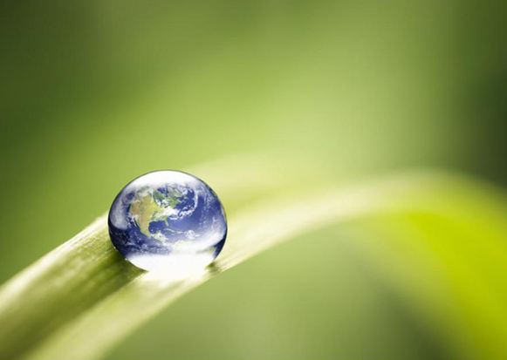
“The universe unfolds in God, who fills it completely. Hence, there is a mystical meaning to be found in a leaf, in a mountain trail, in a dewdrop, in a poor person’s face. Standing awestruck before a mountain, we cannot separate this experience from God” (LS, 233-4).
Notes:
Quotes for opening reflection

Slide 6
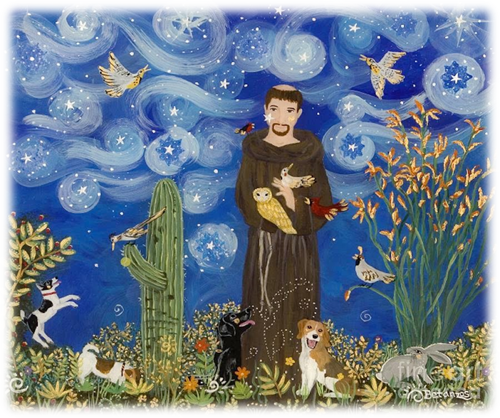
The Canticle of Creation (St. Francis of Assisi)
Praised be You my Lord with all Your creatures,
especially Sir Brother Sun,
Who is the day through whom You give us light.
And he is beautiful and radiant with great splendour,
Of You Most High, he bears the likeness.
Praised be You, my Lord, through Sister Moon and the stars,
In the heavens you have made them bright, precious and fair.
Praised be You, my Lord, through Brothers Wind and Air,
And fair and stormy, all weather’s moods,
by which You cherish all that You have made.
Notes:
Opening Prayer: The Canticle of Creatures (St. Francis of Assisi)

Slide 7
Praised be You my Lord through Sister Water,
So useful, humble, precious and pure.
Praised be You my Lord through Brother Fire,
through whom You light the night and he is beautiful and playful and robust and strong.
Praised be You my Lord through our Sister, Mother Earth
who sustains and governs us, producing varied fruits with coloured flowers and herbs.
Praise be You my Lord through those who grant pardon for love of You and bear sickness and trial.
Blessed are those who endure in peace,
By You Most High, they will be crowned.

Slide 8
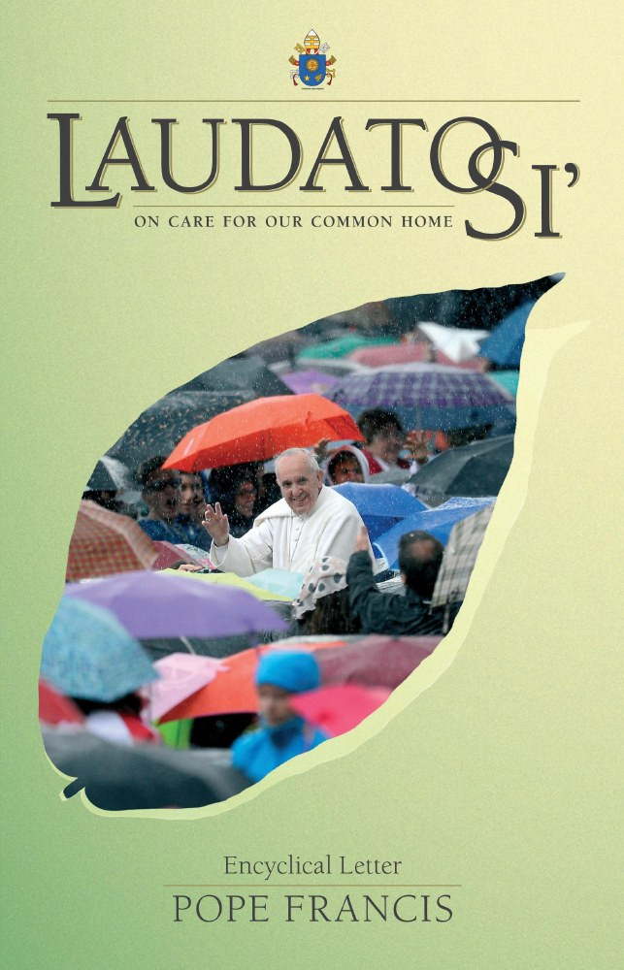
Overview of Laudato Si
Chapter 1: “What is happening to our common home?”
Chapter 2: “The Gospel of Creation”
Chapter 3: “The Human Roots of the Ecological Crisis”
Chapter 4: “Integral Ecology”
Chapter 5: “Lines of Approach & Action”
Chapter 6: “Ecological Education & Spirituality”
Notes:
Brief introduction to Laudato Si’ – On Care for Our Common Home.
In May 2015, Pope Francis released Laudato Si’ – On Care for our Common Home, the first Papal encyclical (letter) on the environment. It focuses on care for the natural environment and all people, as well as broader questions of the relationship between God, humans, and the Earth.
The title, ‘Laudato Si’’ means “May You be Praised” a phrase which comes from a prayer by St. Francis of Assisi, the Canticle of the Creatures which opens “Praise be to you my Lord with all your creatures”.
Drawing on world’s top climate scientists, theologians, anthropologists, philosophers, sociologists, Pope Francis takes us on a journey which encourages us to listen to the cry of the earth, the cry of the poor and to deeply reflect on what is happening to God’s creation and what faith communities can do about it.
A brief summary of chapters (optional)
Chapter One: What is happening to our common home?” outlines what is happening to our common home – reflecting on the facts of the environmental crisis from pollution to climate change, the issue of water, biodiversity loss and global inequality.
Chapter Two: The Gospel of Creation” draws on the Bible as a source of insight. The Genesis creation stories are interpreted as encouraging responsible cultivation and protection of nature. Pope Francis criticises past interpretations of Genesis which justified the absolute human domination of other species. He notes how these are “not a correct interpretation of the Bible” (LS 67). The natural world is further portrayed as a gift, a message, and a common inheritance of all people.
“Chapter Three: The Human Roots of the Ecological Crisis” explores social trends and ideologies that have caused environmental problems. These include the unreflective use of technology, an impulse to manipulate and control nature, a view of humans as separate from the environment and narrowly-focused economic theories.
“Chapter Four: Integral Ecology” presents the encyclical’s main solution to ongoing social and environmental problems. Integral ecology affirms that humans are part of a broader world and calls for “solutions which consider the interactions within natural systems themselves and with social systems” (LS 139). While the study of ecosystems has become well-known in the science of ecology, integral ecology expands this paradigm to consider the ethical and spiritual dimensions of how humans are meant to relate to each other and the natural world – drawing on culture, family, community, virtue, religion, and respect for the common good.
“Chapter Five: Lines of Approach and Action” applies the concept of integral ecology to political life. It calls for international agreements to protect the environment and assist low-income countries, new national and local policies, inclusive and transparent decision-making, and an economy ordered to the good of all.
Lastly, “Chapter Six: Ecological Education and Spirituality” concludes the encyclical with applications to personal life. It recommends a lifestyle focused less on consumerism and more on timeless, enduring values. It calls for environmental education, joy in one’s surroundings, civic love, reception of the sacraments, and an “ecological conversion” in which an encounter with Jesus leads to deeper communion with God, other people, and the world of nature.
If you need further background information on Laudato Si’ you can go to: https://laudatosimovement.org/news/whats-the-best-2-page-summary-youve-seen-of-laudato-si/

Slide 9
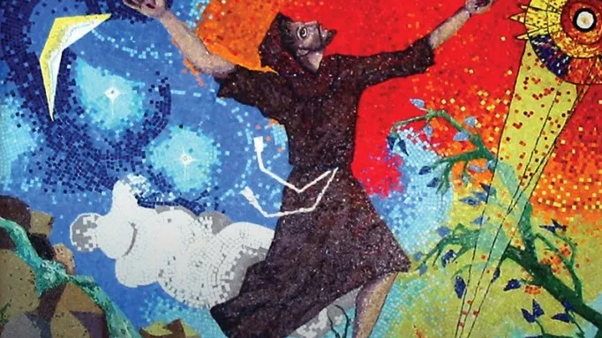

“Saint Francis of Assisi reminds us that our common home is like a sister with whom we share our life, and a beautiful mother who opens her arms to embrace us….
I wish to address every person living on this planet … I urgently appeal for a new dialogue about how we are shaping the future of our planet. We need a conversation which includes everyone, since the environmental challenge we are undergoing, and its human roots, concern and affect us all” (Laudato Si’, 1, 14)
Notes:
Background info:
When we talk about Laudato Si’, we are talking not only about the document itself but the wider charism of Laudato Si’ which is rooted in St. Francis (the patron saint of ecology) and his spirituality, seeing all of creation as family – Brother sun, Sister moon.
Laudato Si’ is now a global movement within the church – encouraging everyone to take action to protect our common home.
The document opens with strong words from Pope Francis which say: “I wish to address every person living on this planet … I urgently appeal for a new dialogue about how we are shaping the future of our planet. We need a conversation which includes everyone, since the environmental challenge we are undergoing, and its human roots, concern and affect us all” (Laudato Si’, 1, 14)
So we are being invited into this conversation, all of us, not just Catholics, but all believers and non-believers, all people of good will, to work together for our common home, for this is an issue which affects everybody.
Image from https://sosf.org/celebrating-the-feast-of-st-francis-2/

Slide 10
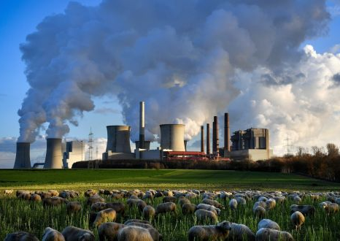
Laudato Si’ urges us to listen to the signs of the times in light of the Gospel. This means listening to:
The cry of the earth
The cry of those made poor
The science
The call of our faith
Young people
“This sister now cries out to us because of the harm we have inflicted on her.” (LS, 2)

Slide 11
What does Laudato Si’ say about biodiversity?
In Laudato Si’, Pope Francis reflects on the immense loss of biodiversity which is taking place around our world:
“The earth’s resources are also being plundered because of short-sighted approaches to economy, commerce, and production. The loss of forests and woodlands entails the loss of species which may constitute extremely important resources in the future, not only for food but also for curing disease and many other uses. Different species contain genes which could be key resources in years ahead for meeting human needs and regulating environmental problems” (Laudato Si’, 32).
Notes:
What does Laudato Si’ say about biodiversity?

Slide 12
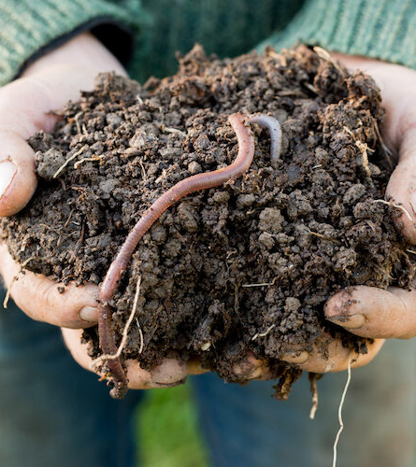
Pope Francis says, “it may well disturb us to learn of the extinction of mammals or birds, since they are more visible. But the good functioning of ecosystems also requires fungi, algae, worms, insects, reptiles and an innumerable variety of micro-organisms. Some species, although unseen, nevertheless play a critical role in maintaining the equilibrium of a particular place” (Laudato Si’, 34).

Slide 13
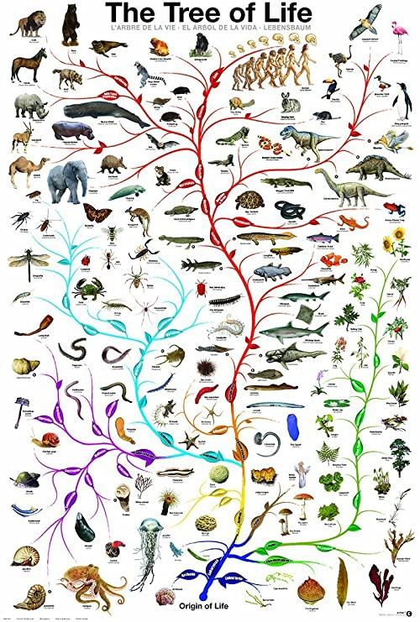
“It is not enough, however, to think of different species merely as potential “resources” to be exploited, while overlooking the fact that they have value in themselves. Each year sees the disappearance of thousands of plant and animal species which we will never know, which our children will never see, because they have been lost for ever. The great majority become extinct for reasons related to human activity. Because of us, thousands of species will no longer give glory to God by their very existence, nor convey their message to us. We have no such right.” (Laudato Si’ 32-33)
Notes:
Optional quotes from Laudato Si’ for opening reflection

Slide 14
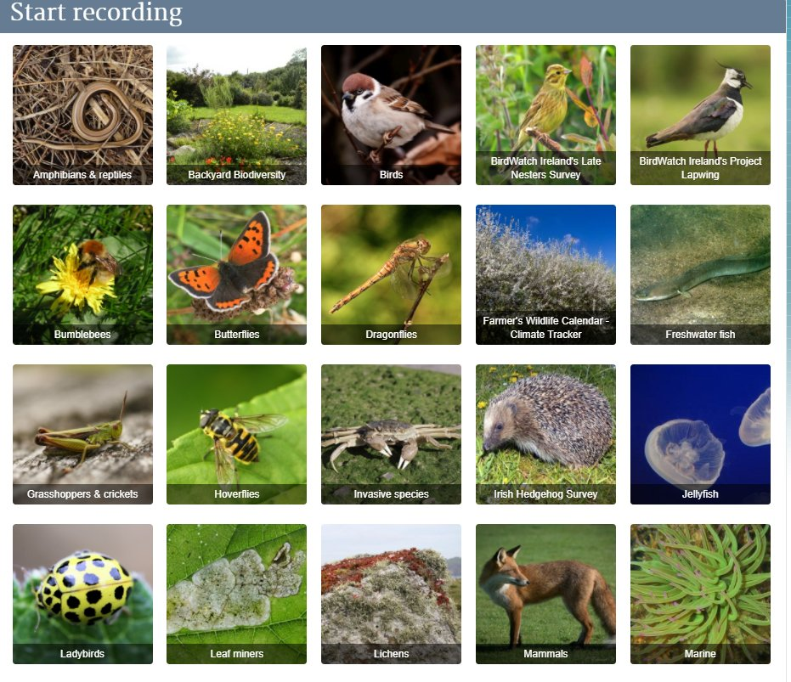
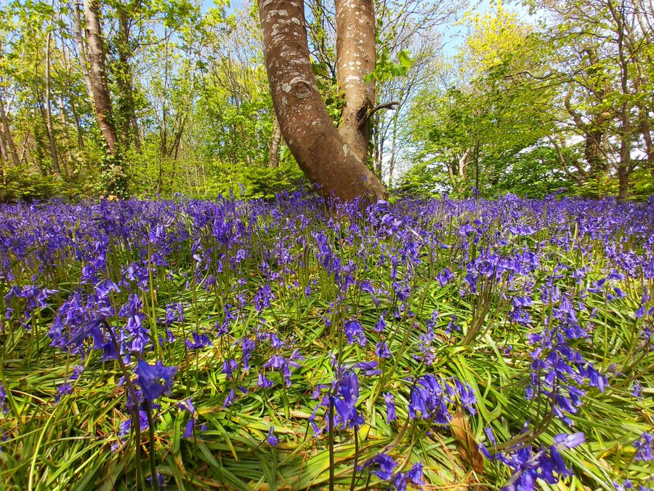
What is biodiversity?
Notes:
Ask the group to define biodiversity and give examples.
Image from National Biodiversity Data Centre.

Slide 15
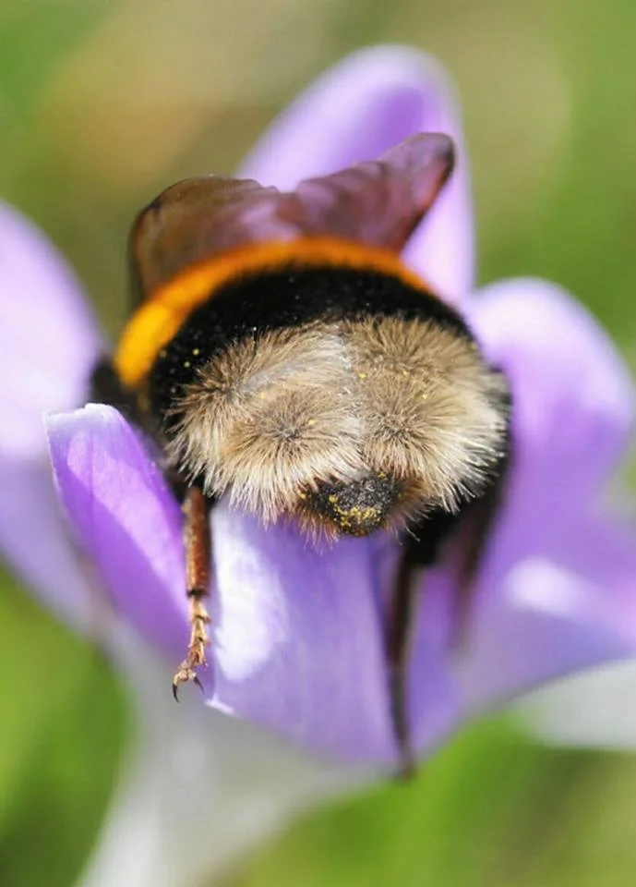
Biodiversity is all the different kinds of life you’ll find in one area—the variety of animals, plants, fungi, and even microorganisms like bacteria that make up our natural world. Each of these species and organisms work together in ecosystems, like an intricate web, to maintain balance and support life. Biodiversity supports everything in nature that we need to survive: food, clean water, medicine, and shelter. (World Wildlife Fund).
Notes:
Biodiversity is all the different kinds of life you’ll find in one area—the variety of animals, plants, fungi, and even microorganisms like bacteria that make up our natural world. Each of these species and organisms work together in ecosystems, like an intricate web, to maintain balance and support life. Biodiversity supports everything in nature that we need to survive: food, clean water, medicine, and shelter.
Further information here: https://www.worldwildlife.org/pages/what-is-biodiversity

Slide 16
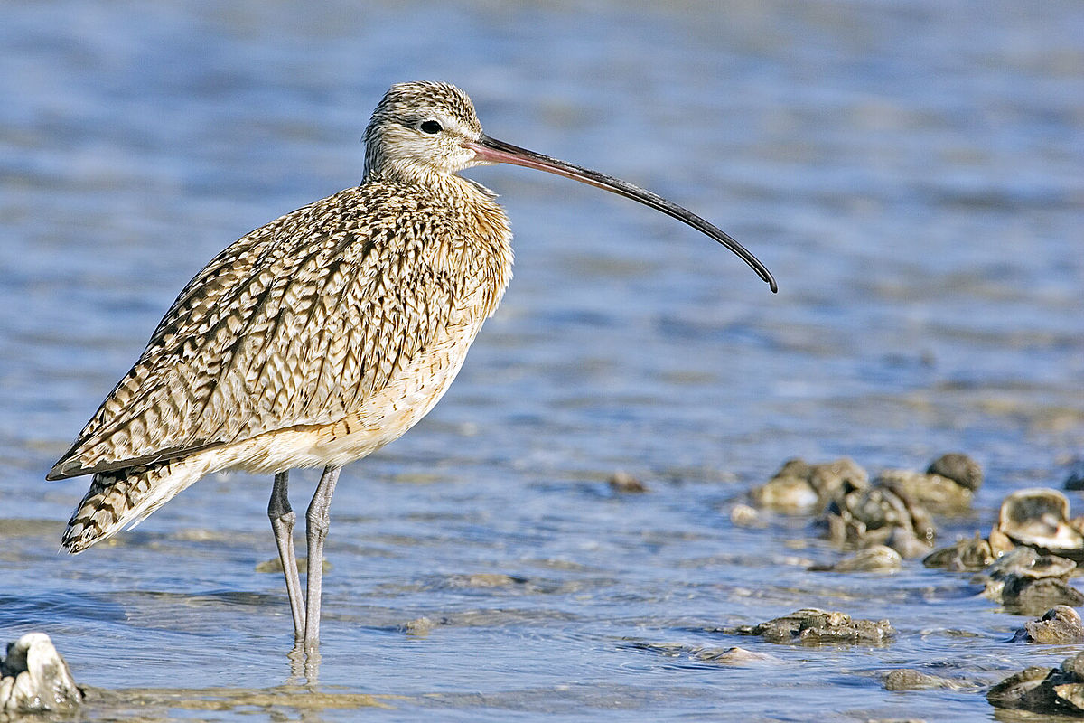
What is happening to biodiversity?
As humans put increasing pressure on the planet, using and consuming more resources than ever before, we risk upsetting the balance of ecosystems and losing biodiversity.
WWF’s Living Planet Report 2022 found an average 69% decline in global populations of mammals, fish, birds, reptiles, and amphibians since 1970 due to human activity.
The 2019 landmark Global Assessment Report (by the Intergovernmental Platform on Biodiversity and Ecosystem Services) reported 1 million animal and plant species are now threatened with extinction—the highest number in human history.
Notes:
What is happening to biodiversity?
As humans put increasing pressure on the planet, using and consuming more resources than ever before, we risk upsetting the balance of ecosystems and losing biodiversity.
WWF’s 2022 Living Planet Report found an average 69% decline in global populations of mammals, fish, birds, reptiles, and amphibians since 1970.
The 2019 landmark Global Assessment Report by the Intergovernmental Platform on Biodiversity and Ecosystem Services reported 1 million animal and plant species are now threatened with extinction—the highest number in human history.

Slide 17
To put it another way:
We are now living in the 6th largest extinction of life on this planet since life began 3.8 billion years ago.
41% of amphibians, 25% of mammals, 34% of conifers, 13% of birds, 27% of reptiles, 31% of sharks and rays and 27% of crustaceans are threatened with extinction.
The last time such a catastrophe struck planet Earth was 66 million years ago when an asteroid 10 to 15 kilometres wide crashed in the Yucatan Peninsula of Mexico causing the extinction of 75 percent of animal and plant life, including the dinosaurs.

Slide 18
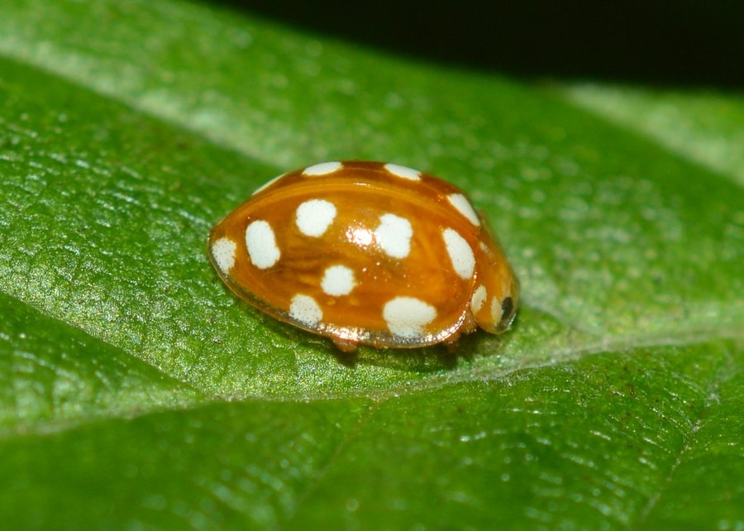
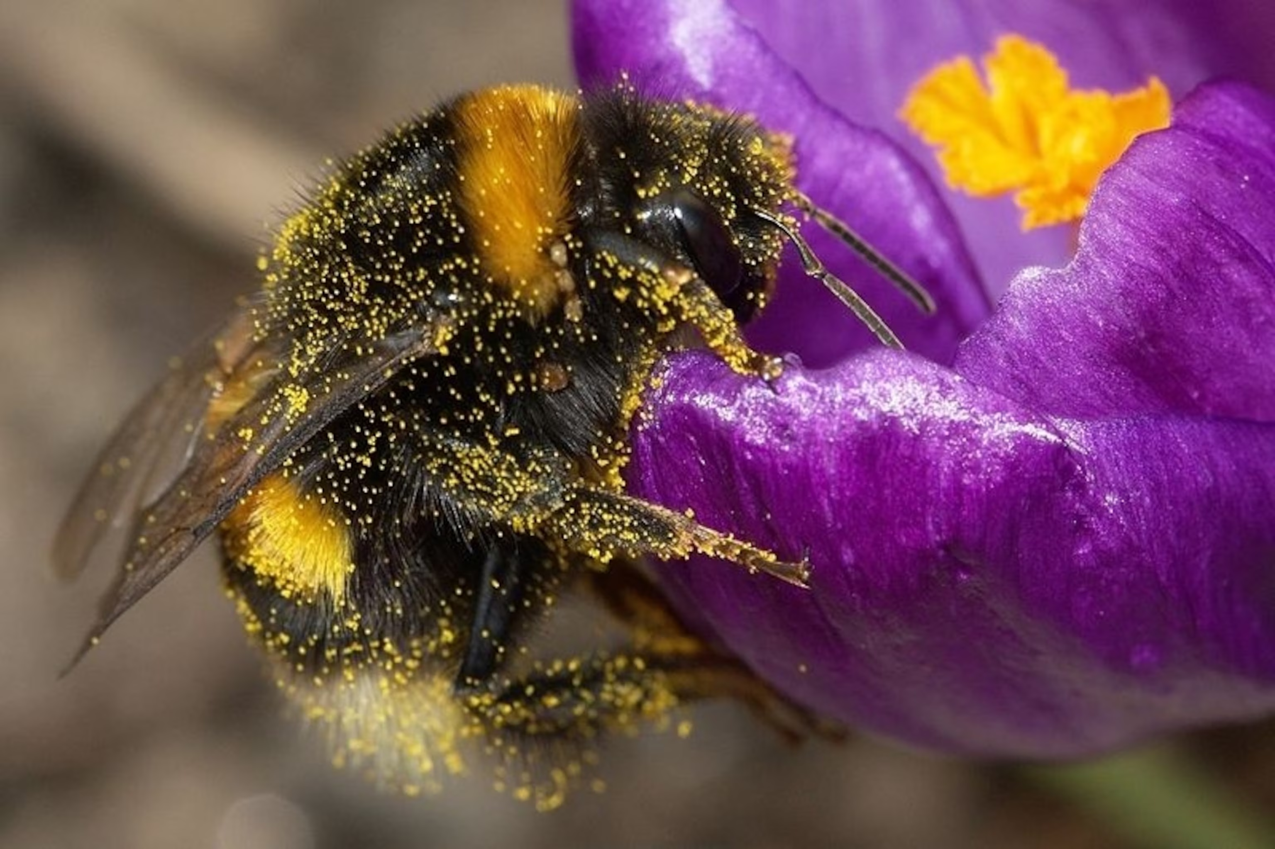
An example: The Destruction of Insects
Today, when we talk of extinction we think of giant pandas, cheetahs, lions, or elephants, but the destruction of insect species has become enormous.
A study by German scientists in 2017, found that flying insect species, including pollinators have reduced by 75% since 1989. About one third of the world’s food depends on pollinators such as bees.
If they become extinct, agricultural yields would plummet causing widespread famine.
Notes:
From Fr. Sean McDonagh’s article: “Why Christians must take COP15 on the protection of species seriously”.

Slide 19
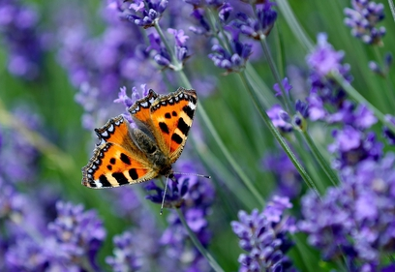
Each species has an “intrinsic value independent of their usefulness. Each organism, as a creature of God, is good and admirable in itself.” (Laudato Si’, 140)

Slide 20
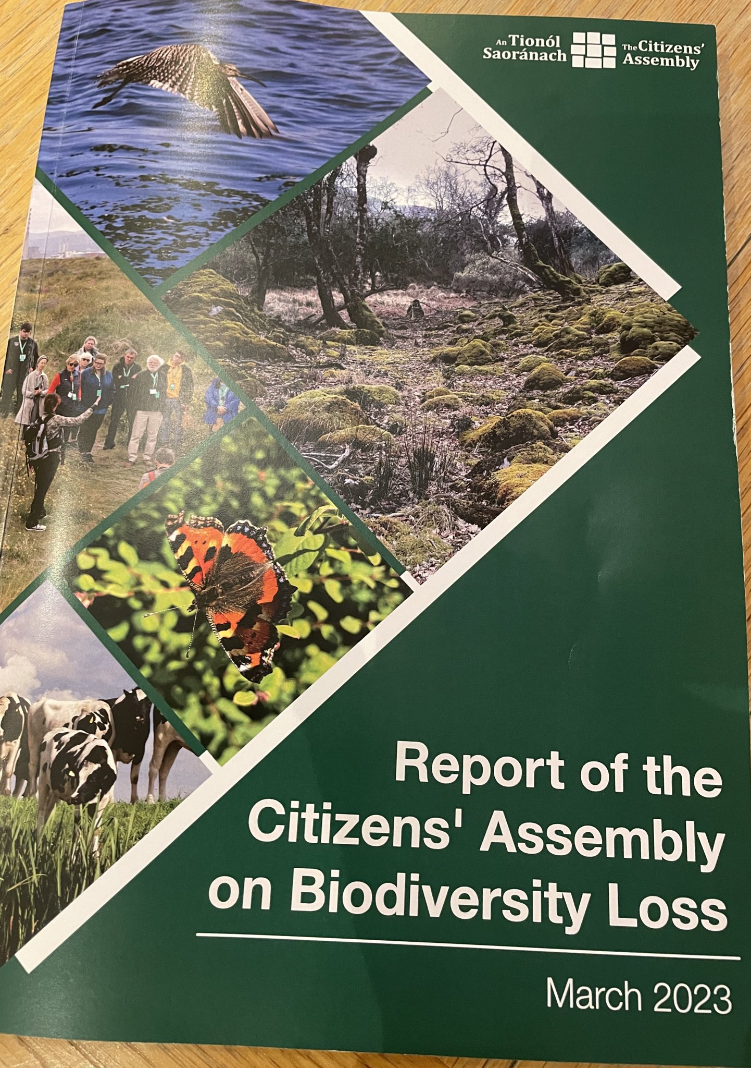
Irish Citizen’s Assembly on Biodiversity
In September 2022, in Ireland, the Citizens’ Assembly on Biodiversity met in Malahide, Dublin. Liam Lysaght from the National Biodiversity Centre told the Assembly that there are now 3,000 species on the International Union for Conservation of Nature’s Red List in Ireland. This includes plants, fish, insects, and birds. In the next number of years, Ireland will lose one third of its 99 species of bees if we do not take action to reverse this trend.
Birdwatch Ireland surveys have shown that 54 species of birds are facing extinction. Among these are quail, grey partridge, swift, corncrake, barn owl, golden eagle, kestrel, and curlew.

Slide 21
The recommendation of the Irish Citizens Assembly is that the rights of nature be enshrined in our constitution.
At the UN Biodiversity Conference (COP15), in December 2022, 200 hundred countries acknowledged that the rights of nature are an integral part of the implementation of its programmes.
The Rights of Nature grant fundamental legal entitlements to trees, rivers and ecosystems that are enjoyed today by human beings.
Notes:
From Fr. Sean McDonagh’s article: “Why Christians must take COP15 on the protection of species seriously”.
Ecuador was the first country to place the rights of nature in its constitution in 2008. Since then, other countries, including Bolivia, New Zealand, Bangladesh, Brazil, Colombia, Mexico, Uganda have taken similar steps In December 2022. Ireland’s Citizens’ Assembly on biodiversity loss recommended a referendum on changing the constitution to protect biodiversity.

Slide 22
At COP15, the UN Conference on Biodiversity 2022, the delegates adopted the Kunming-Montreal Agreement. It suggests that we set aside 30% of our land and 30% of our oceans for nature by 2030.
So, COP 15 urges us to protect significant areas of biodiversity on land and in the oceans to heal it.
As Christian stewards of the earth, we also have a responsibility to safeguard biodiversity for the good of all creatures and for future generations.
Notes:
From Fr. Sean McDonagh’s article.

Slide 23

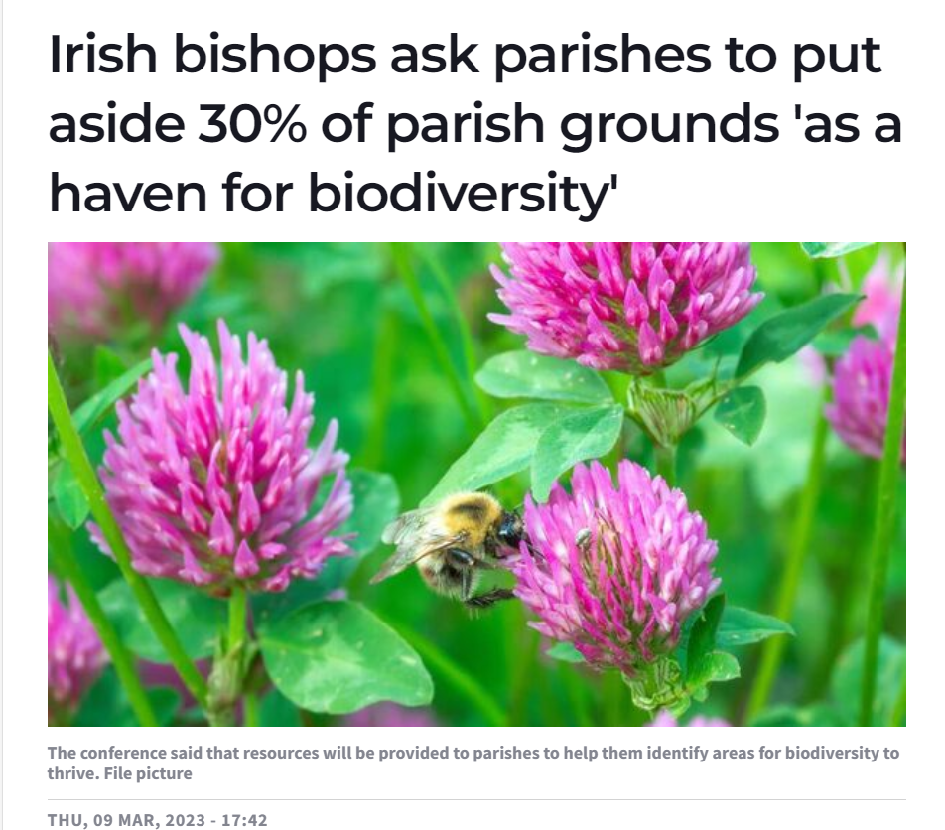
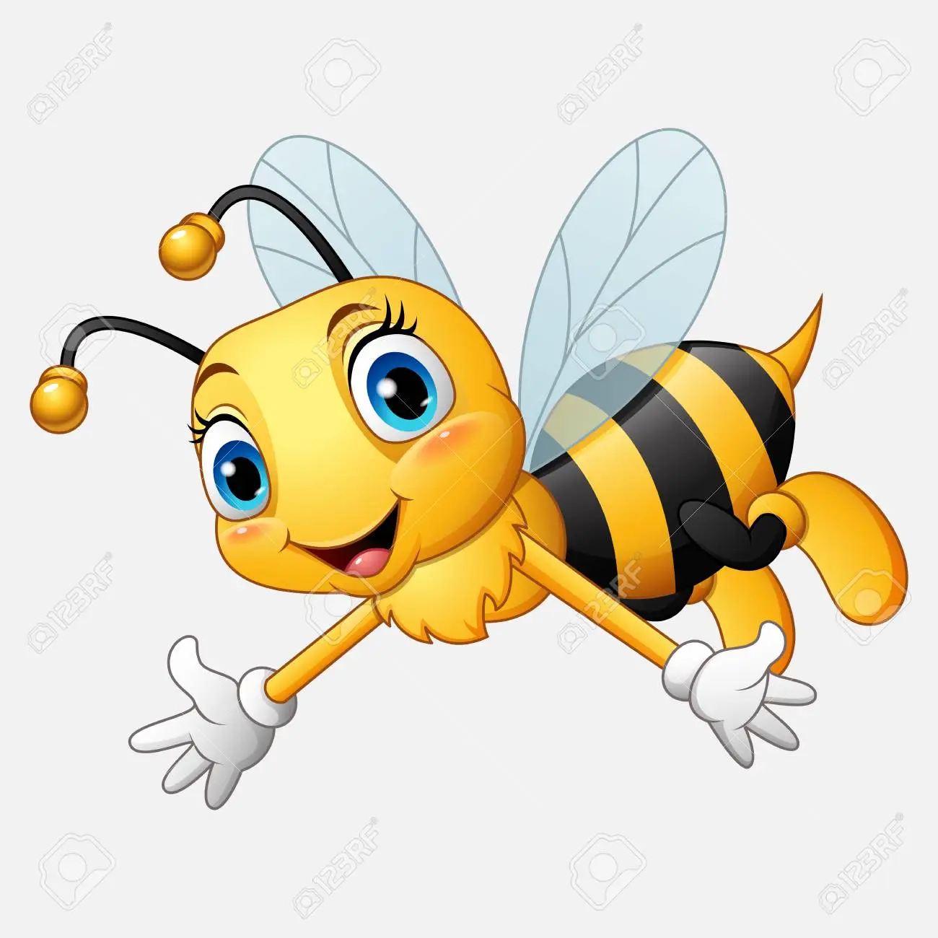
This is why, In March 2023, the Irish Bishops asked that parishes in Ireland return 30% of church grounds to nature by 2030.
They said, "In embracing this initiative, we encourage parishes to expand their circles of solidarity, to protect and care for biodiversity and recommend that, by 2030, 30% of church grounds be returned to nature.
In Laudato Si’, we read that this diversity of species has an intrinsic value independent of their usefulness. Each organism, as a creature of God, is good and admirable in itself’. (LS, 140). "Humanity is called to care for the Earth and all of its creatures, in other words to ‘live out our vocation to be protectors of God’s handiwork’."
Notes:
In March 2023, the Irish Bishops asked that parishes in Ireland return 30% of church grounds to nature by 2030. They said, "In embracing this initiative, we encourage parishes to expand their circles of solidarity, to protect and care for biodiversity and recommend that, by 2030, 30% of church grounds be returned to nature.
"The first goal of Laudato Si’ asks us to respond to the ‘Cry of the Earth’. In Laudato Si’, we read that this diversity of species has an intrinsic value independent of their usefulness. Each organism, as a creature of God, is good and admirable in itself’. (LS, 10). "Humanity is called to care for the Earth and all of its creatures, in other words to ‘live out our vocation to be protectors of God’s handiwork’."

Slide 24

Where to begin?
Watch this introduction to the All-Ireland Pollinator Plan from the National Biodiversity Data Centre: https://www.youtube.com/watch?v=HD7dTR25vFE&t=32s
What has stayed with you from this video?
Notes:
This is a seven-minute video from the National Biodiversity Centre: https://www.youtube.com/watch?v=HD7dTR25vFE&t=32s

Slide 25
Step 1: Host your Meeting
Step 2: Map your parish grounds for biodiversity
Identify what is already there (a great task for young people, engage schools and local experts).
Use the resource “Church Grounds Mapping” on Irish Bishop’s Website – Care for Our Common Home Webpage – Biodiversity – Step 2.
Check out this handy video from Heritage in Schools - https://www.heritageinschools.ie/online-tutorials/how-to-make-a-biodiversity-map-of-your-garden
Then, start identifying what you want to look after and how. What part of the grounds are you considering? What 30% do you want to focus on? Begin small.
Engage with local experts such as horticulturists, Tidy Towns group or other ecology groups and schools who have expertise.

Slide 26
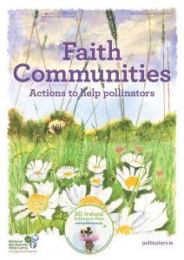
Step 3: Once you have mapped your parish grounds, we then invite you to turn to two resources to continue this journey.
They are:
  The Faith Community Pollinator Plan: This multi-denominational guide suggests 24 practical actions that any Faith Community can take. They are based on scientific research and are the measures that are most likely to benefit Irish pollinators.
  Download for free from: https://pollinators.ie/faith-communities/

Slide 27
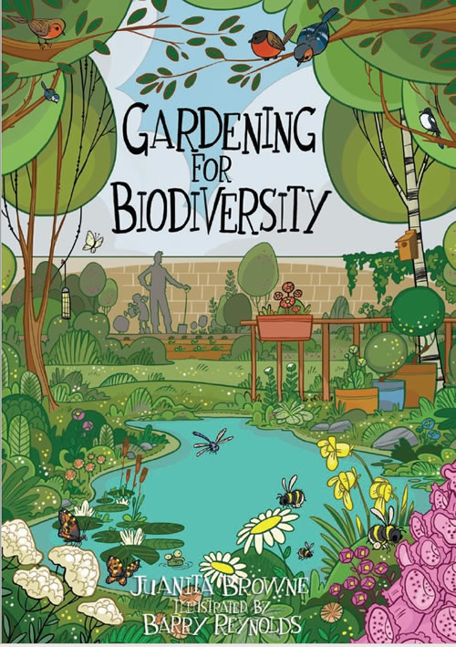
The second useful resource is called “Gardening for Biodiversity”: The aim of this colourful booklet is to introduce some of the ways you can help biodiversity in your own garden and on parish grounds - no matter how big or small the space - and no matter where you live.
Download for free from: https://www.fingal.ie/sites/default/files/2020-04/gardening-for-biodiversity-booklet.pdf

Slide 28
You can also look at Case Studies
The biodiversity section of the GAA Green Clubs toolkit includes video case studies: https://learning.gaa.ie/greenclub/biodiversity
As parish case studies become available, we will upload relevant videos to the Irish Bishop’s webpage.
Perhaps you might consider recording your journey in your parish and send it in as a case study.

Slide 29

Please Sign up your actions straight away on the “Actions for Pollinators mapping system”.
'Actions for Pollinators' is an online mapping system that allows communities to register the actions they have taken for pollinators and put their pollinator-friendly locations on the map. https://pollinators.biodiversityireland.ie/
The All-Ireland Pollinator Plan is managed by the National Biodiversity Data Centre and helps them to track where actions for pollinators are taking place.
In the drop-down list under 'site type' you can select 'faith communities' and see where these have been added and what actions have been taken as well as add your own.

Slide 30
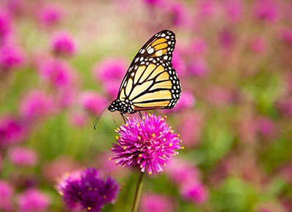
Flower-Insect-Timed counts
This is a simple survey which the National Biodiversity Centre are asking communities to do.
Watch a patch of flowers for 10 minutes and count the insects that visit. A useful way of tracking impact of biodiversity work before you begin your project and then on an annual basis to see your progress.
For more information and to watch a short video click here: https://biodiversityireland.ie/surveys/fit-counts/
Why not use this as a meditation for groups and include some Laudato Si’ quotes for reflection.
Notes:
For more information on this see: https://biodiversityireland.ie/surveys/fit-counts/

Slide 31

You can also track birds which are in your area. BirdTrack is a very useful tool which maps migration, arrivals and departures, timings and monitors scarce birds.
Maybe the parish choir could take this on and record the data on Bird Watch Ireland’s website: https://birdwatchireland.ie/our-work/surveys-research/research-surveys/birdtrack/

Slide 32
Before you finish your meeting:
What has stayed with you from what you have heard during this session?
What are the next steps for your parish?
When can you organise your site mapping? Who will you invite to do this?
When is your next meeting?

Slide 33
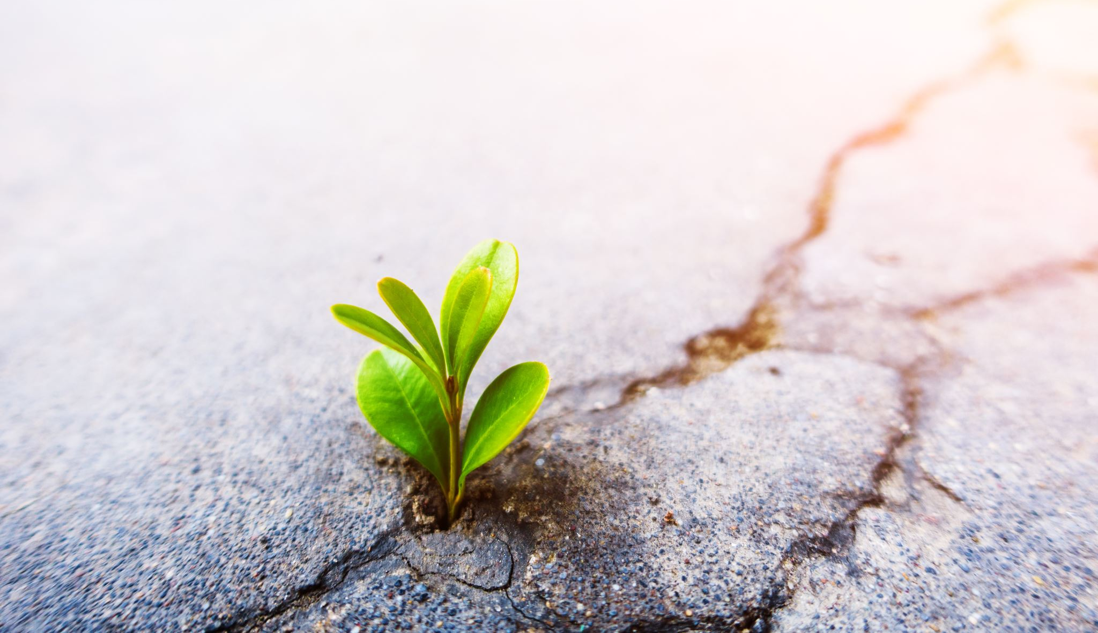
“Hope would have us recognise that there is always a way out, that we can always redirect our steps, that we can always do something to solve our problems. . . The present world system is certainly unsustainable.” (LS, 61)

Slide 34


Laudato Si’ calls us towards sustainability in the spirit of integral ecology.
www.laudatosiactionplatform.org
In taking on this project in your parish you are also responding to the Laudato Si’ Goals as set out by the Laudato Si’ Action Platform.
This is a response to the call for healing in our relationships with God, our neighbours, and the Earth itself as we build a better future. Through the Laudato Si’ Action Platform, we are walking the “path to renewal” together” (LS, 202).
Notes:
Link to how this respond to the Laudato Si’ Action Platform Goals.

Slide 35

www.laudatosiactionplatform.org
Notes:
Specifically this responds to Laudato Si’ Goal 1: Respond to the Cry of the Earth

Slide 36
A Prayer for our Earth
All-powerful God, you are present in the whole universe
and in the smallest of your creatures.
You embrace with your tenderness all that exists.
Pour out upon us the power of your love,
that we may protect life and beauty.
Fill us with peace, that we may live
as brothers and sisters, harming no one.
O God of the poor, help us to rescue
the abandoned and forgotten of this earth, so precious in your eyes.
Bring healing to our lives,
that we may protect the world and not prey on it,
that we may sow beauty, not pollution and destruction.
Notes:
Closing prayer, A Prayer for our Earth, from Laudato Si’ par. 246

Slide 37
Touch the hearts of those who look only for gain
at the expense of the poor and the earth.
Teach us to discover the worth of each thing,
to be filled with awe and contemplation,
to recognize that we are profoundly united
with every creature,
as we journey towards your infinite light.
We thank you for being with us each day.
Encourage us, we pray, in our struggle
for justice, love and peace.
Amen.
Pope Francis, Laudato Si, 246.

Slide 38
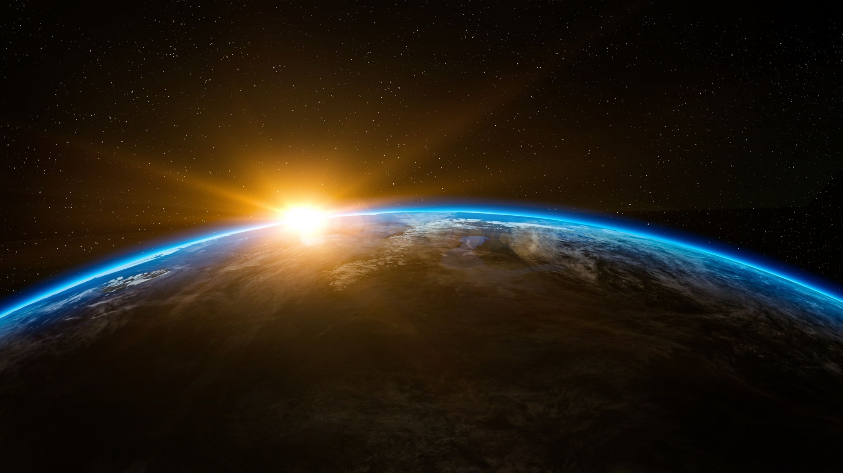
Closing Reflection (music):
“Look at the World” by John Rutter
Video available at: https://www.youtube.com/watch?v=kxr8QBPq1z0
Notes:
Closing Reflection (music):
“Look at the World” by John Rutter Video available at: https://www.youtube.com/watch?v=kxr8QBPq1z0

